Slide 1
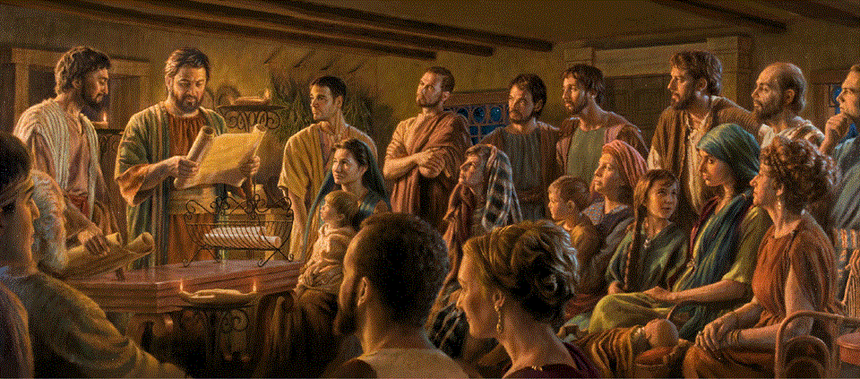
Epistle to the Romans, 12:1-8
A Short Course for Men

Slide 2
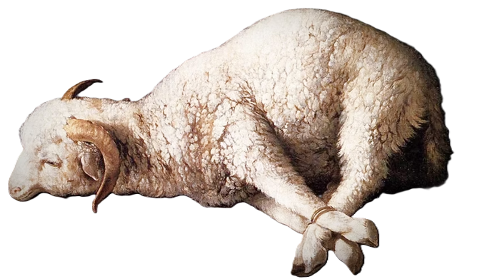
Romans 12:1-8 (NRSVue)
¹ I appeal to you therefore, brothers and sisters, on the basis of God’s mercy, to present your bodies as a living sacrifice, holy and acceptable to God, …
“God has imprisoned all in disobedience so that he may be merciful to all” (Rom. 11:32).
● Mercy:
● Body:
● Sacrifice:
● Accept:
Everything in chapters 1-11.
Physical, mental, emotional.
As Jesus did. God wants us.
Gk-Rom, trying to please.

Slide 3

¹ I appeal to you therefore, brothers and sisters, on the basis of God’s mercy, to present your bodies as a living sacrifice, holy and acceptable to God, …
“Those who kill you will think that by doing so they are offering worship to God” (John 16:2).
which is your reasonable act of worship.
● Which:
● Your:
● Reasonable:
● Worship:
Offer ourselves still alive.
Religions offer others.
Thoughtful ➔ discern (2).
Service, worship to God.

Slide 4
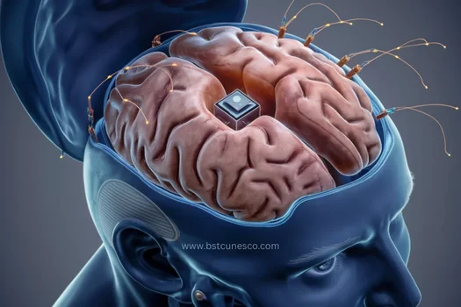
² Do not be conformed to this age, but be transformed by the renewing of the mind,
so that you may discern what is the will of God—what is good and acceptable and perfect.
● Conform:
● Transform:
● Renewal:
● Will:
Neg. pres. imp. = Stop!
Pos. pres. imp. = Keep on!
ana·kainō·sis = process.
Discernable desires.

Slide 5
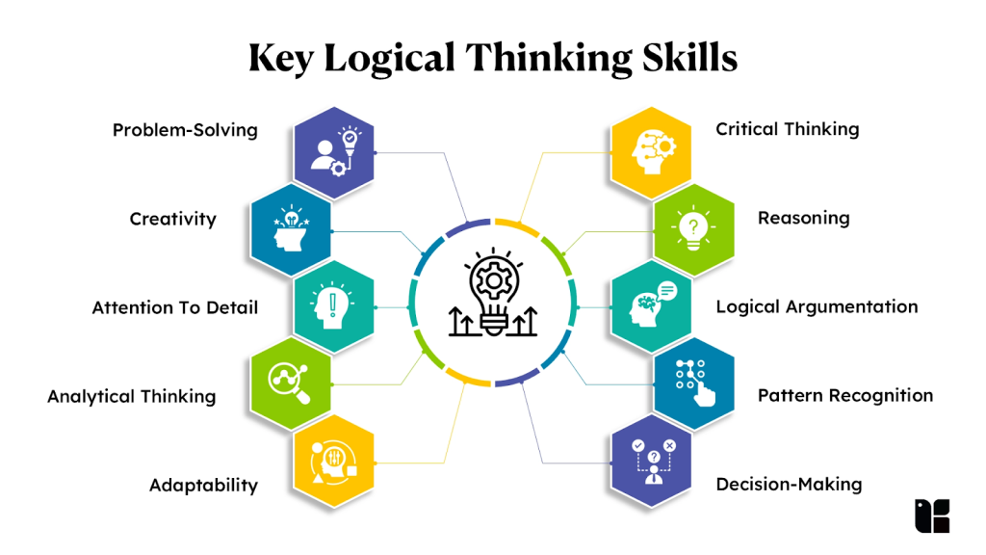
Reasonable (logikos)
● Logical: deduced from “therefore”.
● Thoughtful: able to “discern” (2).
● Metaphorical: like a “sacrifice”.
● Spiritual: “dedicated” to serve God.
● Purposeful: Seeking to please God.
● Human: Not a sacrificial ‘beast’.

Slide 6
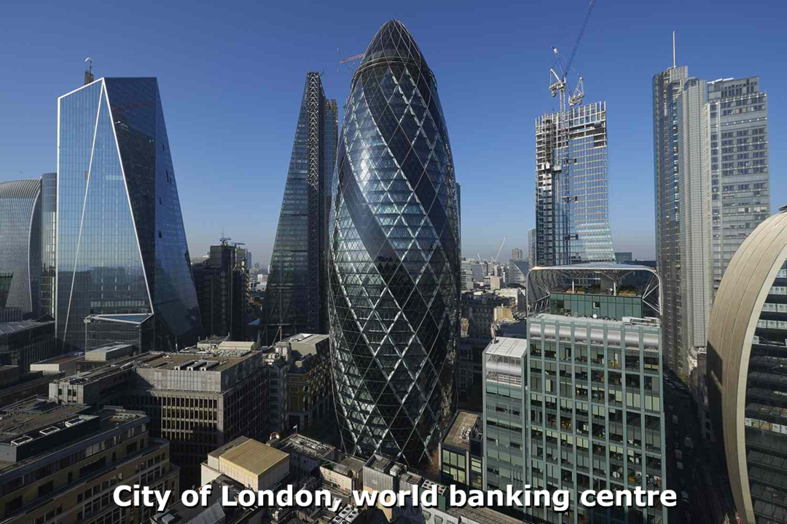
This age (excesses)
● Amorality, immorality, asceticism.
● Political parties, revolts, warfare.
● Finances, possessions, investments.
● Philosophies (stoicism, Marxism, …)
● Origins (evolutionism, age theories).
● Religion, ideology, economic theories.
● Entertainment, sports, hobbies.
● Processed foods, social media, …

Slide 7
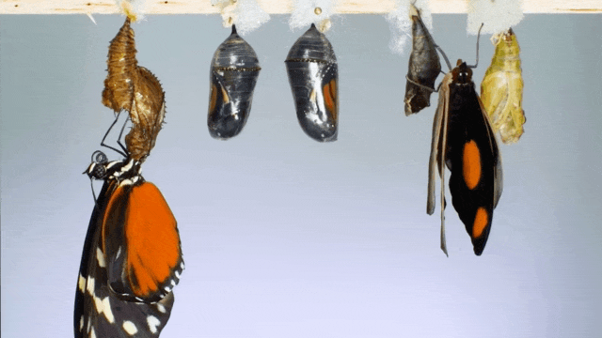
Renewal
● Conformed ⬅ messages from outside.
● Transformed ⬅ messages from inside.
● Renewal = mental, behavioral change.
● Scripture: Jesus’ example & promises.
● Prophecy: Pastoral counsel, messages.
● Fellowship: Sharing in small groups.
● Holy Spirit: Revealed insight, wisdom.
● Experience: Consequences of choices.

Slide 8
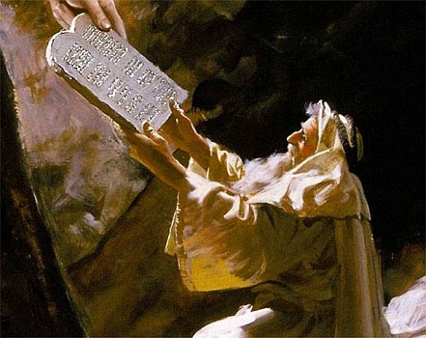
God’s will (desires)
● Secret versus revealed.
● Mosaic: laws, statutes, judgements.
● Moral: behavioral standards.
● Civil: enforcement and punishment.
● Religious: offerings, rituals & purity.
● Universal: that all hear and repent.
● Guidance: mate, career, opportunities.
● Ecclesial: apostolic instructions (NT).

Slide 9

Discern God’s will
● Offer yourself as a living sacrifice.
● Ask God for clarity and willingness.
● Expect an invitation or opportunity.
● Consult with wise counselors.
● Ask God for ‘unusual’ confirmation.
● Ask God for finances or other help.
● Attempt to take action.
● Walk through open doors.

Slide 10

³ For by the grace given to me I say to everyone among you not to think of yourself more highly than you ought to think …
● Grace:
● Think:
● Highly:
● Ought:
To be an apostle of the Messiah.
Thoughts, opinions, attitudes.
Deserving fame and fortune.
God’s purposes for each one.

Slide 11

but to think with sober judgment, each according to the measure of faith that God has assigned.
● Sober:
● Each:
● Measure:
● Faith:
● God:
Mature, stable, thoughtful.
Try, fail, succeed, serve.
metron, assignment.
Faithful service requirement.
The Holy Spirit.

Slide 12
In other words …
Think carefully about this, as mature Christians. God has assigned a special gift to each one among you. And he expects you to be faithful to him in how you serve other people.
● Assigned:
● Gift:
● Faithful:
Measure (metron).
Grace (chrisma).
Faithfulness (pistis).

Slide 13
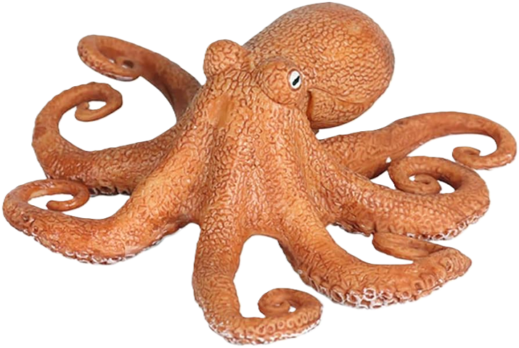
⁴ For as in one body we have many members and not all the members have the same function,
⁵ so we, who are many, are one body in Christ, and individually we are members one of another.
● Function:
● One:
● Member:
● Other:
Something needed to do.
Shared life, reproductive.
We are each one necessary.
Others need our service.

Slide 14

Find our place
● Tell the Lord that we are willing to fit in.
● Expect opportunities to open up.
● Agree to serve for a limited time.
● Observe how others respond, benefit.
● Note which service gives you joy.
● Listen to others’ confirmations, advice.
● Which Bible characters appeal to you?
● Ask church leaders to put you to work.

Slide 15

⁶ We have gifts that differ according to the grace given to us:
● Have:
● Gifts:
● Differ:
● Grace:
● Given:
‘Having’ = everyone, each (3).
chrisma, supernatural ability.
Not all must have the same!
Undeserved favor.
Neither earned nor ‘worked up’.
Every baptized, faithful Christian has a charisma gift by which to serve others.

Slide 16
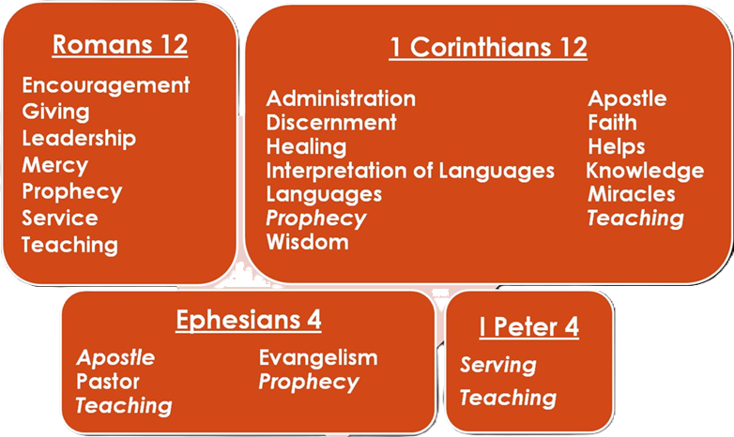
prophecy, in proportion to faith;
⁷ ministry, in ministering;
the teacher, in teaching;
⁸ the encourager, in encouragement;
the giver, in sincerity;
the leader, in diligence;
the compassionate, in cheerfulness.
“Whoever speaks, as one who speaks oracles of God; whoever serves, as one who serves by the strength that God supplies” (1 Cor. 14:3).
“The one who prophesies speaks to people for their upbuilding and encouragement and consolation” (1 Cor. 14:3).
● Prophecy:
● Ministry:
Speaking truth.
Practical help.

Slide 17
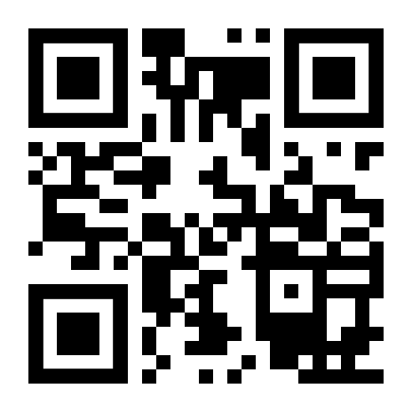
http://romans.forum

