Slide 1
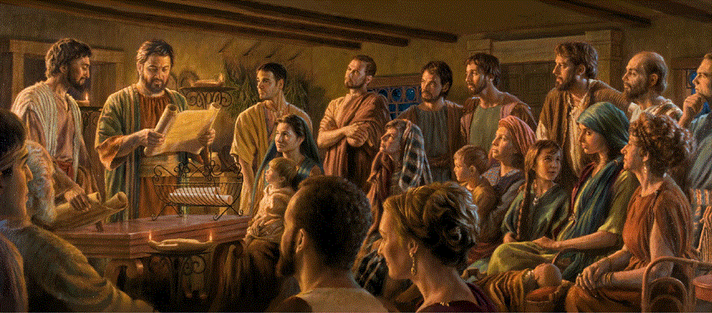
Epistle to the Romans, 12:9-21
A Short Course for Men

Slide 2

Marks of True Christians
Jesus said: “I give you a new commandment, that you love one another. Just as I have loved you, you also should love one another.
By this everyone will know that you are my disciples, if you have love for one another.” Jn 13:34-35

Slide 3
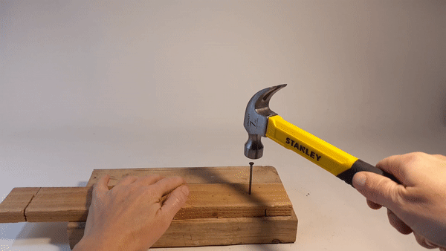
Grammar note
In Romans 12:9-21 active verbs, both imperatives and participles, occur in the Greek present tense, which normally implies continual or oft-repeated action.

Slide 4
Romans 12:9-21 (NRSVue)
⁹ Let love be genuine. …
“The wisdom from above is … without a trace of partiality or hypocrisy” (James 3.17).
~ Love (is) genuine.
● Love:
● Genuine:
A·ga·pé, regard, interest, esteem (seldom emotional).
An·hypo·kritos, not behind a mask.
Verbs in 9b-13 are participles describing genuine love.

Slide 5
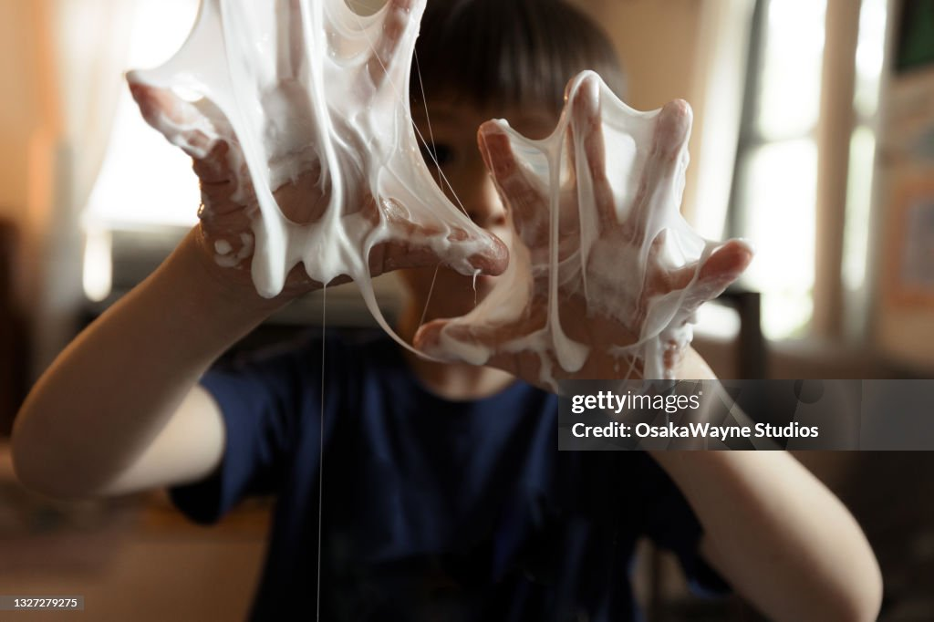
… hate what is evil;
hold fast to what is good;
● Hate:
● Evil:
● Hold:
● Good:
Loath, abhor
Ho ponéros, ‘the pernicious”.
Kolláô, stick like glue.
Ho agathos, suitable for purpose, beneficial.
“Deliver us from the evil one.” (Matt. 6.13).

Slide 6

¹⁰ love one another with mutual affection;
● Love…:
● Affection:
Philadelphia.
Philostorgos, devoted. (Only here in the Bible.)
outdo one another in showing honor.

Slide 7

¹¹ Do not lag in zeal;
● Zeal: spudé, speed.
be ardent in spirit;
● Ardent: enthusiastic, excited.
serve the Lord.
● Serve: as a slave.

Slide 8
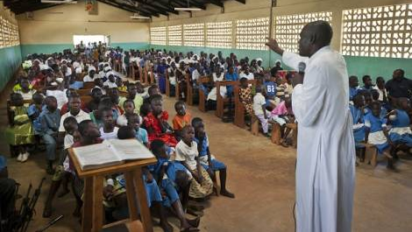
¹² Rejoice in hope;
● Hope: Expecting.
be patient in affliction;
● Patient: hypo·menō, remain under.
persevere in prayer.
● Persevere: Persist.
➔ Why does God require us to keep on praying when we want quick results?

Slide 9
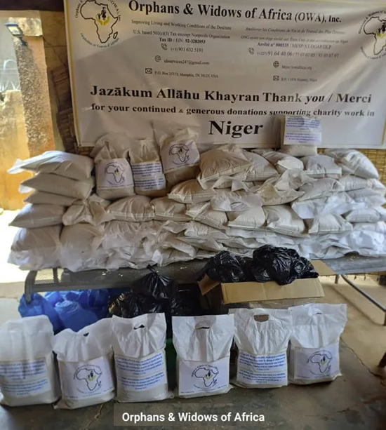
¹³ Contribute to the needs of the saints;
● Contribute: koinōnèō, share or hold in common.
Historically, churches collected funds to support their poor members: widows, slaves, & disabled.
pursue hospitality to strangers.
● Strangers: Traveling evangelists.
Verbs in 14b-19 are participles describing how to bless others.

Slide 10
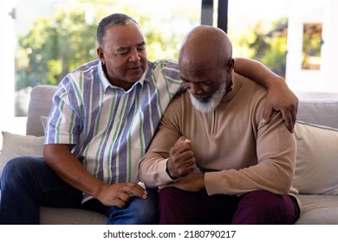
¹⁴ Bless those who persecute you; bless and do not curse them.
● Bless: Eulogèō (eulogize), say something kind in return.
¹⁵ Rejoice with those who rejoice; weep with those who weep.
● With: Meta, “the company within which something takes place” BDAG

Slide 11

¹⁶ Live in harmony with one another;
● Live: Lit., ‘thinking (about) the same things’ (at least part of the time).
Do not be arrogant, but associate with the lowly;
● Lowly: 1. “being of low social status,” 2. “being servile in manner,” 3. “being unpretentious.” BDAG

Slide 12
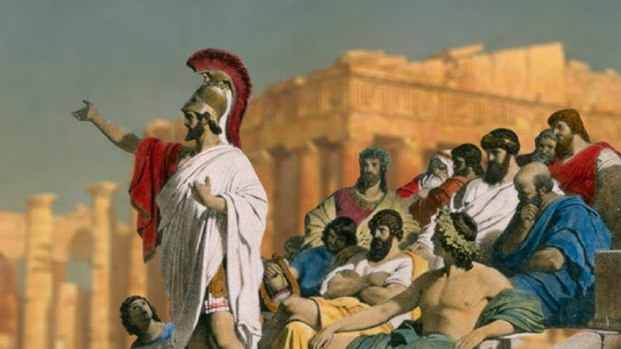
do not claim to be wiser than you are.
● Do not: Stop it!
¹⁷ Do not repay anyone evil for evil,
● …: “harmful or injurious” BDAG
but take thought for what is noble in the sight of all.
● Thought: “Provide for, consider.”
● All: Romans, Jews and Christians.

Slide 13
“You shall not take vengeance or bear a grudge against any of your people, but you shall love your neighbor as yourself: I am the LORD” (Lev. 19.18).
¹⁸ If it is possible, so far as it depends on you, live peaceably with all.
● All: Individuals and communities.
¹⁹ Beloved, never avenge yourselves, but leave room for the wrath of God, for it is written, “Vengeance is mine; I will repay, says the Lord.” Lev. 19:18
● Wrath: Only God can avenge fairly.

Slide 14
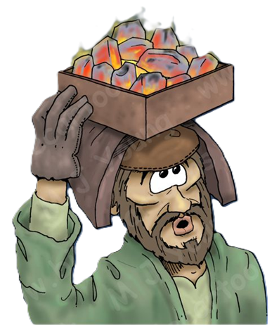
²⁰ Instead, “if your enemies are hungry, feed them; if they are thirsty, give them something to drink,
for by doing this you will heap burning coals on their heads.” Pro. 25.21-22a
● Coals: Metaphore of keeping someone alive by providing warmth and fuel for cooking food. One carried coals in a clay pot on their head (safest place).
“You you will heap burning coals on his head, and the LORD will reward you” (Pro. 25.22).

Slide 15

²¹ Do not be overcome by evil,
but overcome evil with good.
● Overcome :
● Evil: ● Good:
Conquer, vanquish, defeat.
Crime, harm, moral wrong.
Moral quality.
This is the basic Christian response to most offenses. Quietly forgive and seek a way to show undeserved grace.
Then God will always intervene.

Slide 16
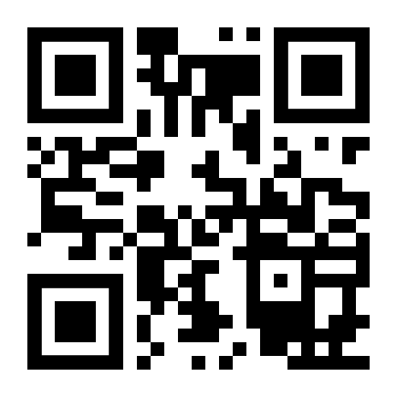
http://romans.forum

