Slide 1
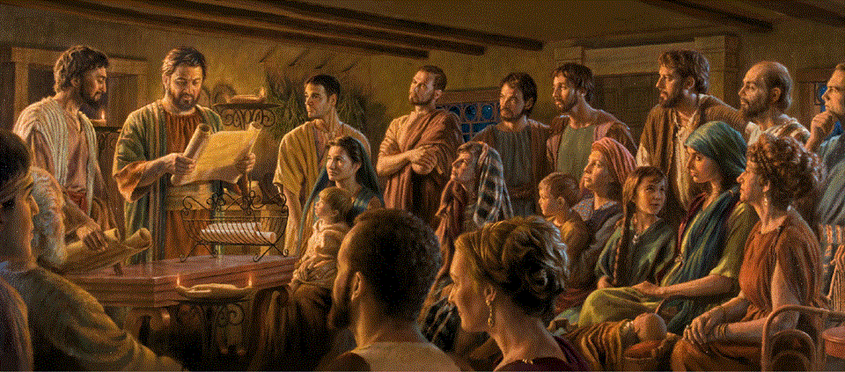
Romans 13:1-14
A Short Course for Men

Slide 2
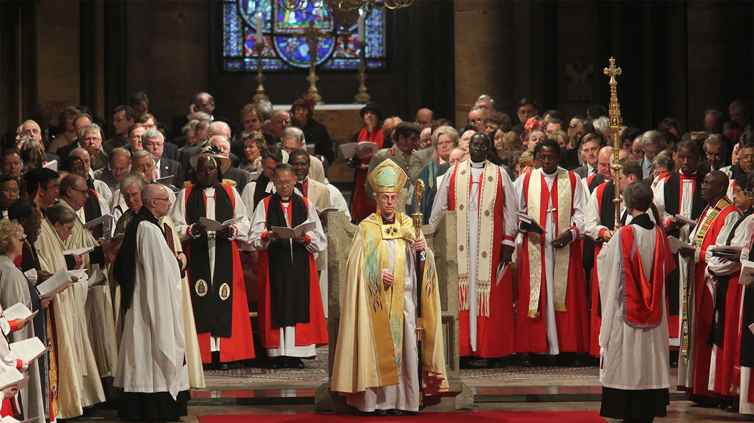
Historical state–church relations
● Catholic: Church over state
State suppresses heresies.
● Protestant: State and church
State enforces Christian morality.
● Anabaptist: Separate church & state
Freedom of conscience & association.
● Communist: State over church
State dictates doctrines and practice.

Slide 3
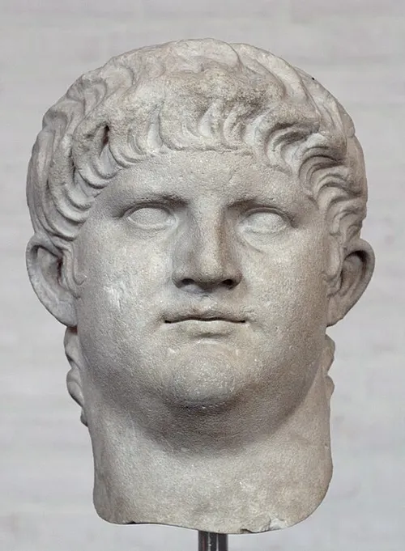
Rome in AD 57
● Emperor: Nero Claudius Caesar,
15 December AD 37 – 9 June AD 68.
● Governance: Well-administered, diplomacy, trade, and culture.
● Non-Romans: Many were ‘slaves’, but protected, and admitted to civic events.
● Persecution: Non-Roman, resident Christians, following the fire of AD 64.

Slide 4

Romans 13:1-7 (NRSVue)
¹ Let every person be subject to the governing authorities,
for there is no authority except from God, and those authorities that exist have been instituted by God.
● Subject:
● Authority:
● Institute:
Keep putting oneself under.
exousia, lawful right to rule.
Perf tense: once for all.

Slide 5
Human Government
God / religion
Constitution / clergy
Legislature / laws /decrees
Courts / judges / ayatollahs
Executive / PM / president / caliph
Military / police / militias
Regulators / deep state /
Inspectors / prosecutors

Slide 6
Inhuman government
Devil / ‘god of this world’
Gods / cosmocrats (Eph. 6:12).
Demons / ‘rulers & authorities’
Globalists / secret societies
Banks / fiat currency / national debt
Cartels / militarized criminals
Mafia / organized criminals
Gangs / local criminals

Slide 7
Ecclesial governance
Father, Son & Spirit
Angels / messengers & protectors
Scripture / laws, statutes, judgments
Conscience / freedom of belief
Elders / respected spiritual guides
Husbands / love, provide, protect
Wives / manage house & business
Parents / train and correct children

Slide 8
Social control
Family / parents / siblings
Friends / peers / taverns
Neighbors / ‘the Joneses’ / HOAs
Associations / churches / clubs
Banks / lenders / financiers
Advertisers / media influencers
Employers / bosses / work mates
Cartels / gangs / criminals

Slide 9
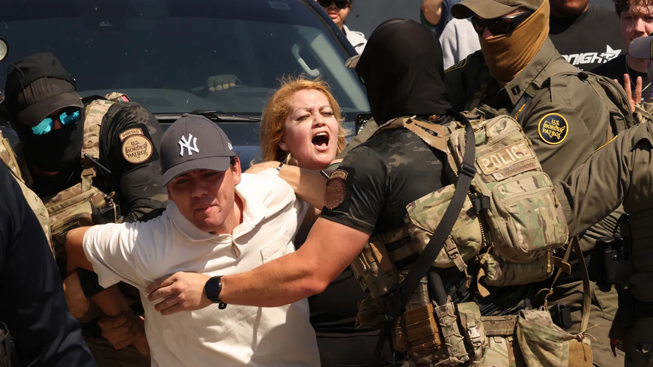
² Therefore whoever resists authority resists what God has appointed, and those who resist will incur judgment.
● Subject:
● Appoint:
● Resist¹:
● Resist²:
● Judgement:
Hypo·tassō, put self under.
Dia·tagé, put through.
Anti·tassō, put self against.
Ant·histémi, stand self against.
Condemnation, sentence.

Slide 10

³ For rulers are not a terror to good conduct but to bad. Do you wish to have no fear of the authority?
Then do what is good, and you will receive its approval,
⁴ for it is God’s agent for your good.
● Rulers:
● Fear:
● Approval:
● Agent:
Archōn. Officials.
Fobos. As you fear fire, God.
Tacit, seldom spoken.
Diakonos, deacon, servant.

Slide 11
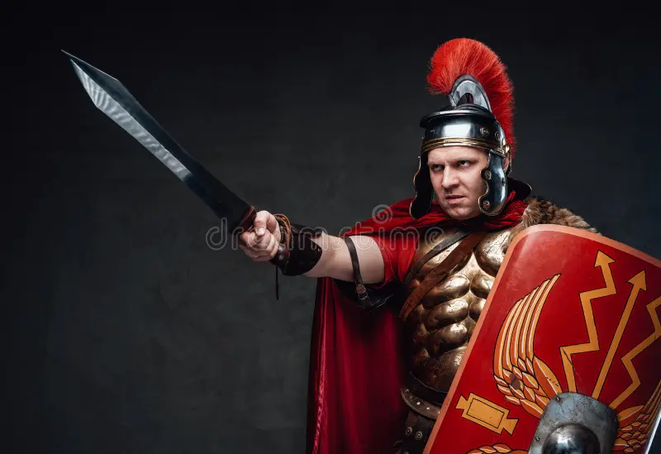
But if you do what is wrong, you should be afraid, for the authority does not bear the sword in vain!
It is the agent of God to execute wrath on the wrongdoer.
“Their own conscience also bears witness, and their conflicting thoughts will accuse or perhaps excuse them” (Rom. 2:15).
“The humans have become like one of us, knowing good and evil” (Gen. 3:22).
⁵ Therefore one must be subject, not only because of wrath but also because of conscience.
● Wrath:
● Conscience:
Both God’s and Gov’s.
“Knowing good & evil.”

Slide 12
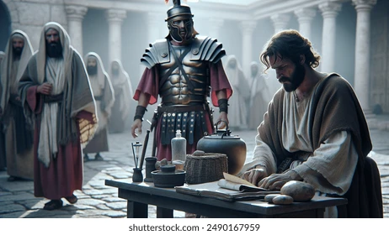
⁶ For the same reason you also pay taxes, for the authorities are God’s agents, busy with this very thing.
⁷ Pay to all what is due them: taxes to whom taxes are due, revenue to whom revenue is due, respect to whom respect is due, honor to whom honor is due.
“… the grace given me by God to be a minister of Christ Jesus to the gentiles in the priestly service of the gospel” (Rom. 15.15).
● Agent:
Leitourgos, religious worker.

Slide 13
Random thoughts
● Submission does not mean approval.
● Submission implies faith in God.
● Every authority replies to another.
● They protect us if we remain peaceful.
● Religious authorities are the most evil.
● Secular authorities are preferable.
● Constitutional republics are the safest.
● Christians must pray to remain safe.

Slide 14
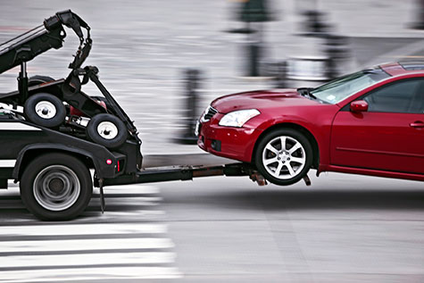
Romans 13:8-10 (NRSVue)
⁸ Owe no one anything, except to love one another, for the one who loves another has fulfilled the law.
⁹ The commandments, “You shall not commit adultery; you shall not murder; you shall not steal; you shall not covet,”
and any other commandment, are summed up in this word, …

Slide 15
“You shall love your neighbor
as yourself.”
¹⁰ Love does no wrong to a neighbor; therefore, love is the fulfilling of the law.
● Shall:
● As:
● The law:
● Neighbor:
● Does:
Hebrew idiom = “must.”
“as [you love] yourself.”
Lit., “a fulfilling of law.”
Jesus: “anyone in need.”
“Activity involving effort.”

Slide 16

Romans 13:11-14
¹¹ Besides this, you know what time it is, how it is already the moment for you to wake from sleep.
For salvation is nearer to us now than when we became believers; …
● Time:
● Moment:
● Wake:
“season,” long period.
“hour,” short period.
Resurrection = final salvation

Slide 17

¹² the night is far gone; the day is near. Let us then throw off the works of darkness and put on the armor of light;
¹³ let us walk decently as in the day, not in reveling and drunkenness, not in illicit sex and licentiousness, not in quarreling and jealousy.
“Take up the whole armor of God, so that you may be able to withstand on the evil day” (Eph. 6:13)
● Armor:
● Walk:
Truth… right… gospel… faith.
Obey Jesus in our behavior.

Slide 18
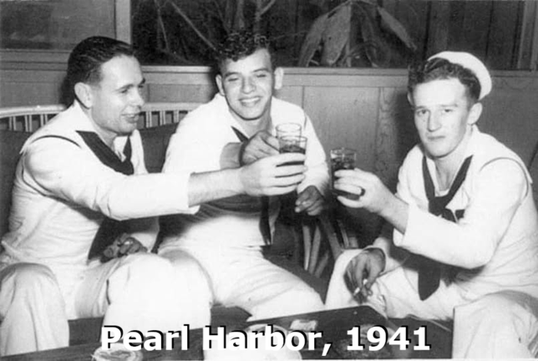
¹⁴ Instead, put on the Lord Jesus Christ,
and make no provision for the flesh, to gratify its desires.
● Put on:
● Lord:
● Provision:
● Flesh:
● Desires:
Show how to obey Jesus.
The One whom we obey.
Pro·noia, forethought, plan.
Natural body, self, sin.
Lust, illicit desires.

Slide 19
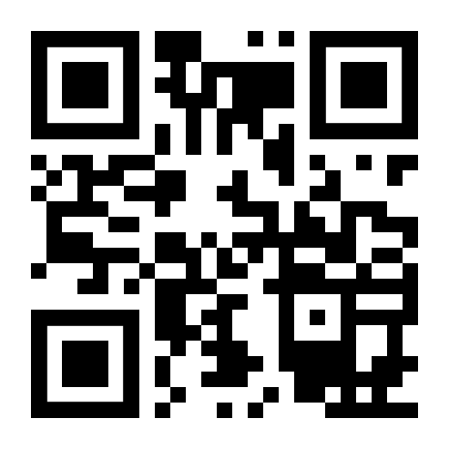
http://romans.forum

