Slide 1
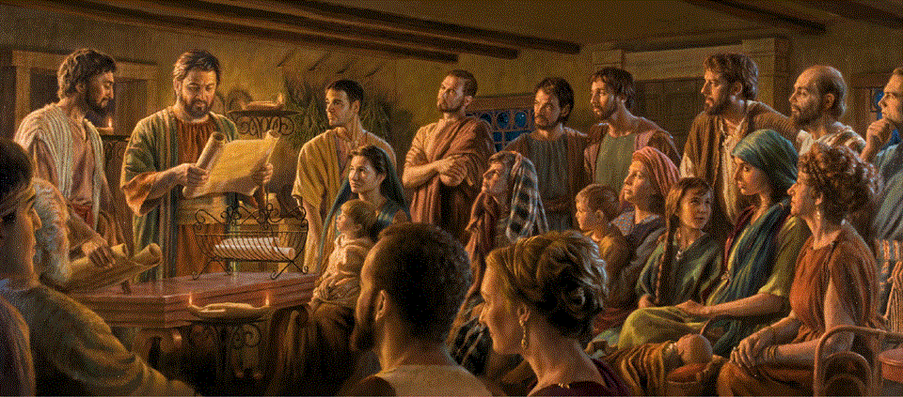
Romans 14:1-23
A Short Course for Men

Slide 2
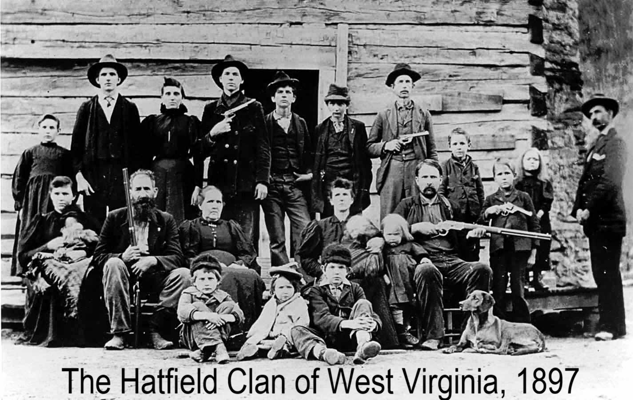
Causes of church division
● Theological disputes (1, 11-12)
● Dietary regulations (2, 17, 20-21)
● Judgmental attitudes (3-4, 10,13)
● Calendars & holy days (5-6)
● Doubt about Jesus’ lordship (7-9)
● Cleanliness practices (14)
● Inflexible legalism (22)
● Sinful behavior (23)

Slide 3
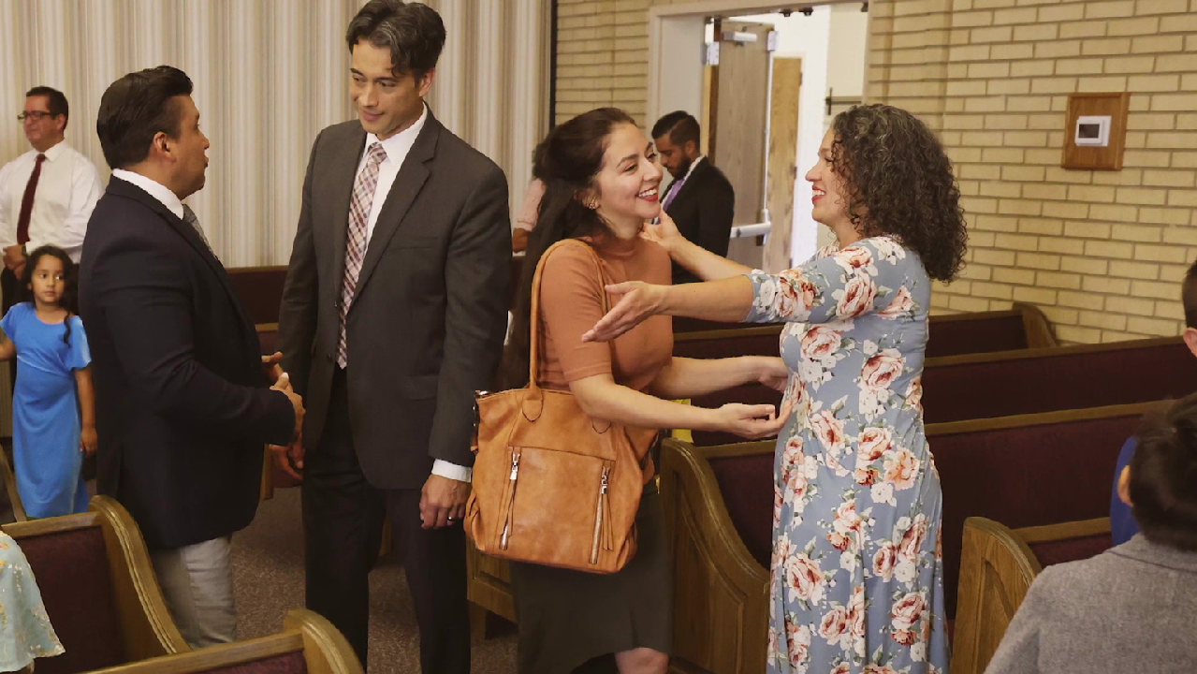
Weak in faith
¹ Welcome those who are weak in faith but not for the purpose of quarreling over opinions.
“Now faith is the assurance of things hoped for, the conviction of things not seen” (Heb. 11:1).
● Welcome:
● Weak:
● Faith:
● Quarrel:
Or receive (into churches).
Or lacking, lit. ‘sick’.
Or conviction.
Or disputing

Slide 4
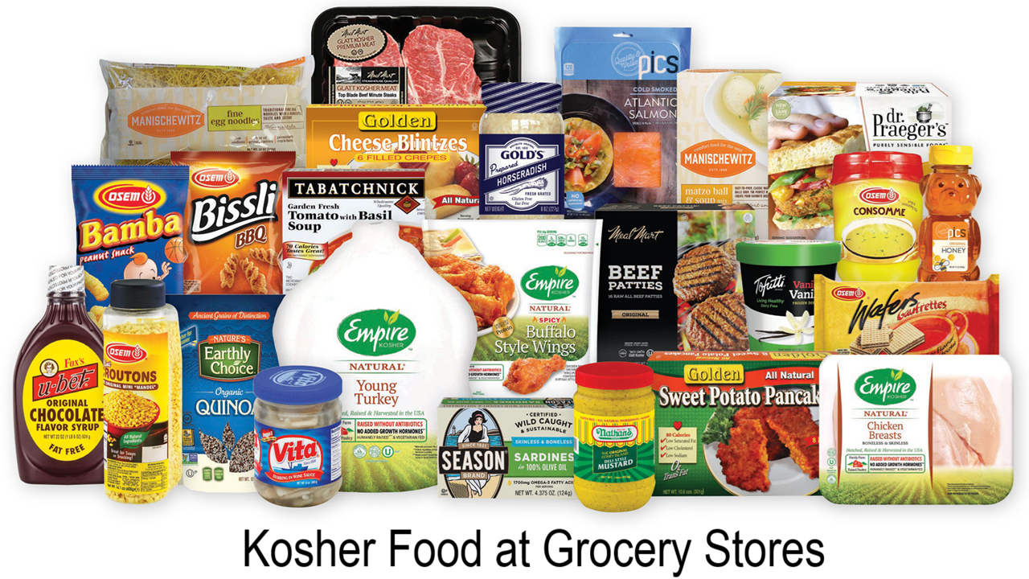
Dietary beliefs
“Whatever goes into a person … enters not his heart but his stomach, and is expelled. (Thus he declared all foods clean.)” (Mark 7:19)
² Some believe in eating anything, while the weak eat only vegetables.
● Some:
● Believe:
● Eat:
● Weak:
● Vegies:
Not an essential doctrine.
These have ‘strong’ faith.
“All foods are ‘clean’.”
Lacking full faith.
Good choice, wrong reason.

Slide 5
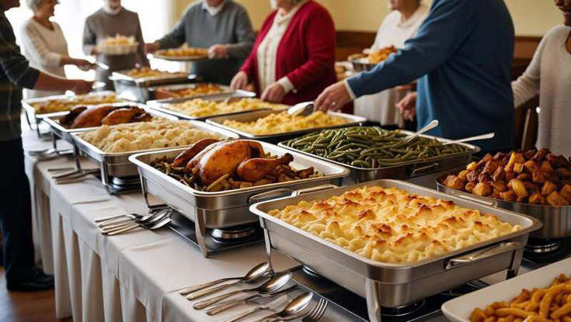
³ Those who eat must not despise those who abstain,
and those who abstain must not pass judgment on those who eat, for God has welcomed them.
“There is only one lawgiver and judge, he who is able to save and to destroy. ” (Jam. 4:12)
● Despise:
● Judge:
● God:
● Welcome:
Pres. Tense = Stop despising.
Pres. = Stop condemning.
Everyone’s Savior-Judge.
Aorist tense = present truth.

Slide 6
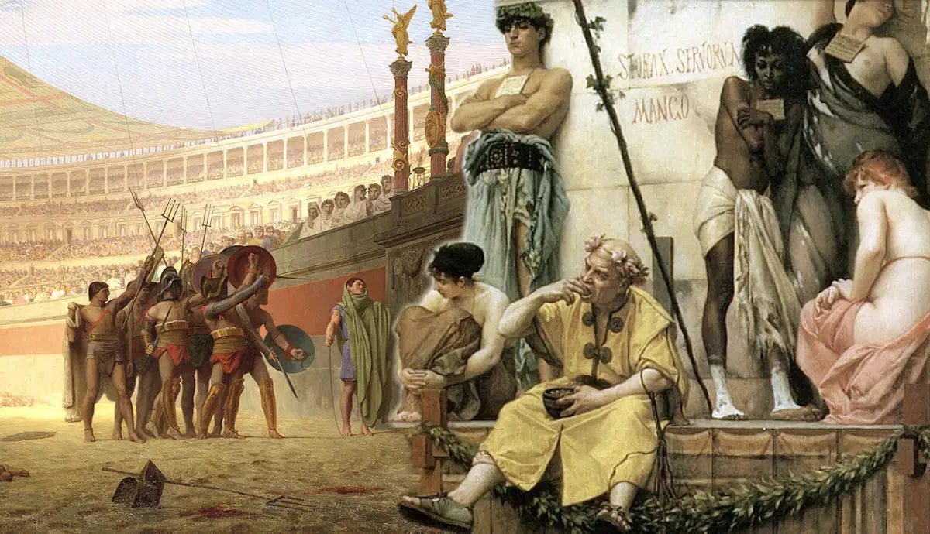
⁴ Who are you to pass judgment on slaves of another? It is before their own lord that they stand or fall.
And they will be upheld, for the Lord is able to make them stand.
● Slaves:
● Lord:
● Able:
● Stand:
Another party’s property.
Master. Life and death.
Both just and powerful.
Metaphor = innocent.
“The wicked will not stand in the judgment” (Psa. 1:5).

Slide 7
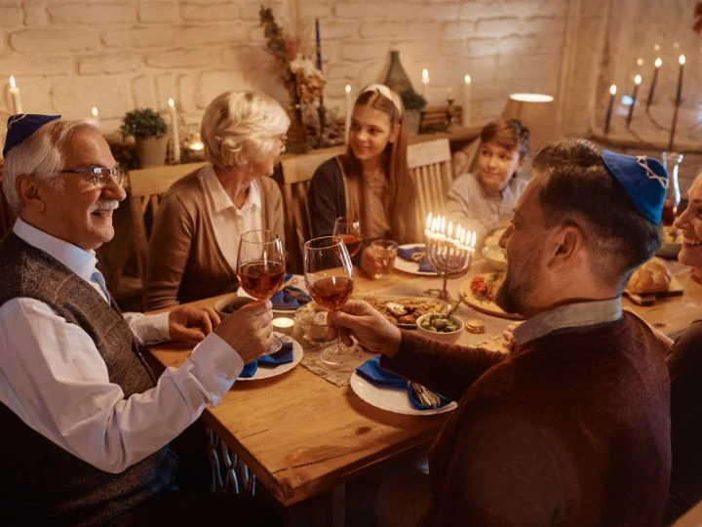
Sabbaths and holy days
⁵ Some judge one day to be better than another, while others judge all days to be alike.
“On the first day of the week, when we were gathered together to break bread…” (Acts 20:7).
Let all be fully convinced in their own minds.
● Day:
● Convinced:
● Mind:
Friday, Saturday, Sunday.
Have your reasons.
And understand them.

Slide 8
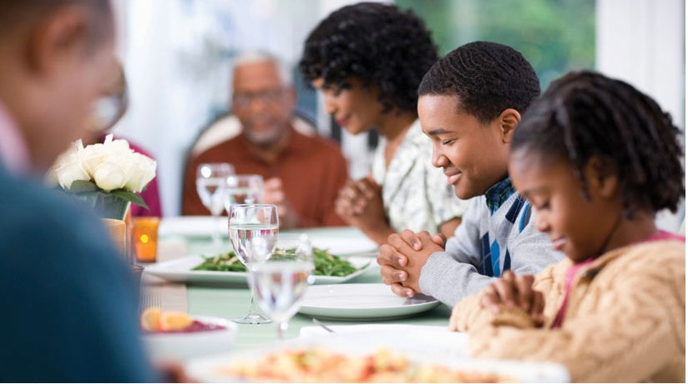
⁶ Those who observe the day, observe it for the Lord. Also those who eat, eat for the Lord, since they give thanks to God,
while those who abstain, abstain for the Lord and give thanks to God.
● For:
● Lord:
● Thank:
● God:
Dative = no clear meaning.
Yahweh the Son
Eu·charis = reply to grace.
Yahweh the Father
“Yahweh said to me, ‘You are my Son’” (Psa. 2:7).

Slide 9
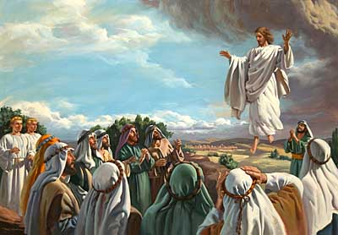
⁸ If we live, we live to the Lord, and if we die, we die to the Lord; so then, whether we live or whether we die, we are the Lord’s.
⁹ For to this end Christ died and lived again, so that he might be Lord of both the dead and the living.
● To:
● This:
● Both:
Dative = no clear meaning.
= that he be Lord
Starts already, goes on forever.
“He is the one appointed by God to be judge of the living and the dead” (Acts 10:42).

Slide 10
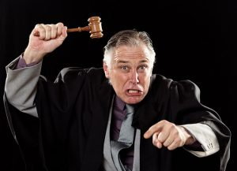
⁷ Why do you pass judgment on your brother or sister? Or you, why do you despise your brother or sister?
For we will all stand before the judgment seat of God.
“We must all appear before the judgment seat of Christ, so that each one may receive what is due for what he has done in the body, whether good or evil” (2 Cor. 5:10).
● Why:
● Brother:
● All:
● Seat:
Satan = divide & conquer
Fellow Christian
Regardless of denomination
Béma, raised platform.

Slide 11
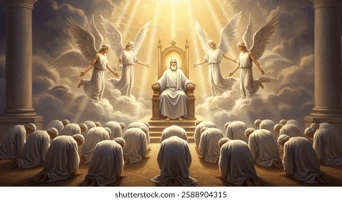
¹¹ For it is written,
As I live, says the Lord, every knee shall bow to me, and every tongue shall give praise to God.” [Isa. 45:23]
“By myself I have sworn (šv^{ʕ}) … To me every knee shall bow, every tongue shall swear (šv^{ʕ}) ” (Isa. 45:23)
¹² So then, each one of us will be held accountable [to God].
● Praise:
● Account:
eks·omo·logeô (say from same) = admit wrong doing.
“give word (logos)”

Slide 12
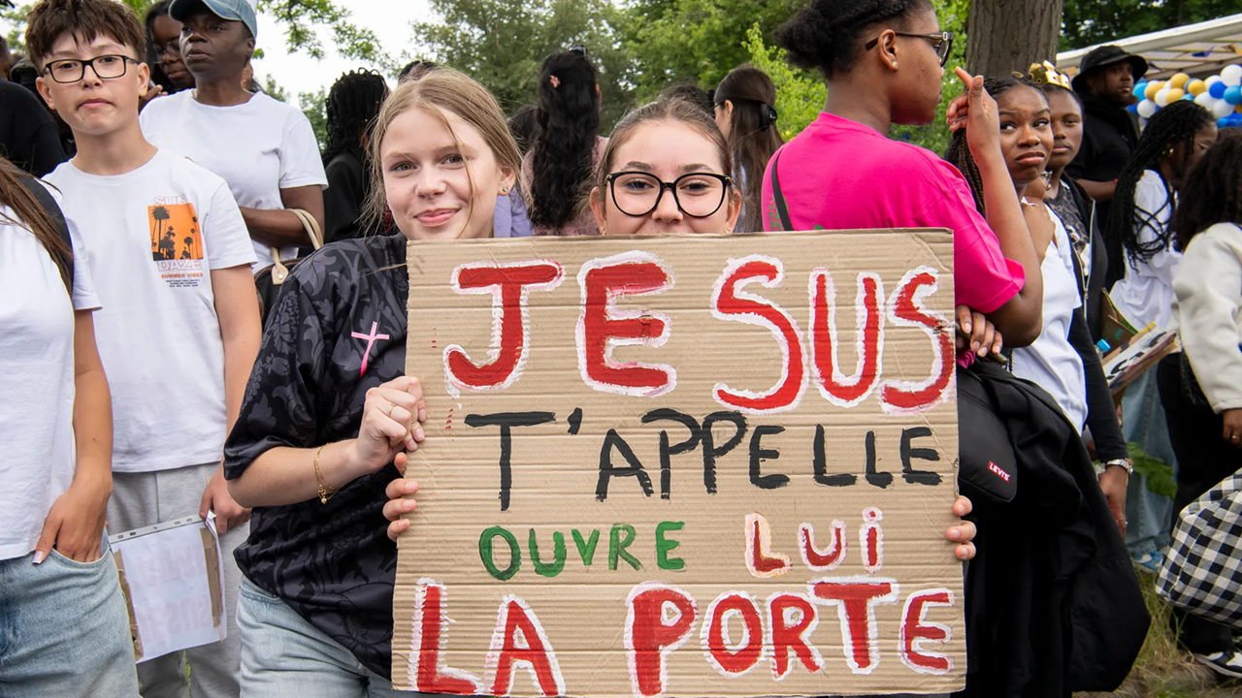
16th–21st century evangelical·ism
● Salvation and believers’ (re)baptism.
● Personal faith, prayer and witness.
● Biblical authority and interpretation.
● Freedom of conscience & association.
● Social mercy, justice and equality.
● Lay ministers, chosen and dismissed.
● Separation of church and state.
● National and international missions.

Slide 13
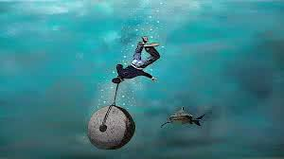
¹³ Let us therefore no longer pass judgment on one another,
“It would be better for him if a millstone were hung around his neck and he were cast into the sea than that he should cause one of these little ones to sin” (Luke 17:2).
but resolve instead never to put a stumbling block or hindrance in the way of a brother or sister.
● Judge:
● Resolve:
● Block:
● Hindrance:
Krinō, decide (for others).
Krinō, decide (for ourselves).
A cause of offense.
A temptation to sin.

Slide 14
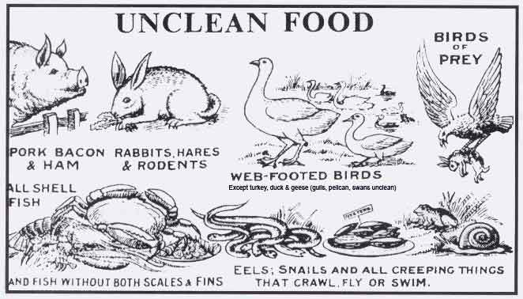
Clean and unclean foods
¹⁴ I know and am persuaded in the Lord Jesus that nothing is unclean in itself,
“Thus he declared all foods clean.” (Mark 7:19).
but it is unclean for anyone who considers it unclean.
● Persuaded:
● Clean:
● Unclean:
● Consider:
Know to be true.
Acceptable to God.
Forbidden by God.
Reckon, think, assume.

Slide 15
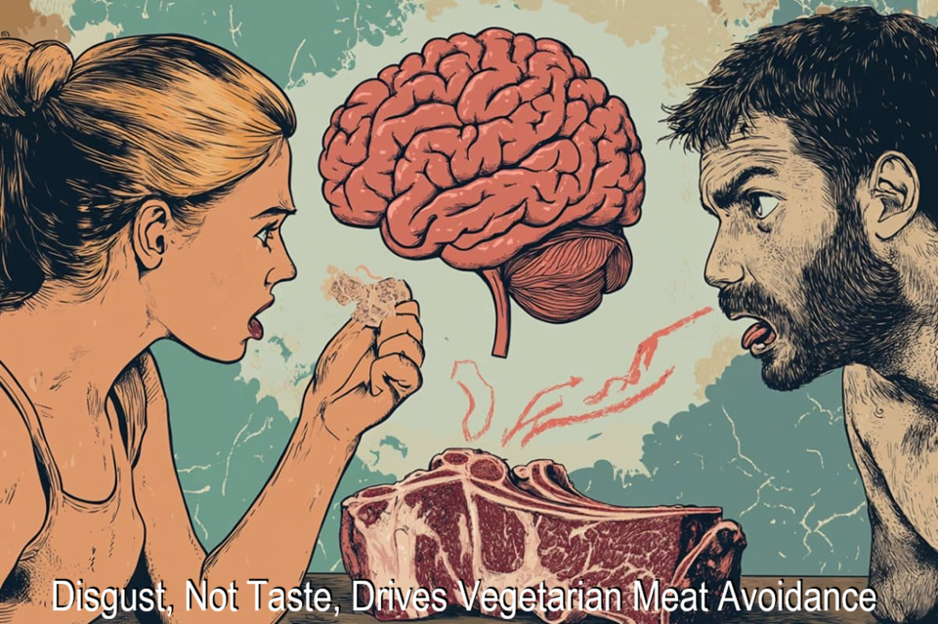
¹⁵ If your brother or sister is distressed by what you eat, [then] you are no longer walking in love. Do not let what you eat cause the ruin of one for whom Christ died.
¹⁶ So do not let your good be slandered.
● Distress:
● Ruin:
● Good:
We flaunt what we eat.
They violate their conscience.
Our freedom of conscience.

Slide 16
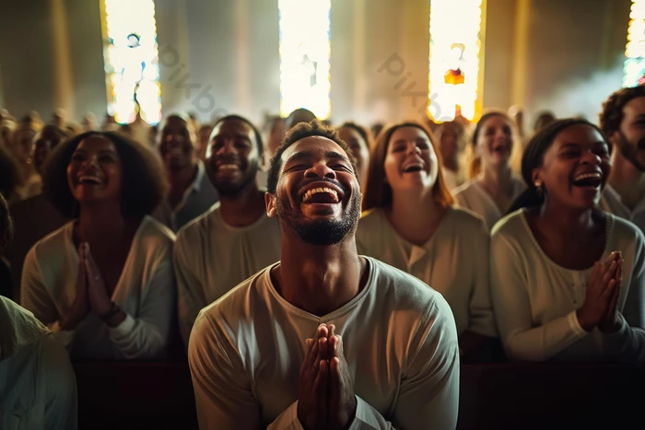
¹⁷ For the kingdom of God is not food and drink but righteousness and peace and joy in the Holy Spirit.
“Discern what is the will of God, what is good and acceptable and perfect” (Rom. 12:2).
¹⁸ The one who serves Christ in this way is acceptable to God and has human approval.
● Kingdom:
● Holy Spirit:
● Acceptable:
● Approval:
Obedience to God.
The indwelling God.
Regardless of days & diet.
To meet standards.

Slide 17
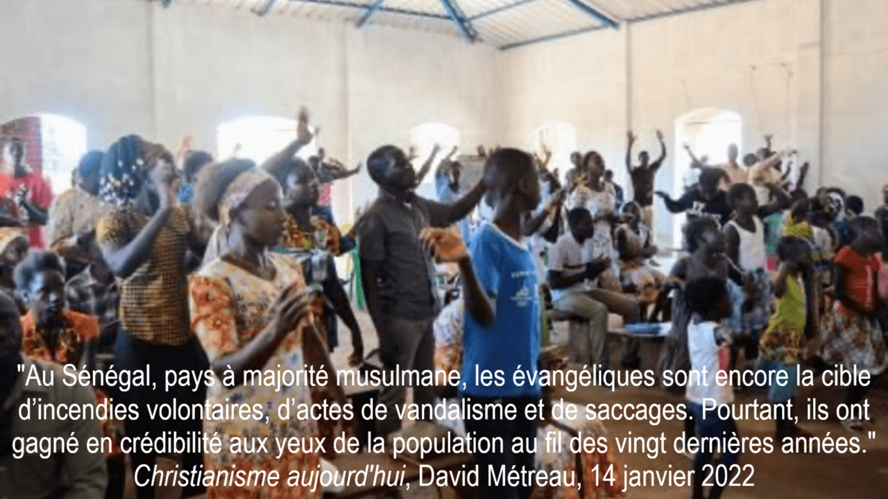
So then …
¹⁹ Let us then pursue what makes for peace and for mutual upbuilding.
²⁰ Do not, for the sake of food, destroy the work of God.
● Peace:
● Upbuilding:
● Destroy:
● Work:
Harmonious relations.
Cause faithful obedience.
Undo or styme growth.
Fellow Christians.

Slide 18
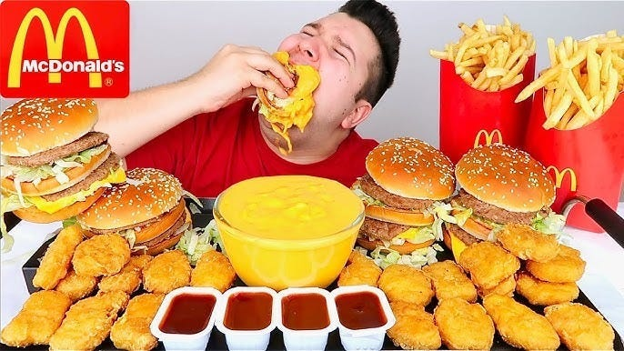
Everything is indeed clean, but it is wrong to make someone stumble by what you eat;
²¹ it is good not to eat meat or drink wine or do anything that makes your brother or sister stumble.
● Clean:
● Stumble¹:
● Good:
● Stumble²:
Acceptable to God.
They eat what you eat.
Kalos, beautiful, to refrain.
To fall (into sin).

Slide 19
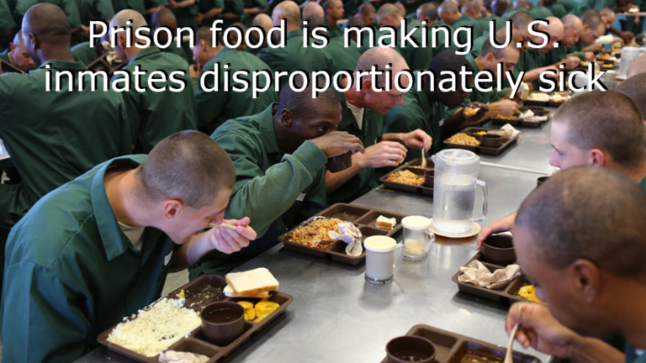
²² Hold the conviction that you have as your own before God.
Blessed are those who do not condemn themselves because of what they approve.
● Conviction:
● Own:
● Condemn:
● Approve:
Pistis, faith, faithfulness.
What I believe and practice.
By haranguing others.
As God’s revealed will.

Slide 20
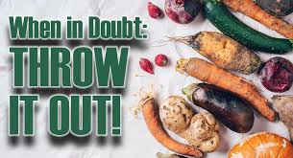
²³ But those who have doubts are condemned if they eat because they do not act from faith,
for whatever does not proceed from faith is sin.
● Doubts:
● Condemn:
● Faith:
● Sin:
To hesitate.
Feel shame or guilt.
Conviction on a matter.
A selfish act or attitude.
“Sin is lawlessness” (1 John 3:4).

Slide 21

How to cause Christians to sin
● Split churches over disputed issues.
● Entice them to violate their convictions.
● Cast doubt on OT & NT Scriptures.
● Teach that Jesus is not the Messiah.
● Teach that Jesus was only human.
● Rationalize immoral practices.
● Neglect the hungry at church meals.
● Offer them sugar, carbs and seed oils.

Slide 22
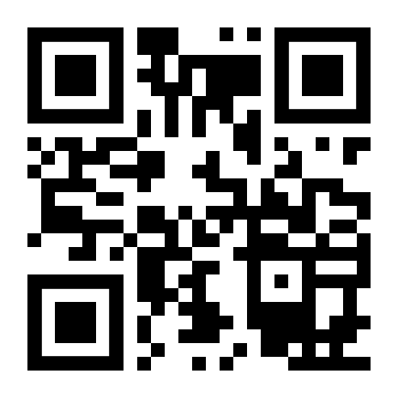
http://romans.forum

