Slide 1
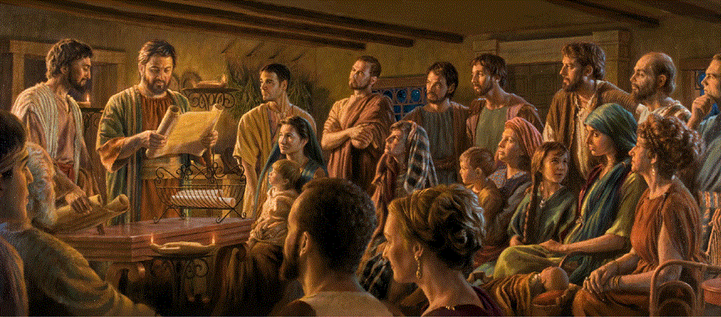
Epistle to the Romans, 15:1-21
A Short Course for Men

Slide 2

Three practical lessons from this epistle
For local gatherings (1-13)
For Paul’s mission to gentiles (14-21)
For Paul’s soon visit to Rome (22-33)

Slide 3
Three practical lessons from this epistle
For local gatherings (1-13)
For Paul’s mission to gentiles (14-21)
For Paul’s soon visit to Rome (22-33)

Slide 4
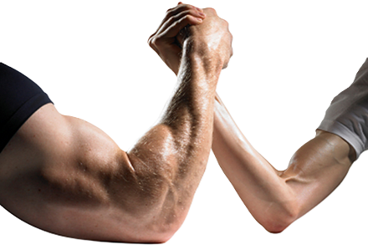
Romans 15:1-6 (NRSVue)
¹ We who are strong ought to put up with the failings of the weak and not
to please ourselves.
² Each of us must please our neighbor for the good purpose of building up the neighbor.
● Put up:
● Please :
● Build:
To support, meet needs.
As we love ourselves.
To strengthen, add to.

Slide 5
Kinds of ‘weak’
● ‘Weak in faith’: whose convictions disallow certain foods.
● In health: who require assistance.
● Economically: slaves & laborers.
● Politically: have little influence.
● Socially: despised minorities.
● Culturally: immigrants, foreigners.
● Mentally: uneducated, misinformed.

Slide 6
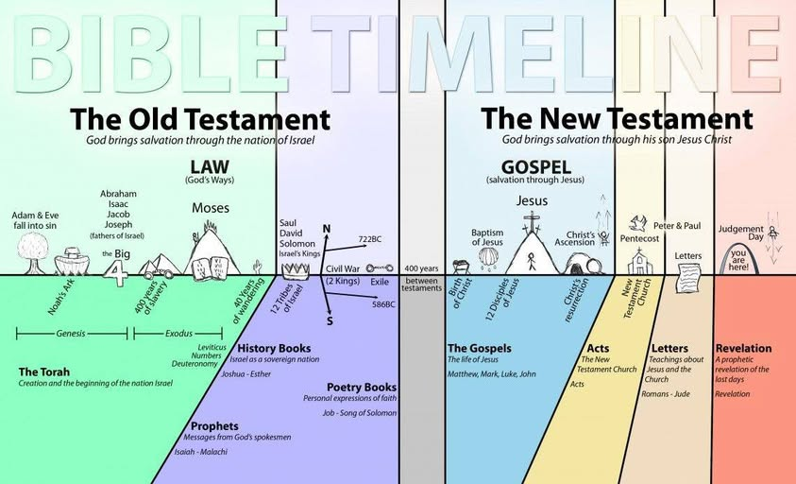
³ For Christ did not please himself, but, as it is written,
“The insults of those who insult you have fallen on me.”
[Psa. 69:9]
⁴ For whatever was written in former days was written for our instruction, …
● Former:
● Written:
● Instruction:
Before (NT) Gospels.
Tanakh (OT) Scriptures.
Most lessons for our life.

Slide 7
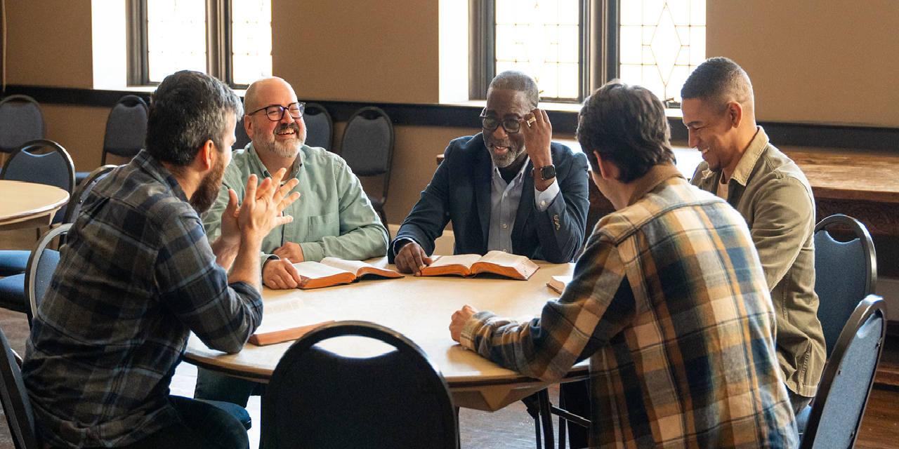
so that
by steadfastness and
by the encouragement
of the scriptures
we might have hope.
● Steadfast:
● Encourage:
● Scriptures:
● Hope:
Endurance under stress.
Applicable truth.
Read/study the Tanakh.
Firm expectation.

Slide 8
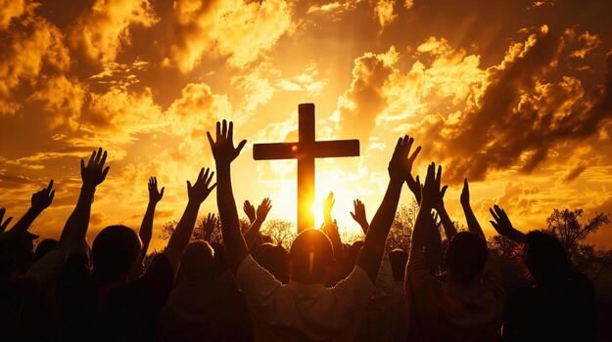
⁵ May the God of steadfastness and encouragement grant you to live
in harmony with one another,
in accordance with Christ Jesus,
⁶ so that together you may with one voice glorify the God and Father
of our Lord Jesus Christ.
● Grant:
● Together:
A gift from God.
The strong and the weak.

Slide 9
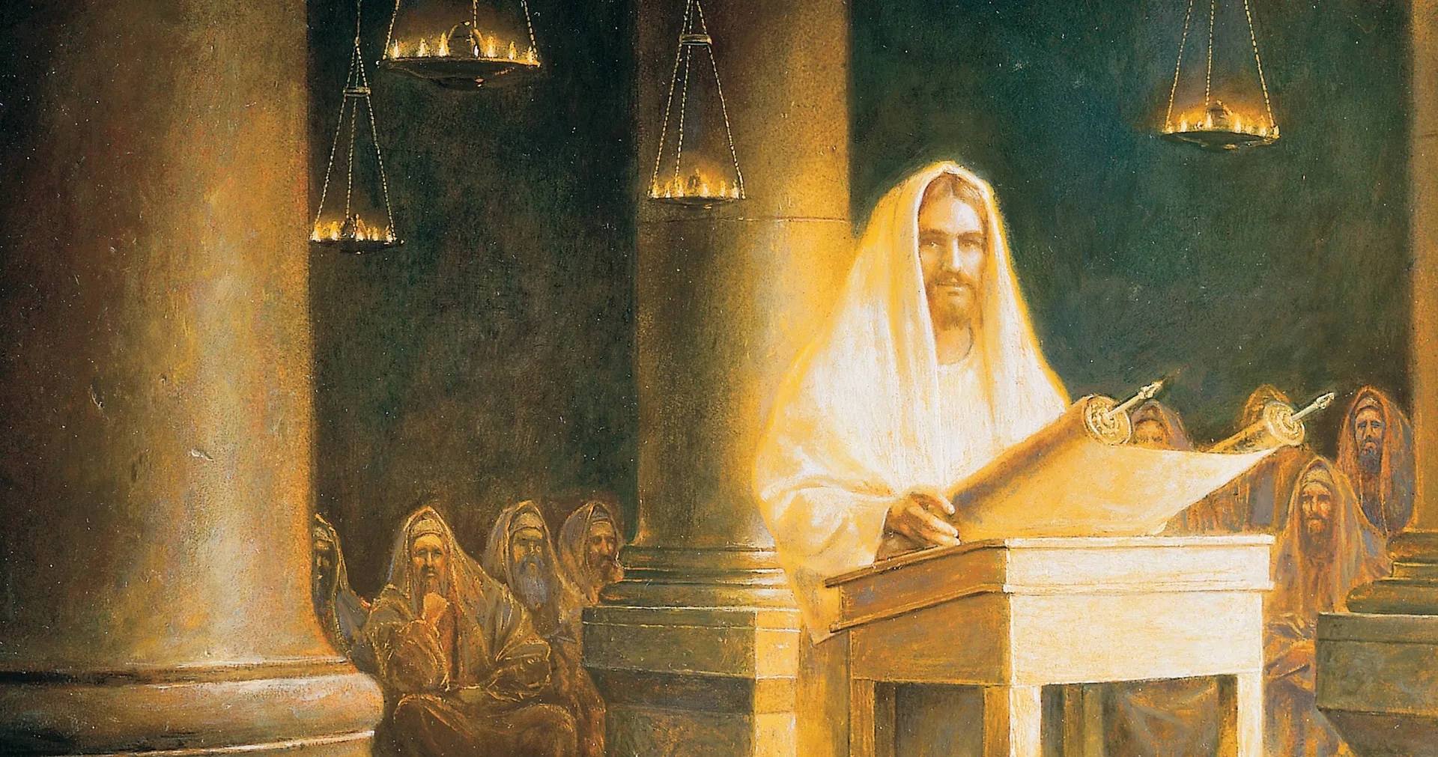
Romans 15:7-13 (NRSVue)
⁷ Welcome one another, therefore,
just as Christ has welcomed you, for the glory of God.
⁸ For I tell you that Christ has become a servant of the circumcised on behalf of the truth of God …
● Welcome:
● Servant:
● Truth:
Receive into churches.
To meet Israelites’ needs.
As promised in Scripture.

Slide 10
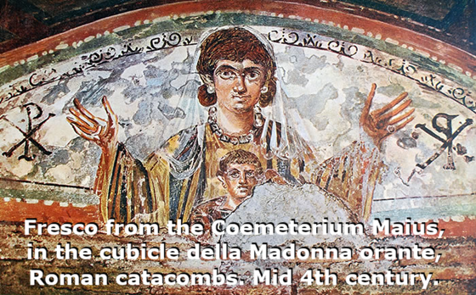
in order that he might confirm the promises given to the ancestors
⁹ and that the gentiles might glorify God for his mercy.
● Confirm:
● Promises:
● Ancestors:
● Gentiles:
● Mercy:
Show to be true.
What had God promised?
Who received promises?
Genesis 12:3 (to Abraham).
Kindly meeting needs.

Slide 11
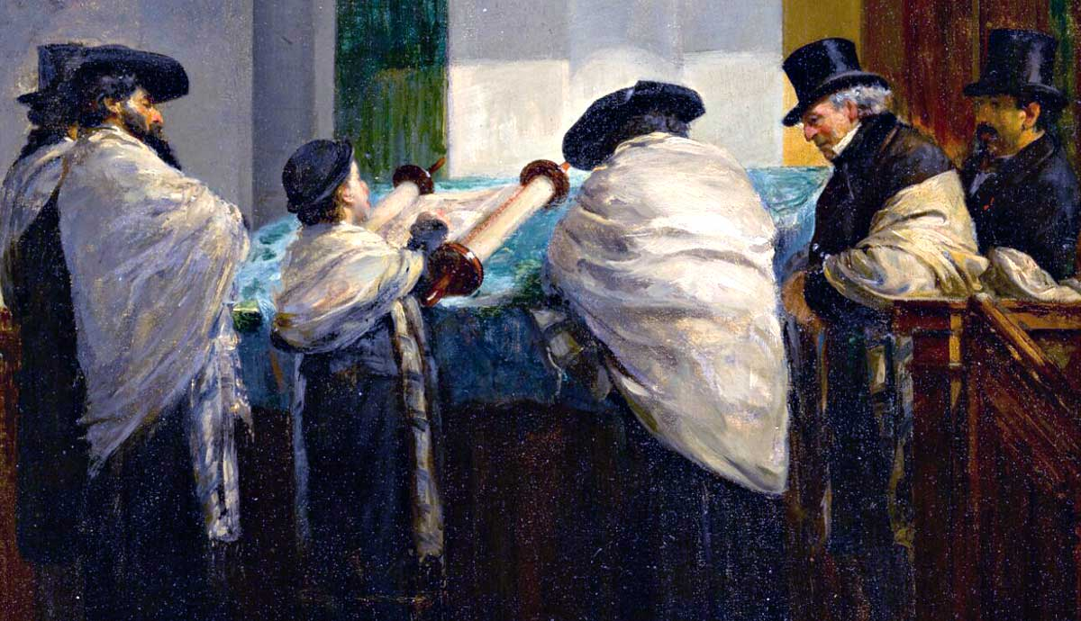
As it is written, [2 Sam. 22:50; Psa. 18:49]
“Therefore I will confess you among the gentiles
and sing praises to your name”;
¹⁰ and again he says, [Deut. 32:43]
“Rejoice, O gentiles, with his people”;
● Confess:
● Name:
● People:
To declare openly.
Idiom = sum of qualities.
With the Israelites.

Slide 12
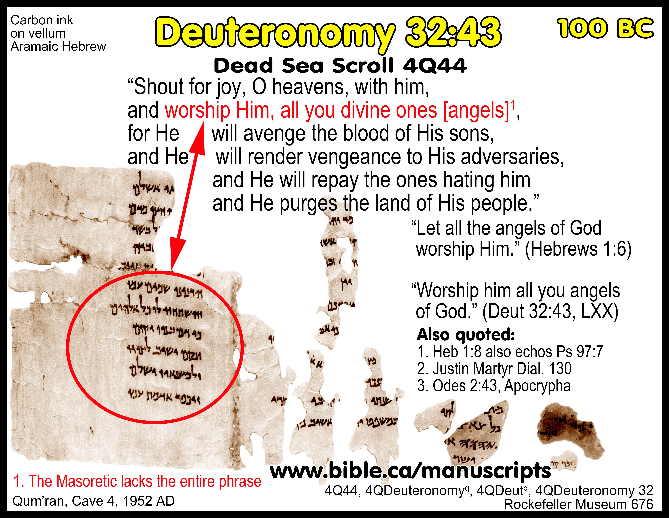
Deuteronomy 32:43
Sources
● Masoretic text (10th century AD/CE),
4 cola (lines):
“Praise, O heavens, his people” NRSVue.
● Greek Septuagint and another version (3rd century BC/BCE), 8 cola.
● Qumran (DSS) 4QDeut^{q} (1st century BC/BCE or earlier), 6 cola.

Slide 13
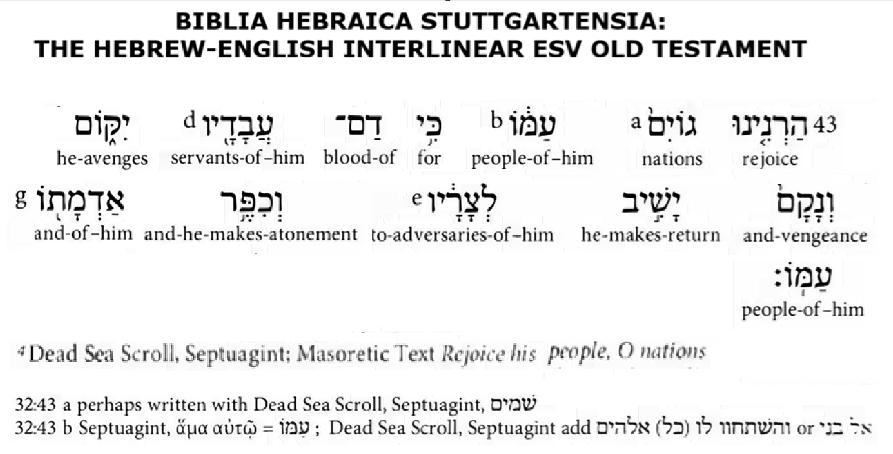
Deuteronomy 32:43 restored
Rejoice, heavens^{M}/gentiles^{G} with Him /
his people*;
[Bow to him, all you gods.]
For he avenges his sons’ blood;
He takes revenge upon his adversaries.
[Those who hate him will he requite;]
He cleanses his people’s land.
*Heb. ^{ʔ}imwo=with him, ^{ʔ}amwo=his people

Slide 14

¹¹ and again, [Psa. 117:1]
“Praise the Lord, all you gentiles,
and let all the peoples praise him”;
● Lord:
● All:
● Let:
● Gentiles:
● Peoples:
Gk ‘the Lord’ ⬅ Hb ‘Yahweh’.
All=extent of Gentile mission.
Imperative ‘must’, not ‘allow’.
Ethnos, i.e., ethnicities.
Social classes & structures.

Slide 15
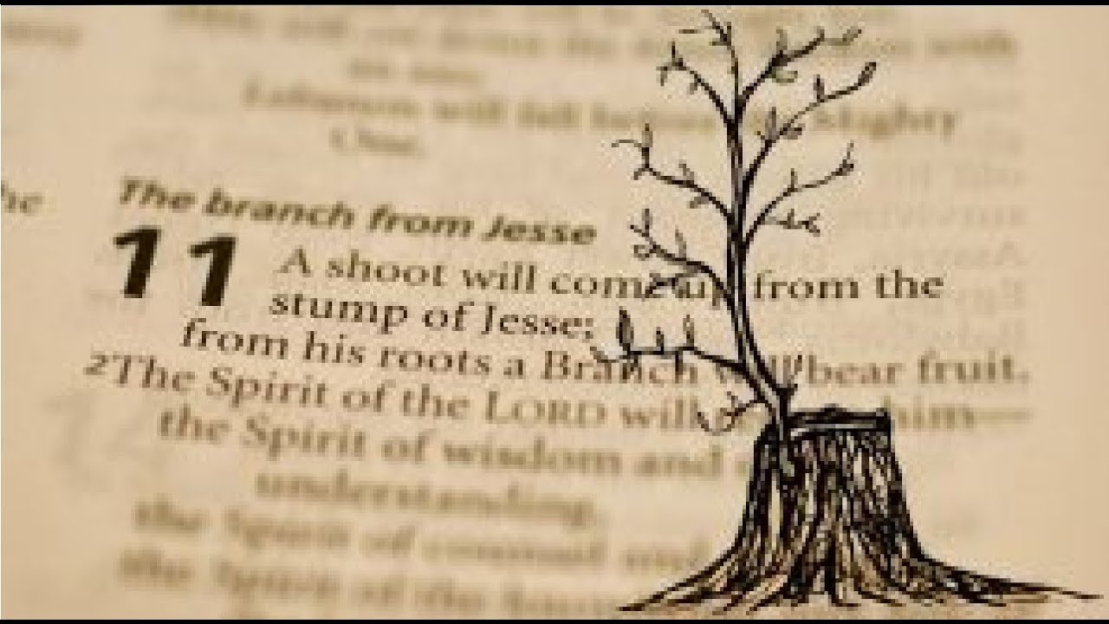
¹² and again Isaiah says, [Isa. 11:10]
“The root of Jesse shall come,
the one who rises to rule the gentiles;
in him the gentiles shall hope.”
● Root:
● Jesse:
● Rise:
● Rule:
● Hope:
Left when tree is cut down.
King David’s father.
Attain or seize power.
King over all nations.
Now awaiting Israel’s Messiah.

Slide 16
Three practical lessons from this epistle
For local gatherings (1-13)
For Paul’s mission to gentiles (14-21)
For Paul’s soon visit to Rome (22-33)

Slide 17
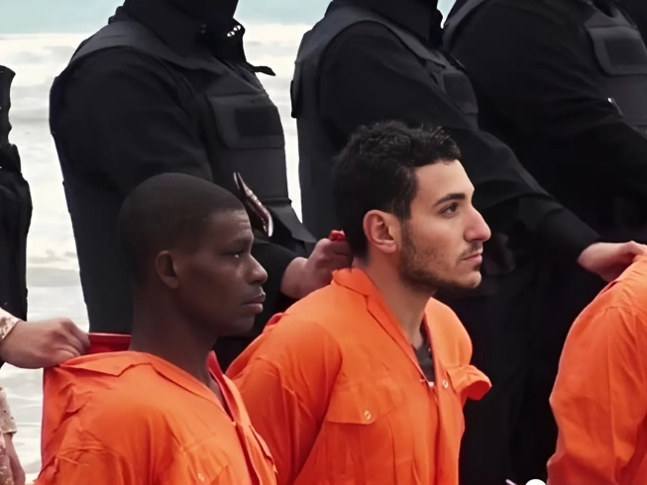
¹³ May the God of hope fill you with all joy and peace in believing,
so that you may abound in hope by the power of the Holy Spirit.
● Fill:
● Hope:
● Joy:
● Peace:
● Believe:
Cause to experience.
God plans our future.
Divine pneumatonine.
Not frightened by NWO.
Remaining faithful to Jesus.

Slide 18

Romans 15:14-16 (NRSVue)
¹⁴ I myself feel confident about you, my brothers and sisters, that you yourselves are full of goodness,
filled with all knowledge, and able to instruct one another.
● Goodness:
● knowledge:
● Instruct:
Motivation: to help.
Material: useful.
Methods: outcomes.

Slide 19
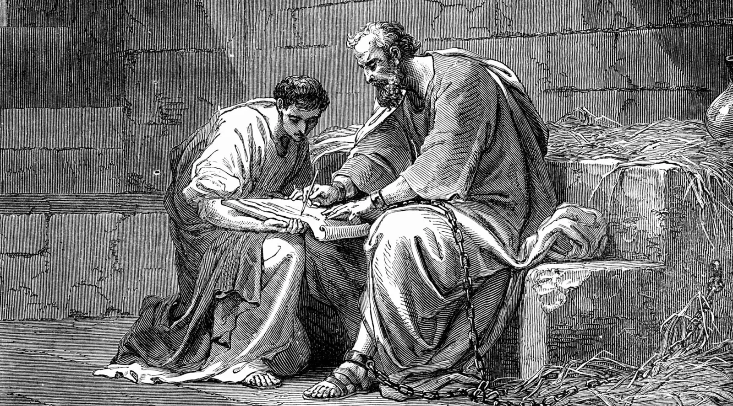
¹⁵ Nevertheless, on some points I have written to you rather boldly by way of reminder, because of the grace given me by God
¹⁶ to be a minister of Christ Jesus to the gentiles in the priestly service of the gospel of God, …
● Reminder:
● Grace :
● Gospel:
We forget facts and acts.
The Spirit opens opportunity
Always share good news.

Slide 20
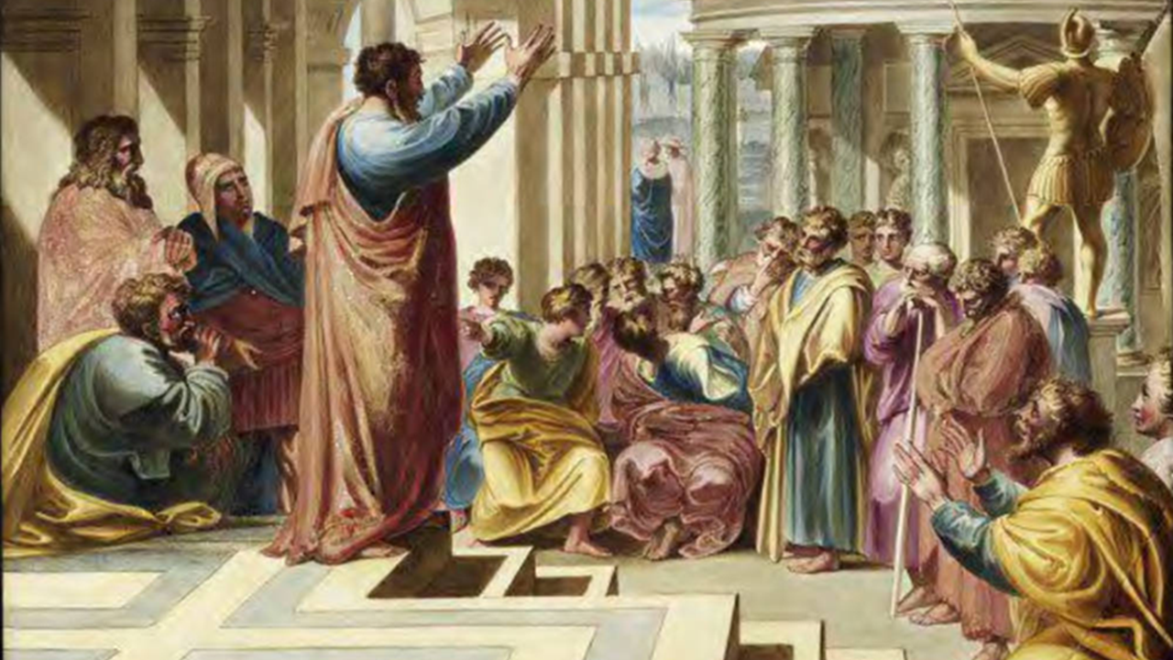
… so that the offering of the gentiles may be acceptable, sanctified by the Holy Spirit.
¹⁷ In Christ Jesus, then, I have reason to boast of my work for God.
● Offering:
● Acceptable:
● Sanctified:
● Boast:
● Work:
= gentile believes.
Ethnicity does not matter.
Made holy = new owner.
Rejoice, not vain bragging.
(Not in the original.)

Slide 21
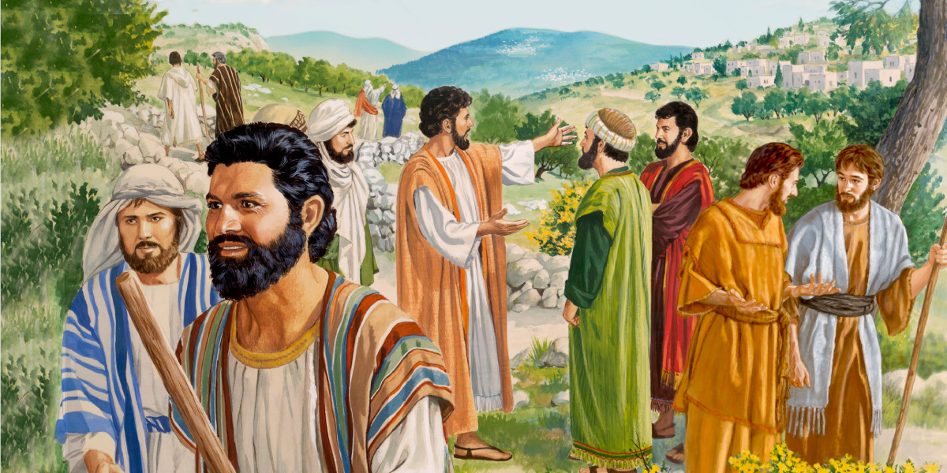
¹⁸ For I will not be so bold as to speak
of anything except what Christ has accomplished through me to win obedience from the gentiles, by word and deed,
¹⁹ by the power of signs and wonders, by the power of the Spirit, …
● Christ:
● Obedience:
● Spirit:
God active in the world.
Jesus’ commandments.
Active in the supernatural.

Slide 22
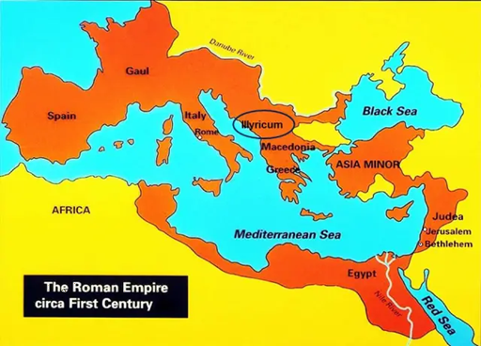
… so that from Jerusalem and as far around as Illyricum I have fully proclaimed the gospel of Christ.
²⁰ Thus I make it my ambition to proclaim the gospel, not where Christ has already been named, so that I do not build on someone else’s foundation,
● Fully:
● Named:
Now self-propogating churches
Messiah’s name is …

Slide 23
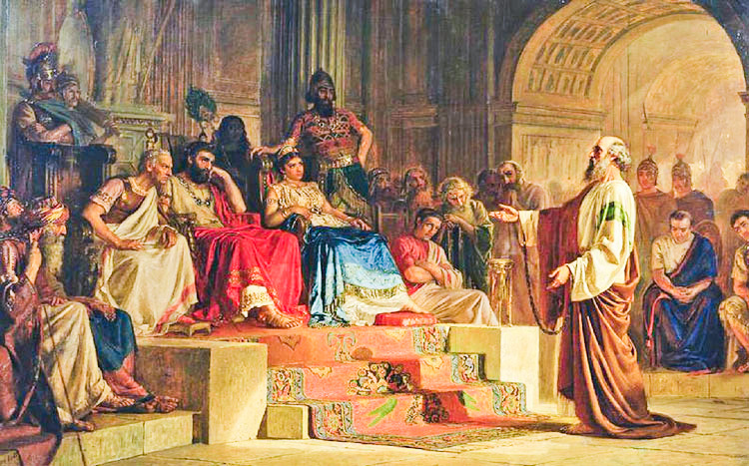
²¹ but as it is written, [Isa. 52:15]
“Those who have never been told of him shall see,
and those who have never heard of him shall understand.”
Messiah for ‘many nations’.
‘My servant … lifted up’ [52:13].
Figuratively, meaning …
Poetic parallelism.
● Written:
● Him:
● See:
● Understand:

Slide 24
Three practical lessons from this epistle
For local gatherings (1-13)
For Paul’s mission to gentiles (14-21)
For Paul’s soon visit to Rome (22-33)

Slide 25
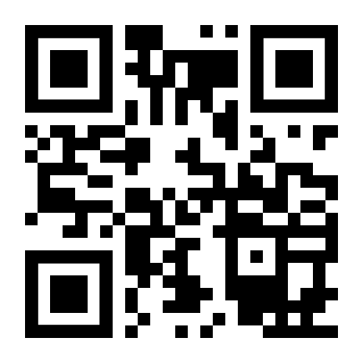
http://romans.forum

Slide 26
…

