Slide 1
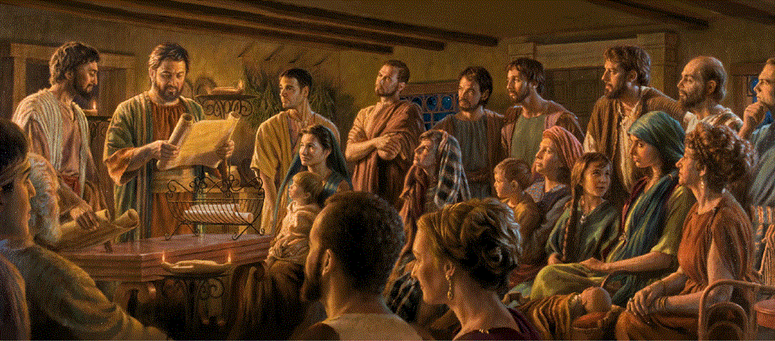
Epistle to the Romans, 15:22-16:2
A Short Course for Men

Slide 2

Three practical lessons from Romans 15
For local gatherings (1-13)
For Paul’s mission to gentiles (14-21)
For Paul’s soon visit to Rome (22-33)

Slide 3
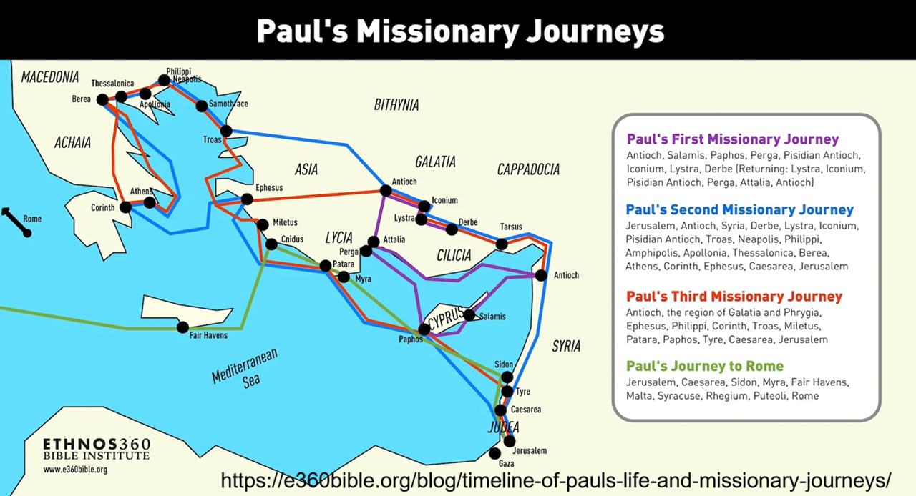
Romans 15:22-29 (NRSVue)
²² This is the reason that I have so often been hindered from coming to you.
²³ But now, with no further place for me in these regions, I desire, as I have for many years, to come to you …
Different from “Satan hindered us” (1 Thes. 2:18).
● Reason:
● Place:
● Desire:
‘fully proclaim the gospel’ (19)
Pop. centers have churches.
Why Rome?

Slide 4
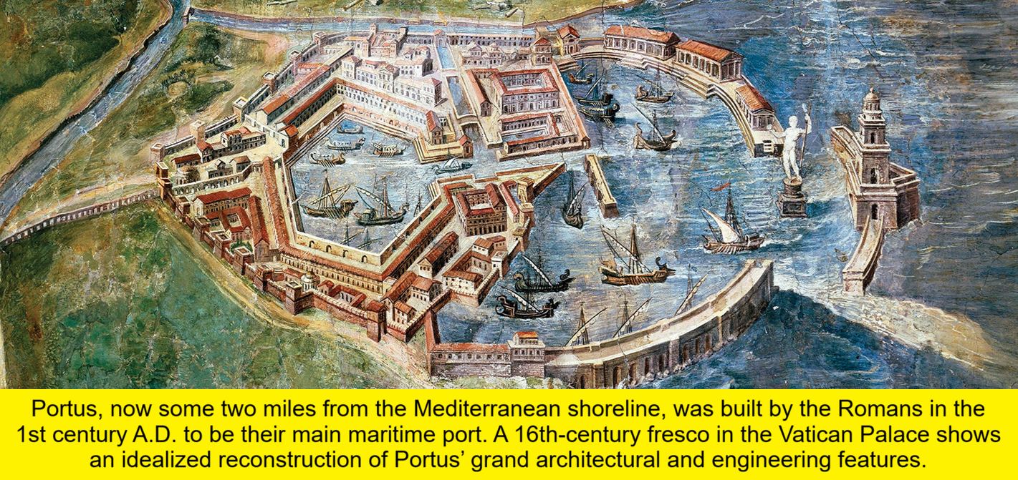
²⁴ when I go to Spain.
For I do hope to see you on my journey and to be sent on by you, once I have enjoyed your company for a little while.
DMM / CPM
Disciple-Making Movement Church-Planting Mission
● Spain:
● Journey:
● Sent on:
● Once:
Western “end of the earth.”
Fourth DMM journey.
Monetary support.
Lit., ‘if’, 2nd class cond.

Slide 5
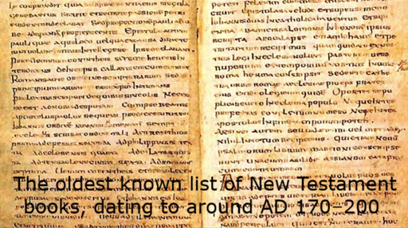
Did Paul go to Spain?
● Clement of Rome (70s AD): “reached the farthest limits of the west.”
● Muratorian Canon (c. AD 170): “when he journeyed to Spain.”
● Acts of Peter (c. AD 180): “departed from the Roman harbor of Ostia.”
● Cyril of Jerusalem (4th cent. AD): “carried the earnestness of his preaching as far as Spain.”

Slide 6
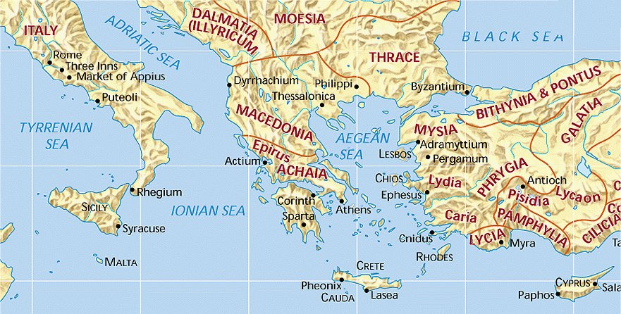
²⁵ At present, however, I am going to Jerusalem in a ministry to the saints,
²⁶ for Macedonia and Achaia were pleased to share their resources with the poor among the saints at Jerusalem.
“God loves a cheerful giver” (2 Cor. 9:7).
● Ministry:
● Pleased:
● Poor:
● Saints:
‘Deaconing’ = care for poor
‘Cheerful givers’.
Shunned by major religions.
Measure of divine favor.

Slide 7
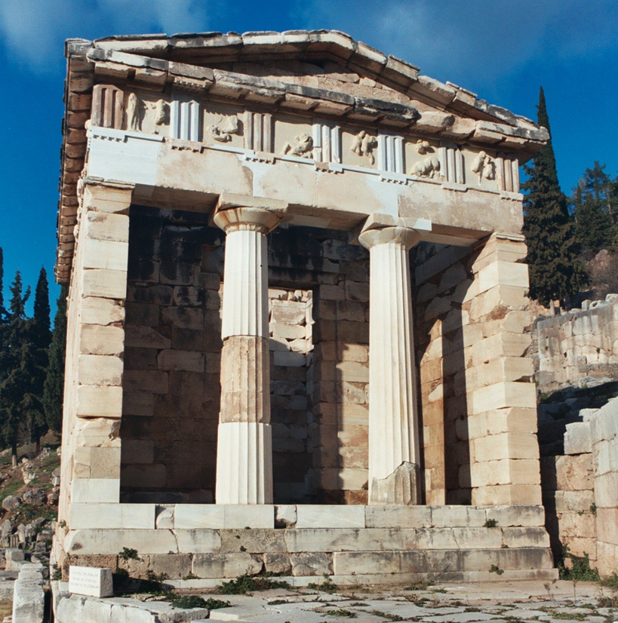
²⁷ They were pleased to do this, and indeed they owe it to them,
for if the gentiles have come to share in their spiritual blessings, [then] they ought also to be of service to them in material things.
“Owe no one anything, except to love each other” (Rom. 13:8).
● Owe:
● Spiritual:
● Material:
Noun ‘owe’ = verb ‘ought’.
Everlasting benefits.
Survival needs.

Slide 8
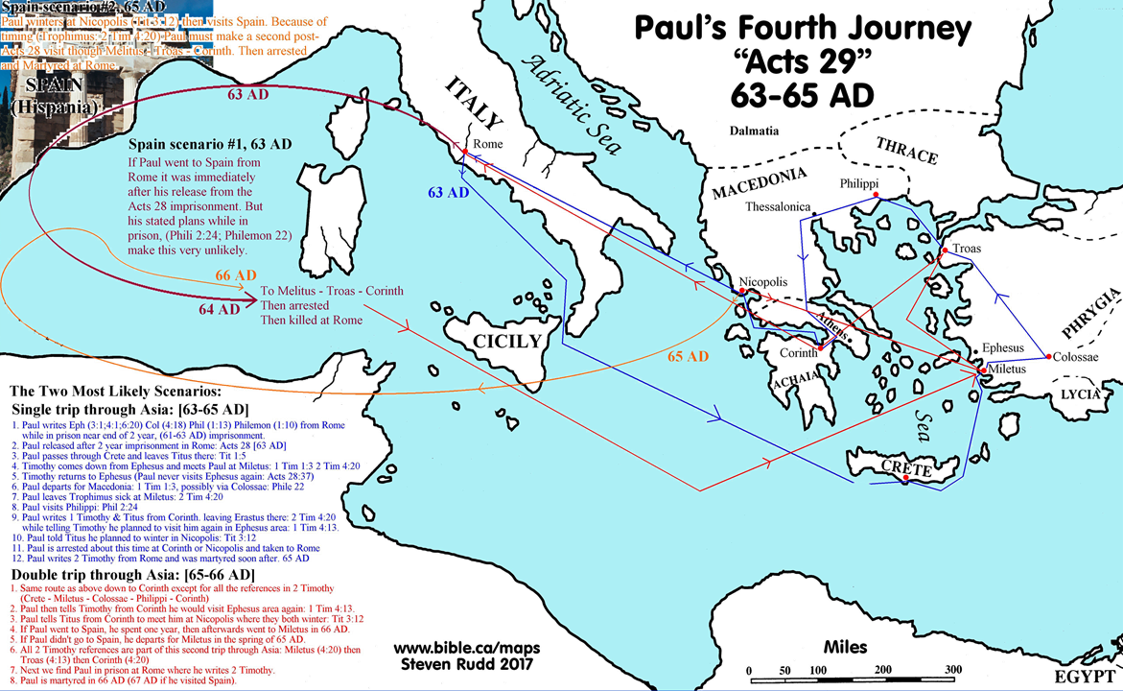
²⁸ So, when I have completed this and have delivered to them what has been collected, I will set out by way of you to Spain,
“… mutually encouraged by each other's faith, both yours and mine” (Rom. 1:12).
²⁹ and I know that when I come to you I will come in the fullness of the blessing of Christ.
● Complete:
● I will:
● “Go”:
Current plan accomplished.
Future plan initiated.
Romans bless Paul!

Slide 9
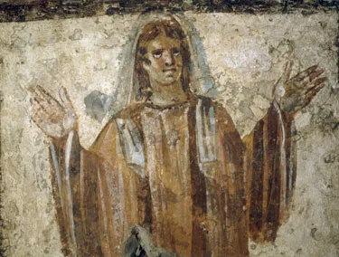
Romans 15:30-33 (NRSVue)
³⁰ I appeal to you, brothers and sisters, by our Lord Jesus Christ and by the love of the Spirit, to join me in earnest prayer to God on my behalf, …
“The prayer of a righteous person has great power as it is working” (James 5:16).
● Lord:
● Spirit:
● God:
● Prayer:
God incarnate.
God indwelling.
God superintending.
Make verifiable requests!

Slide 10
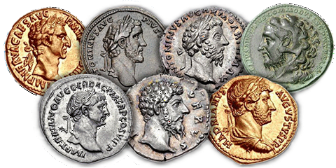
³¹ that I may be rescued from the unbelievers in Judea,
and that my ministry to Jerusalem may be acceptable to the saints, …
“Whose likeness and inscription is this?” (Mark 12:16).
● Rescued:
● Unbelievers:
● Acceptable:
● Saints:
Jews had issued a fatwa.
Roman pagans? Jews?
‘Tainted’ gentile money.
Jewish Christians.

Slide 11
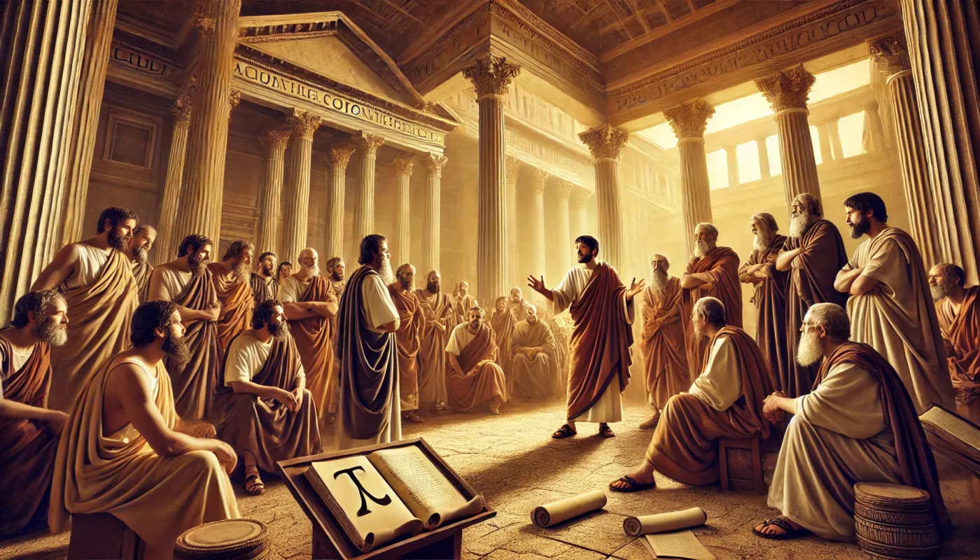
³² so that by God’s will I may come to you with joy and be refreshed in your company.
³³ The God of peace be with all of you. Amen.
“Peace I leave with you; my peace I give to you” (John 14:27).
● Will:
● Joy:
● Refresh:
● Peace:
God’s will is contingent on…
Success at Jerusalem.
Relax with others.
Gk ← Heb Šalōm = prosperity.

Slide 12
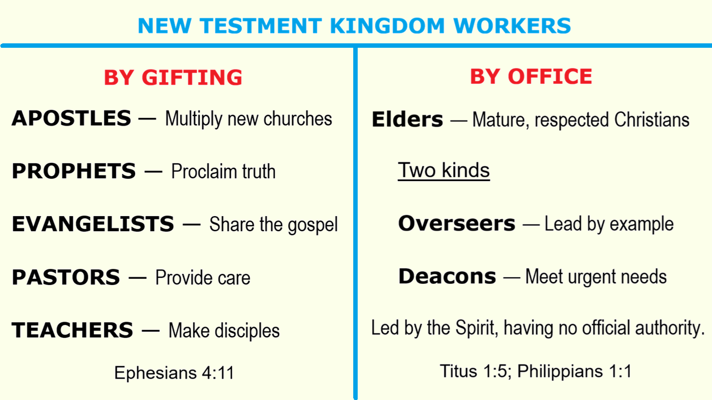

Slide 13
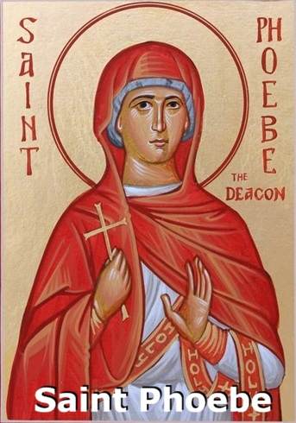
Romans 16: 1-2 (NRSVue)
¹ I commend to you our sister Phoebe, a deacon of the church at Cenchreae,
² so that you may welcome her in the Lord, as is fitting for the saints, …
● Deacon:
● Church:
● Welcome:
● Saints:
Same form masc. and fem.
Care for poor and workers.
As the Lord’s emissary.
Fellow Christians.
“I locked up many of the saints in prison” (Acts 28:10).

Slide 14
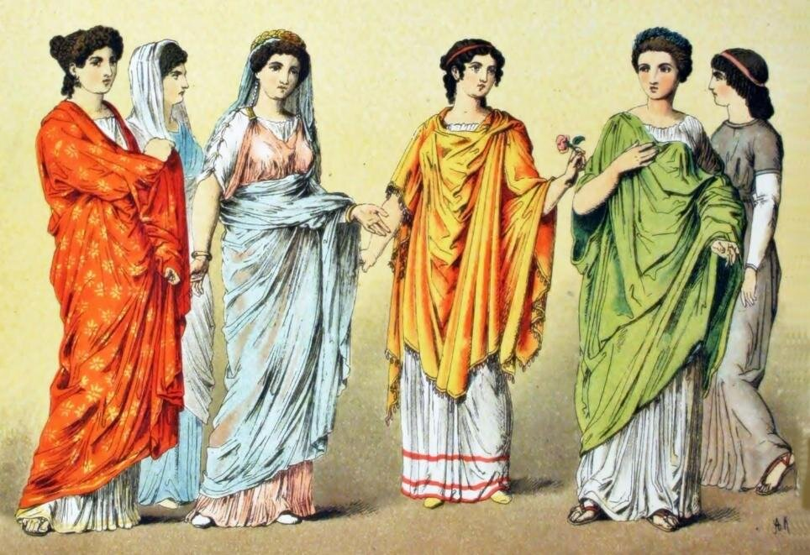
Women ministers in the NT
In the first century AD, men and women alike ministered in churches and in Christian mission. Women include:
● Apostles:
● Prophets:
● Evangelists:
● Pastors: ● Teachers:
Junia, Ro 16:7
Philip’s daughters, Ac 21:9
Euodia, Syntyche, Phil 4:2
Nympha, Col 4:15
Priscilla, Acts 18:26

Slide 15
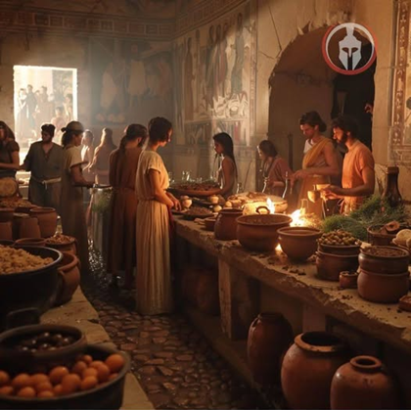
and help her in whatever she may require from you, for she has been a benefactor of many and of myself as well.
“Give, and it will be given to you” (Luke 6:38).
● Help:
● Require:
● Benefactor:
● Many:
“To put at one’s disposal.”
“Anything she needs.”
Noun form of verb ‘to help’.
Who = helpful in church?

Slide 16
To secure cooperation
“You have been faithful over a little; I will set you over much.” — Jesus (Matt. 25:21).
This three-step approach increases cooperation or compliance ten-fold!
1 Establish a mutually-agreed framework, e.g., a desirable outcome.
2 Ask for a small favor, easy to initiate.
3 Ask for a big favor, hard to implement.

Slide 17
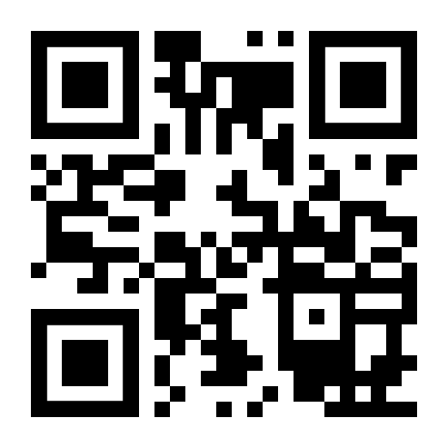
http://romans.forum

