Slide 1
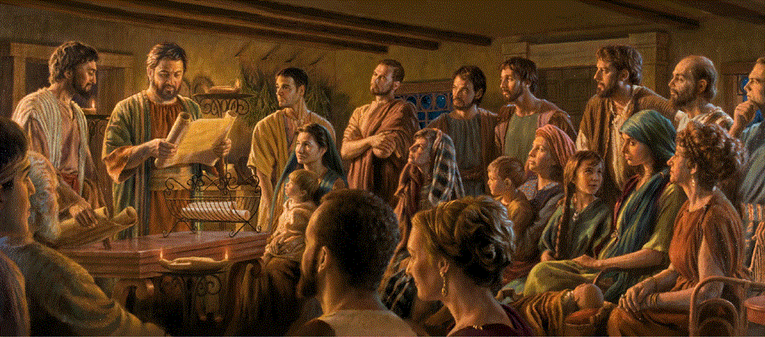
Epistle to the Romans, 16:1-27
A Short Course for Men

Slide 2
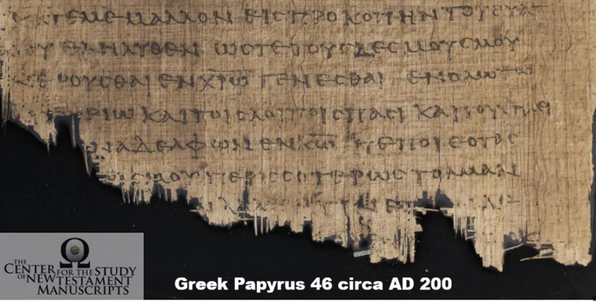
Romans chapter 16
● 1-16 and 21-23 may come from other ancient epistles, appended later.
● Verse 24 is clearly not original.
● The benediction in 25-27 occurs at different places in ancient manuscripts.
● 1-23 reveal insights into the early churches which multiplied quickly and spread across regions and cultures.

Slide 3
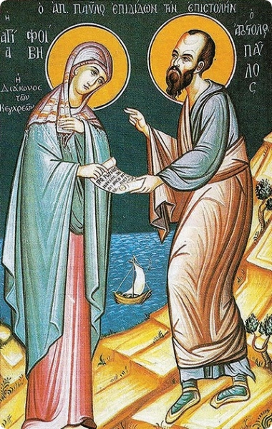
¹ I commend to you our sister Phoebe, a deacon of the church at Cenchreae,
² so that you may welcome her in the Lord, as is fitting for the saints,
“To the church of God that is in Corinth, to those sanctified in Christ Jesus, called to be saints together with all those who
in every place call upon the name of our Lord Jesus Christ”
(1 Cor 1.2)
and help her in whatever she may require from you, for she has been a benefactor of many and of myself as well.
● Cenchreae:
● Church:
Corinth city’s sea port.
‘Sister’ to other churches.

Slide 4
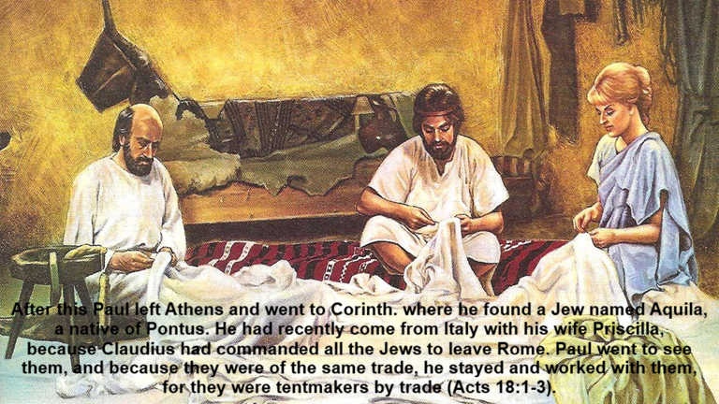
³ Greet Prisca and Aquila, my coworkers in Christ Jesus,
⁴ who risked their necks for my life, to whom not only I give thanks but also all the churches of the gentiles.
● Greet:
● Prisca and Aquila:
● Churches:
Middle voice verb.
AD 49/50 Claudius expelled Jews from Rome, till AD 54, disputes about ‘Chrestus’.
Churches that Paul planted.
“The church in their house”
(1 Cor 16.19)

Slide 5
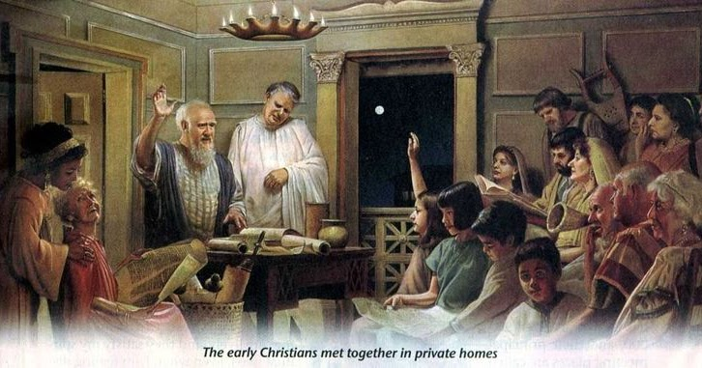
⁵ Greet also the church in their house.
Greet my beloved Epaenetus, who was the first convert in Asia for Christ.
⁶ Greet Mary, who has worked very hard for you.
● House:
● Convert:
● Asia:
● Mary:
● Work:
No separate chapels.
Lit. ‘firstfruits’; others followed.
Roman province, Ephesus.
Women were not silent.
Women planted, led churches.

Slide 6
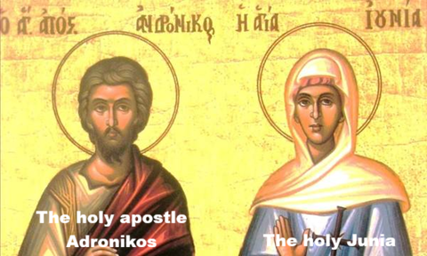
⁷ Greet Andronicus and Junia, my fellow Israelites who were in prison with me;
they are prominent among the apostles, and they were in Christ before I was.
● Junia:
● Israelite:
● Among:
● Apostle:
One 3rd cent. mss: Julian.
Lit., relatives, same stock.
Not ‘by the apostles’.
Pioneer church planters.
“Paul, Silvanus, and Timothy…
apostles of Christ”
(1 Thess 1.1, 2.6)

Slide 7
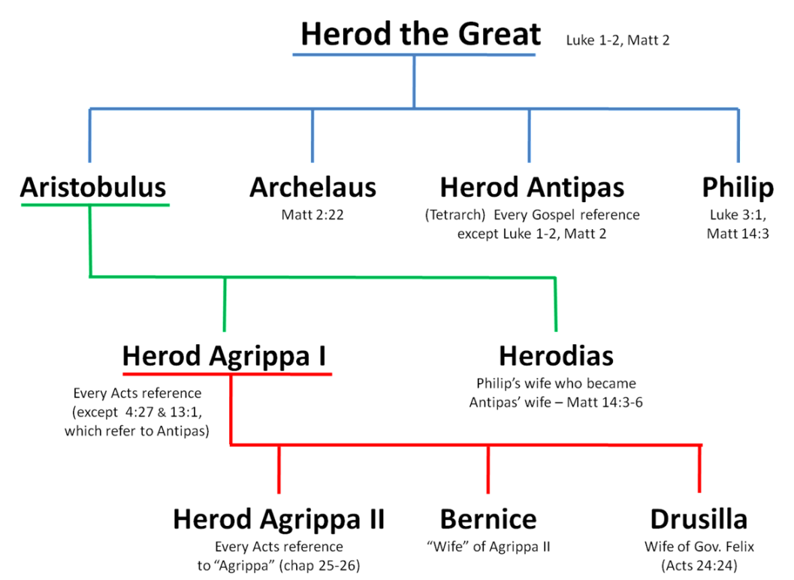
⁸ Greet Ampliatus, my beloved in the Lord.
⁹ Greet Urbanus, our coworker in Christ, and my beloved Stachys.
¹⁰ Greet Apelles, who is approved in Christ. Greet those who belong to the family of Aristobulus.
● Beloved:
● Coworker:
● Approved:
Even if not famous.
Never ranks trainees.
Implies having suffered.

Slide 8

¹¹ Greet my fellow Israelite Herodion.
Greet those in the Lord who belong to the family of Narcissus.
¹² Greet those workers in the Lord, Tryphaena and Tryphosa. Greet the beloved Persis, who has worked hard in the Lord.
● Narcissus:
● Workers:
● T. and T.:
Slave’s or freedman’s name.
God rewards good deeds.
Twins Dainty & Delicate.

Slide 9

¹³ Greet Rufus, chosen in the Lord, and greet his mother—a mother to me also.
¹⁴ Greet Asyncritus, Phlegon, Hermes, Patrobas, Hermas, and the brothers and sisters who are with them.
● Chosen:
● Mother:
● With:
Probably handicapped.
Care giver, hospitable.
Care group or house church.

Slide 10
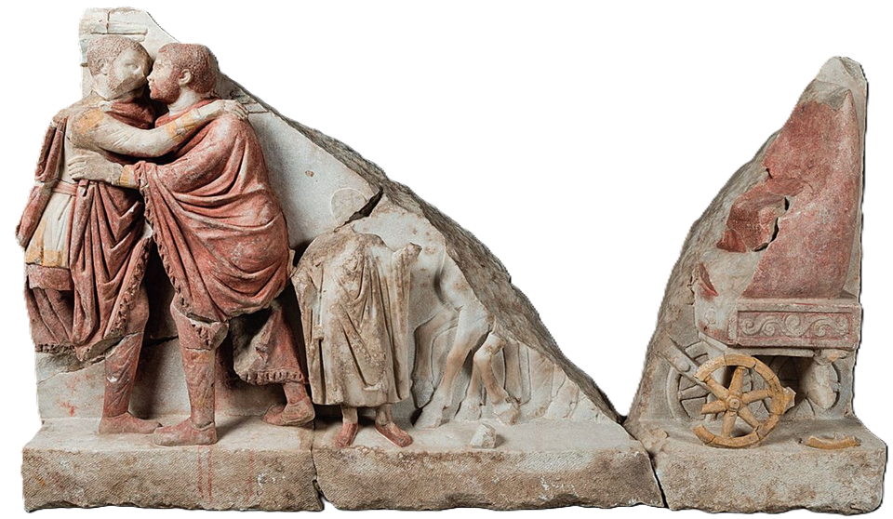
¹⁵ Greet Philologus, Julia, Nereus and his sister, and Olympas, and all the saints who are with them.
¹⁶ Greet one another with a holy kiss. All the churches of Christ greet you.
● Saints:
● Kiss:
● All:
Usual NT word for Christians.
Touch faces, not lips.
‘Both’ or several in one city.

Slide 11

Church-Planting Movements
David Garrison (2000)
Ten universal elements:
1 Leaders pray, workers learn to pray.
2 Abundant gospel sowing, non-stop.
3 Intentional church planting.
4 Scriptural authority and models.
5 Local leadership, from the start

Slide 12
6 Lay leadership, usually bi-vocational.
7 Cell or house churches.
8 Churches planting churches.
9 Rapid reproduction, before ‘mature’.
10 Healthy churches:
● Worship.
● Evangelistic or missionary outreach.
● Education and discipleship.
● Ministry.
● Fellowship.

Slide 13
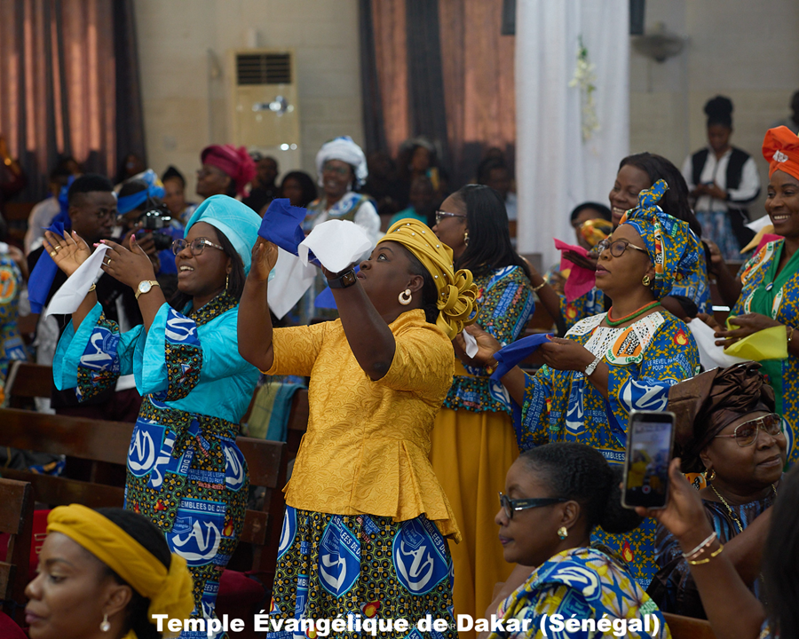
Ten common factors:
1 Worship in the heart language.
2 Evangelism has communal implications.
3 Rapid … converts into the … church.
4 Passion and fearlessness.
5 A price to pay to become a Christian.
6 Perceived … crisis … in society.
7 On-the-job training for church leadership.
8 Leadership authority is decentralized.
9 Outsiders keep a low profile.
10 Missionaries suffer.

Slide 14
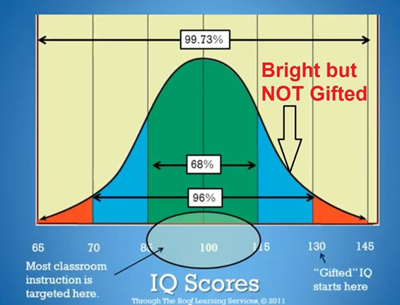
¹⁷ I urge you, brothers and sisters, to keep an eye on those who create dissen-sions and hindrances, in opposition to the teaching that you have learned; avoid them.
¹⁸ For such people do not serve our Lord Christ but their own appetites, and by smooth talk and flattery they deceive the hearts of the simple-minded.
● Teaching:
● Appetite:
Didakhé: Truth & behavior.
Organs = emotions.

Slide 15
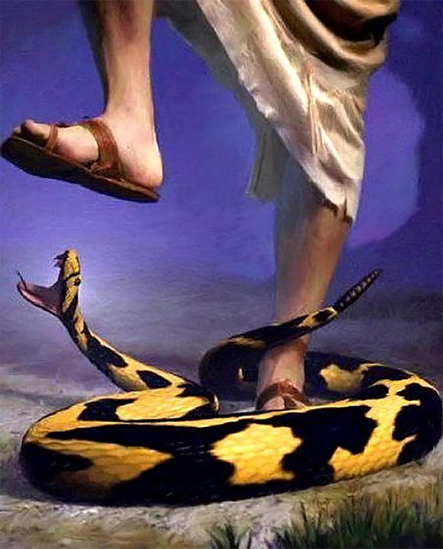
¹⁹ For your obedience is known to all; therefore, I rejoice over you, but I want you to be wise in what is good and guileless in what is evil.
²⁰ The God of peace will shortly crush Satan under your feet. The grace of our Lord Jesus Christ be with you.
“he will watch your head,
and you will watch his heel”
(Gen 3:15 LXX)
● Obedience:
● Guileless:
● Satan:
● Grace:
To Jesus’ commandments.
Unmixed with.
Gen. 3:15 in Hebrew (not LXX)
Strength to obey Jesus.

Slide 16

Doxology (16:25-27)
● Appears as 14:24-25 in the majority
of Greek NT manuscripts.
● Appears after 15:33 in the early third-century papyrus P46.
● In a few manuscripts, it appears at both places.
● It reads more like third-century Christian formula than like Paul.

Slide 17
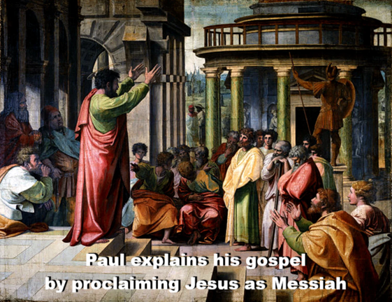
²⁵ Now to God who is able to strengthen you according to my gospel and the proclamation of Jesus Christ,
according to the revelation of the mystery that was kept secret for long ages …
“The rulers of this age … would not have crucified the Lord of glory.”
(1 Cor 2.8)
● Gospel:
● Proclamation:
● Mystery:
Paul’s writings.
Jesus’ teachings.
God incarnate in Jesus.

Slide 18

²⁶ but is now disclosed and through the prophetic writings is made known to all the gentiles, according to the command of the eternal God, to bring about the obedience of faith —
“When the Spirit of truth comes, he will guide you into all the truth”
(John 16.13)
²⁷ to the only wise God, through Jesus Christ, to whom be the glory forever! Amen.
● Writings:
● Faith:
By 2nd cent., includes the NT.
Faith in Jesus = faith in God!

Slide 19
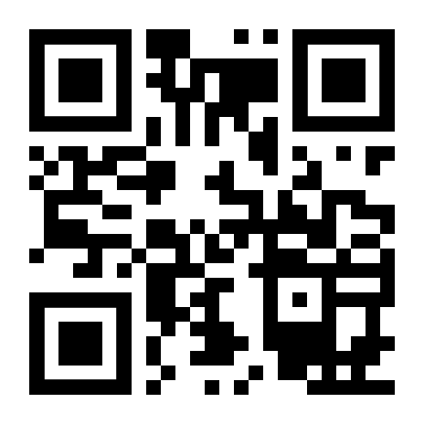
http://romans.forum

