Slide 1
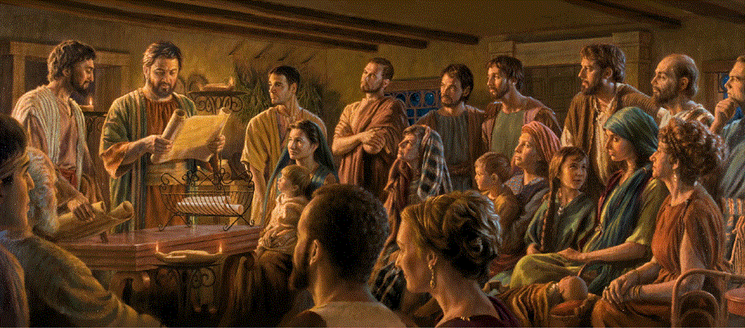
Epistle to the Romans, 8:18-30
A Short Course for Men

Slide 2
God solves Christians’ indwelling-sin problem in seven ways (Romans 8)
1 God does not condemn Christians (1-11)
2 Sin cannot require Christians to sin (12-17)
3 Christians wait patiently for a new body (18-25)
4 God’s Spirit prays for Christians (26-27)
5 God has decided to glorify Christians (26-30)
6 Christ died & intercedes for Christians (31-34)
7 Nothing separates Christians from God’s love (35-39)

Slide 3
God solves Christians’ indwelling-sin problem in seven ways (Romans 8)
1 God does not condemn Christians (1-11)
2 Sin cannot require Christians to sin (12-17)
3 Christians wait patiently for a new body (18-25)
4 God’s Spirit prays for Christians (26-27)
5 God has decided to glorify Christians (28-30)
6 Christ died & intercedes for Christians (31-34)
7 Nothing separates Christians from God’s love (35-39)

Slide 4
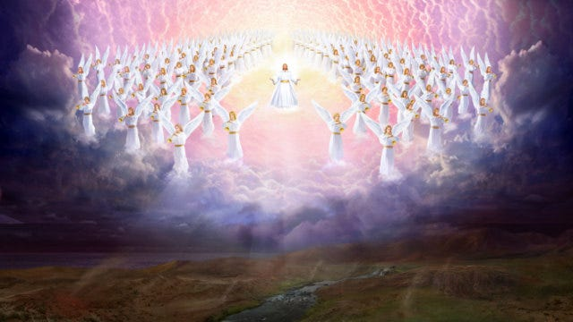
Romans 8:18-30 (NRSVue)
¹⁸ I consider that the sufferings of this present time are not worth comparing with the glory about to be revealed to us.
● Sufferings:
● Present:
● Worth:
● Glory:
● about to:
Do not discount God’s love.
The context of this chapter.
Rewards disproportionate.
‘he will glorify’ in 8:30.
Verb which indicates future.

Slide 5
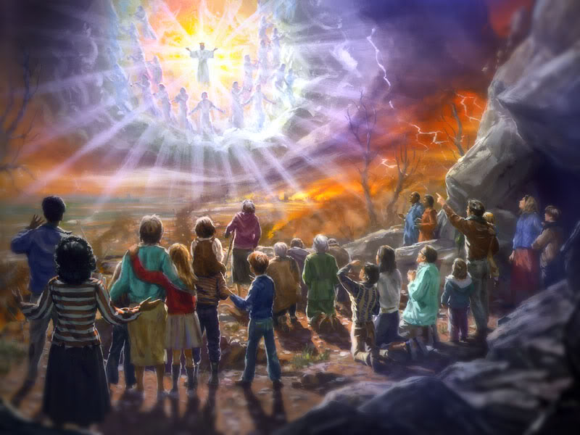
¹⁹ For the creation waits with eager longing for the revealing of the children of God,
²⁰ for the creation was subjected to futility, not of its own will, but by the will of the one who subjected it, …
● Creation:
● Revealing:
● Futility:
● Subjected:
To be made a new creation.
Replacing the fallen ones.
At the Satan-Adam fall.
No perfect governance.

Slide 6

… in hope ²¹ that the creation itself will be set free from its enslavement
to decay and will obtain the freedom
of the glory of the children of God.
● Free:
● Decay:
● Glory:
● Children:
New creation yet to come.
All (known) life forms die.
Risen, ruling, and righteous.
Born again and adopted.

Slide 7
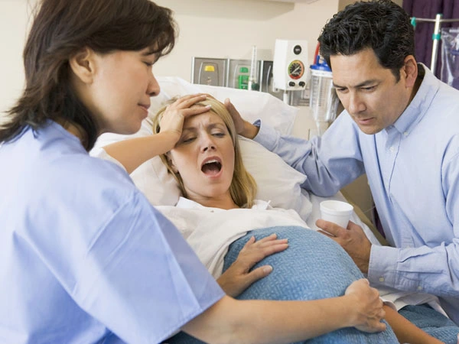
²² We know that the whole creation has been groaning together as it suffers together the pains of labor,
²³ and not only the creation, but we ourselves, who have the first fruits of the Spirit, groan inwardly while we wait for adoption, the redemption of our bodies.
● Adoption:
● Redemption:
Publicly displayed.
Made immortal, like Jesus.

Slide 8
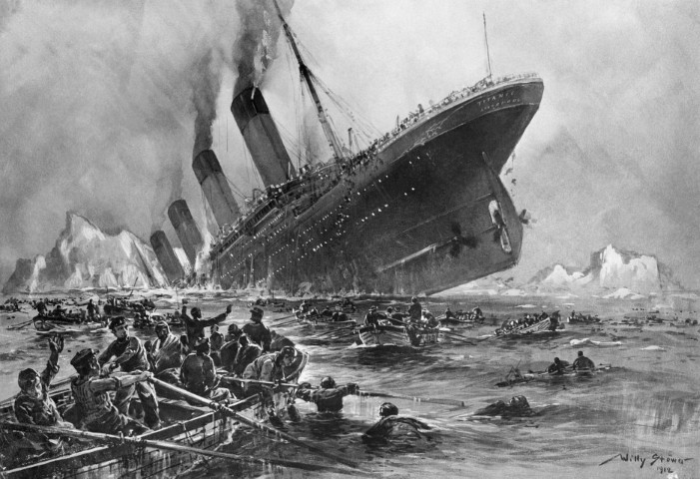
²⁴ For in hope we were saved. Now hope that is seen is not hope, for who hopes for what one already sees?
²⁵ But if we hope for what we do not see, we wait for it with patience.
● Hope:
● Seen:
● Wait:
● Patience:
Confident expectation.
“Is this all we get?”
Eagerly.
Endure ‘under’ difficulties.

Slide 9
God solves Christians’ indwelling-sin problem in seven ways (Romans 8)
1 God does not condemn Christians (1-11)
2 Sin cannot require Christians to sin (12-17)
3 Christians wait patiently for a new body (18-25)
4 God’s Spirit prays for Christians (26-27)
5 God has decided to glorify Christians (28-30)
6 Christ died & intercedes for Christians (31-34)
7 Nothing separates Christians from God’s love (35-39)

Slide 10

²⁶ Likewise the Spirit helps us in our weakness, for we do not know how
to pray as we ought,
but that very Spirit intercedes with groanings too deep for words.
● Spirit:
● Weakness:
● Intercede:
● Groaning:
Ministry by the Holy Spirit
Easily tempted, discouraged.
Asking the Father for help.
More felt than thought.

Slide 11
²⁷ And God, who searches hearts, knows what is the mind of the Spirit,
because the Spirit intercedes for the saints according to the will of God.
● Searches:
● Mind:
● Intercede:
● Will:
Enjoys intimacy with us.
The Holy Spirit thinks!
Asks the Father for help.
He wants us to remain joyful.

Slide 12
God solves Christians’ indwelling-sin problem in seven ways (Romans 8)
1 God does not condemn Christians (1-11)
2 Sin cannot require Christians to sin (12-17)
3 Christians wait patiently for a new body (18-25)
4 God’s Spirit prays for Christians (26-27)
5 God has decided to glorify Christians (28-30)
6 Christ died & intercedes for Christians (31-34)
7 Nothing separates Christians from God’s love (35-39)

Slide 13
²⁸ We know that all things work together for good for those who love God,
who are called according to his purpose.
● All:
● Good:
● Those:
● Called:
● Purpose:
All which things?
Good what?
As a group or as individuals?
To what?
What purpose?

Slide 14
²⁹ For those whom he foreknew he also predestined to be conformed to the image of his Son,
in order that he might be the firstborn within a large family.
● Foreknow:
● Predestine:
● Image:
● Firstborn:
● Family:
Before when?
Pre-when?
We are his image-bearers.
Superior in rank.
Holy angels, saved humans.

Slide 15
³⁰ And those whom he predestined
he also called, and those whom he called he also justified, and those whom he
justified he also glorified.
● Verbs:
● Order:
● Justify:
● Glorify:
Timeless aorist tenses.
Logical or chronological?
Acquit, declare innocent.
Future bodies like Jesus’ body.

Slide 16
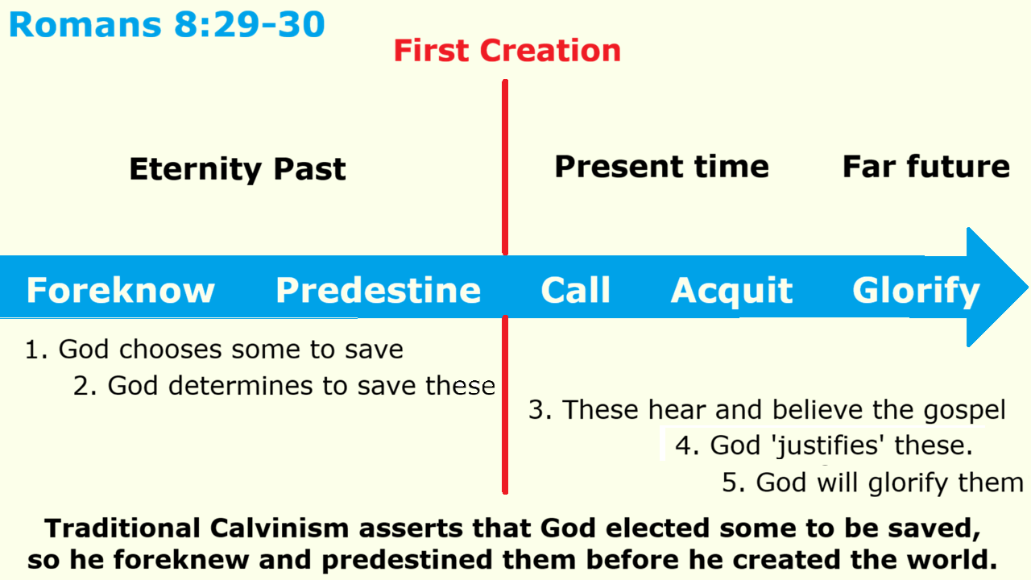

Slide 17
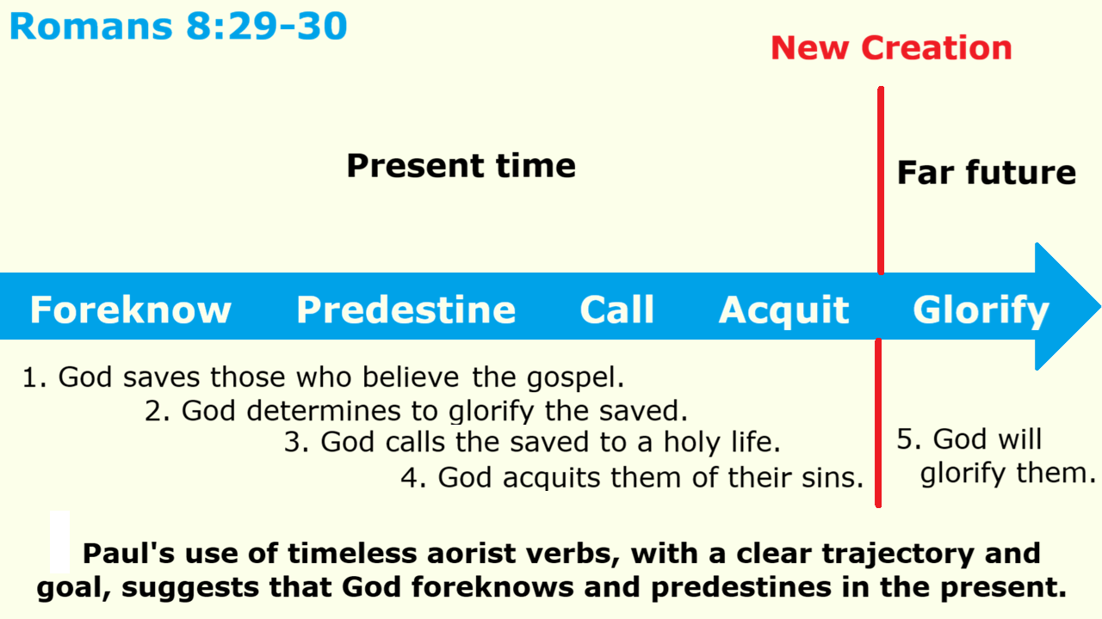

Slide 18
Soteriological definitions
● Foreknow: to acknowledge as saved.
● Predestine: to ensure eternal life.
● Call: to invite into a new life on earth.
● Acquit: to declare believers forgiven.
● Glorify: to resurrect in the Kingdom.
Whether one adopts a Calvinist view or another view, the implication remains the same:
It is God who ensures our everlasting glory despite our failures and tribulations!

Slide 19
God solves Christians’ indwelling-sin problem in seven ways (Romans 8)
1 God does not condemn Christians (1-11)
2 Sin cannot require Christians to sin (12-17)
3 Christians wait patiently for a new body (18-25)
4 God’s Spirit prays for Christians (26-27)
5 God has decided to glorify Christians (28-30)
6 Christ died & intercedes for Christians (31-34)
7 Nothing separates Christians from God’s love (35-39)

Slide 20
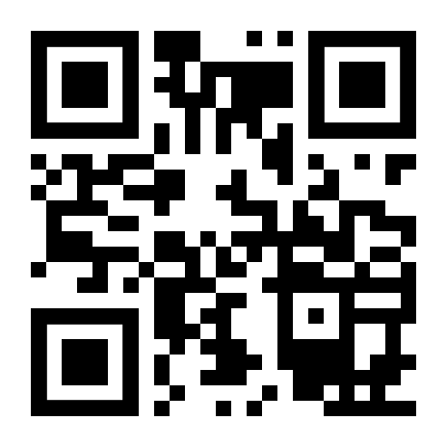
http://romans.forum

