Slide 1
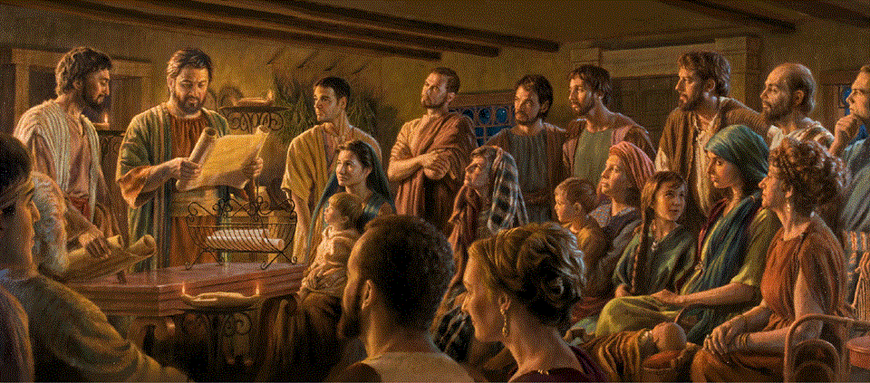
Epistle to the Romans, 8:31-39
A Short Course for Men

Slide 2
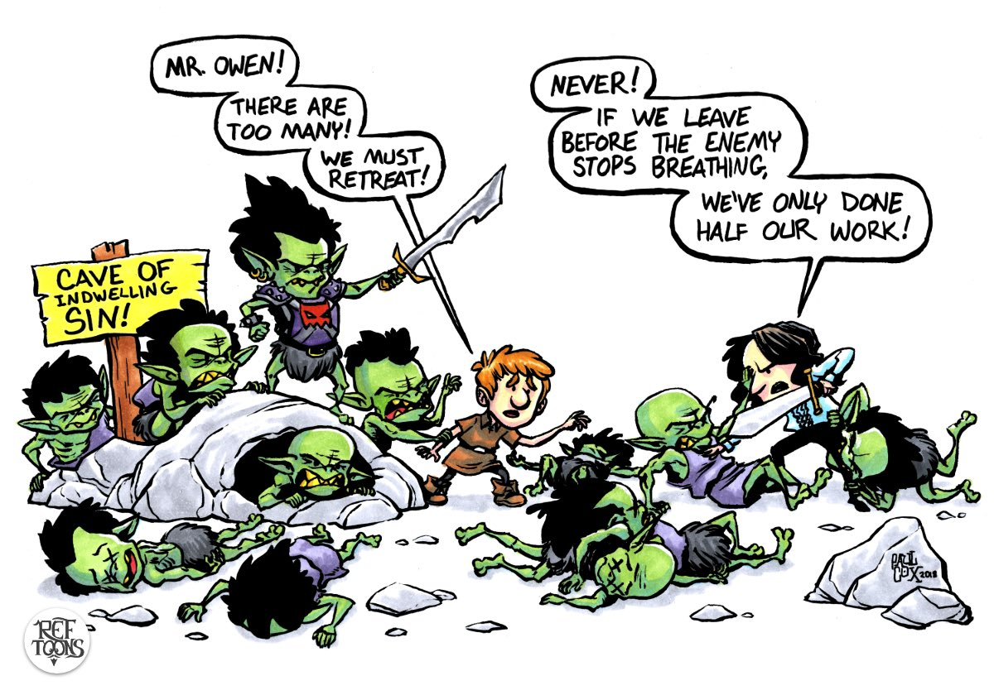
God solves Christians’ indwelling-sin problem in seven ways (Romans 8)
1 God does not condemn Christians (1-11)
2 Sin cannot require Christians to sin (12-17)
3 Christians wait patiently for a new body (18-25)
4 God’s Spirit prays for Christians (26-27)
5 God has decided to glorify Christians (28-30)
6 Christ died & intercedes for Christians (31-34)
7 Nothing separates Christians from God’s love (35-39)

Slide 3
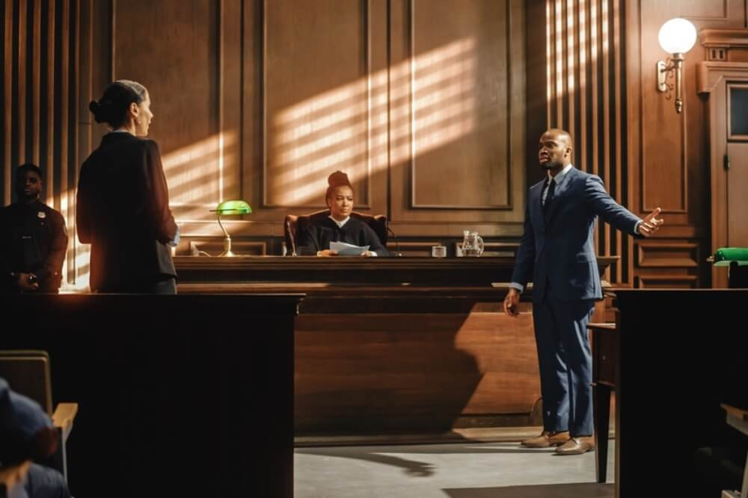
Conclusion
³¹ What, then, shall we say in response to these things?
If God is for us, who can be against us?
● Things:
● If God:
● For us:
● Prosecution:
“Predestined to glory.”
1st class condition: Since.
Hyper. The defense.
Kata. The prosecution.

Slide 4
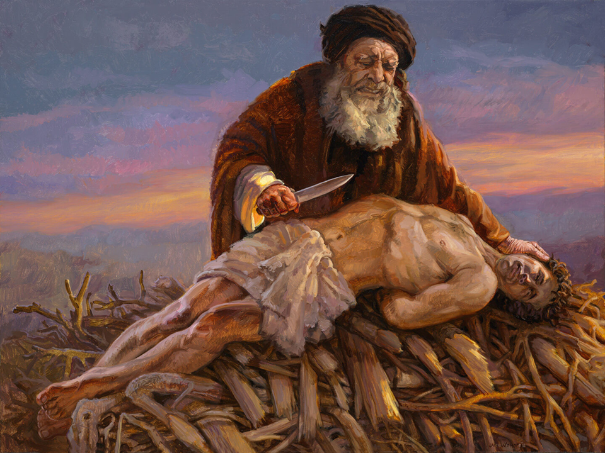
³² He who did not spare his own Son,
but gave him up for us all—how will he not also, along with him, graciously give us all things?
● Gave:
● For us all:
● Give:
● All things:
To the devil? To humans?
Hyper. Humans? Elect only?
“To grace” To favor, acquit.
All which things? Charges?

Slide 5
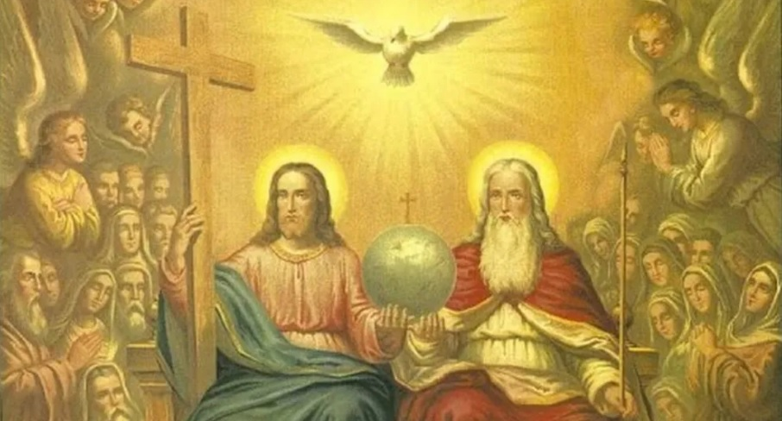
³³ Who will bring any charge against those whom God has chosen?
It is God who justifies.
● Who:
● Chosen:
● Justifies:
Devil. Government. Pope. Sultan. Theology. Neighbor.
Joined to The Chosen One.
Called ➔ chosen ➔ faithful.
Legal acquittal.

Slide 6
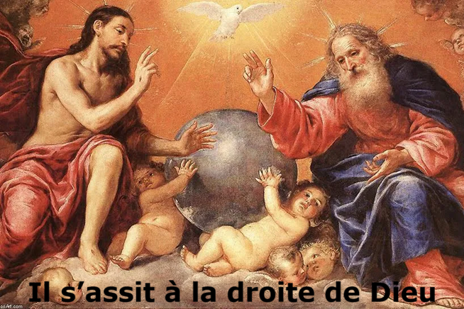
³⁴ Who is to condemn? It is Christ Jesus who died — more than that, who was raised to life — is at the right hand of God and is also interceding for us.
● Died:
● Raised:
● Right:
● Intercede:
Substitute. Carried our sins.
Victorious over our death.
Supreme authority.
Pleads our cause.

Slide 7
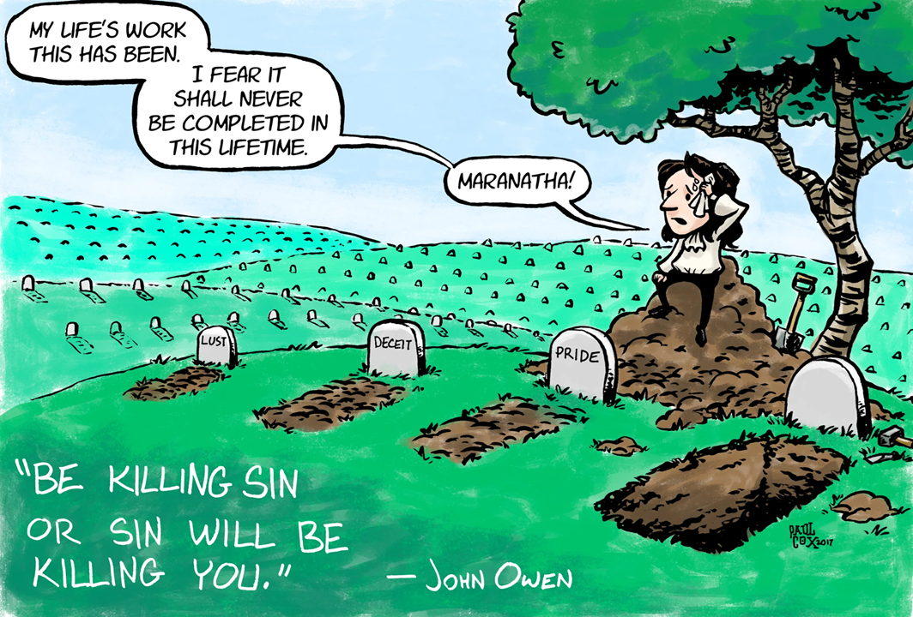
God solves Christians’ indwelling-sin problem in seven ways (Romans 8)
1 God does not condemn Christians (1-11)
2 Sin cannot require Christians to sin (12-17)
3 Christians wait patiently for a new body (18-25)
4 God’s Spirit prays for Christians (26-27)
5 God has decided to glorify Christians (28-30)
6 Christ died & intercedes for Christians (31-34)
7 Nothing separates Christians from God’s love (35-39)

Slide 8
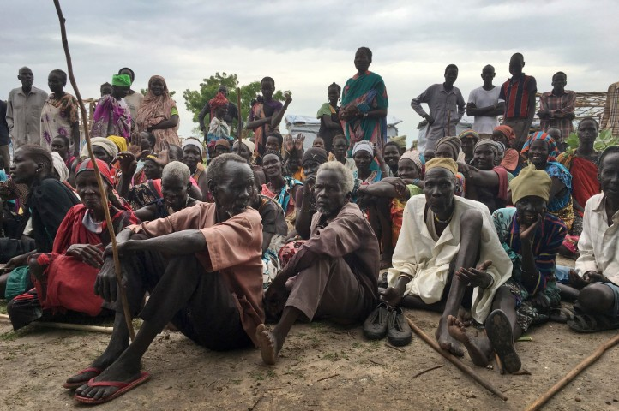
³⁵ Who shall separate us from the love of Christ? Shall trouble or hardship or persecution or famine or nakedness or danger or sword?
³⁶ As it is written:
“For your sake we face death all day long; we are considered as sheep to be slaughtered.” [Psalm 44:22]
● Who:
● Shall:
Masc. pron. = living creature.
Causes of physical death.

Slide 9
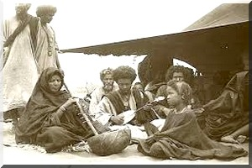
Psalm 44
National Lament and Prayer for Help
Our ancestor’s victories (1-3)
¹ We have heard with our ears, O God;
our ancestors have told us
what deeds you performed in their days,
in the days of old: …

Slide 10
² you with your own hand drove out the nations, but them you planted;
you afflicted the peoples,
but them you set free;
³ for not by their own sword did they win the land,
nor did their own arm give them victory,
but your right hand, and your arm,
and the light of your countenance,
for you delighted in them.
● They, them:
Ancestors.

Slide 11
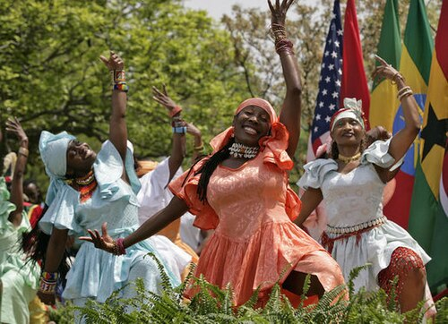
Our past victories (4-8)
⁴ You are my King and my God;
you command victories for Jacob.
⁵ Through you we push down our foes;
through your name we tread down our assailants.
⁶ For not in my bow do I trust,
nor can my sword save me.
⁷ But you have saved us from our foes
and have put to confusion those who hate us.

Slide 12
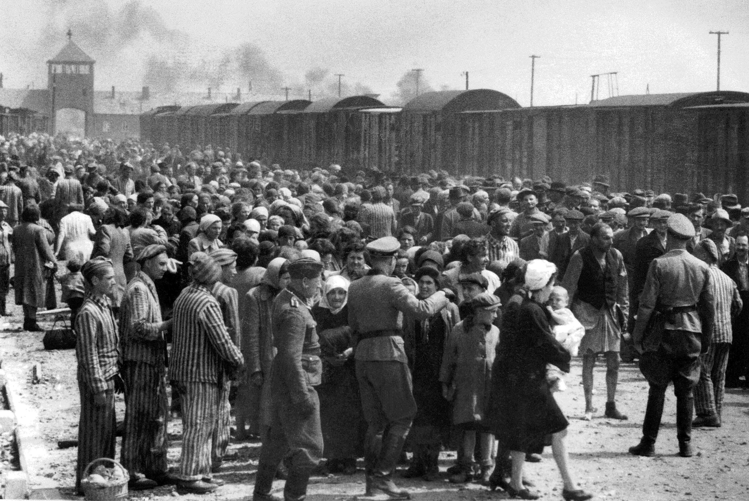
⁸ In God we have boasted continually,
and we will give thanks to your name forever.
Selah
Our present woes (9-16)
⁹ Yet you have rejected us and shamed us
and have not gone out with our armies.
¹⁰ You made us turn back from the foe,
and our enemies have gotten spoil.
¹¹ You have made us like sheep for slaughter
and have scattered us among the nations.

Slide 13
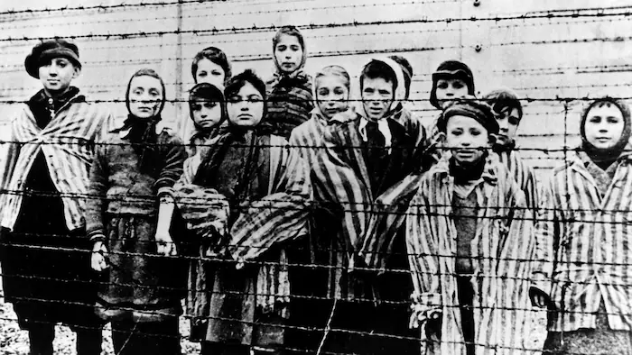
¹⁴ You have made us a byword among
the nations,
a laughingstock among the peoples.
¹⁵ All day long my disgrace is before me,
and shame has covered my face
¹⁶ at the words of the taunters and revilers,
at the sight of the enemy and the avenger.
● Revilers: ● Enemies:
“Imaginary sky fairy.”
E.g., Islamic State.

Slide 14

Our present faithfulness (17-22)
¹⁷ All this has come upon us,
yet we have not forgotten you
or been false to your covenant.
¹⁸ Our heart has not turned back,
nor have our steps departed from your way,
¹⁹ yet you have broken us in the haunt of jackals
and covered us with deep darkness.
● False:
● Heart/steps:
Unfaithful.
Disbelieving, disobedient.

Slide 15
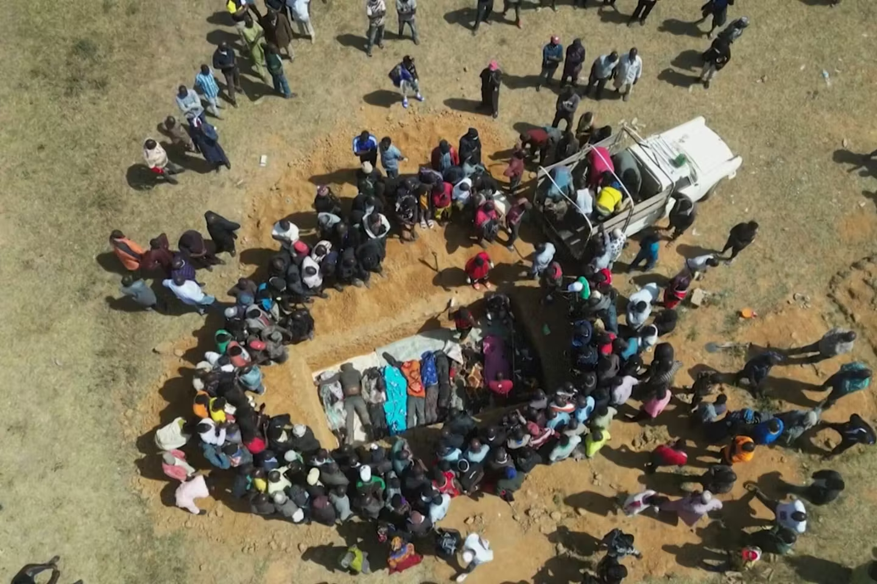
²⁰ If we had forgotten the name of our God
or spread out our hands to a strange god,
²¹ would not God discover this?
For he knows the secrets of the heart.
²² Because of you we are being killed
all day long
and accounted as sheep for the slaughter.
[Romans 8:36]
● Name:
● Strange:
OT: Yahweh; NT: Jesus Christ.
Convert to another religion.

Slide 16
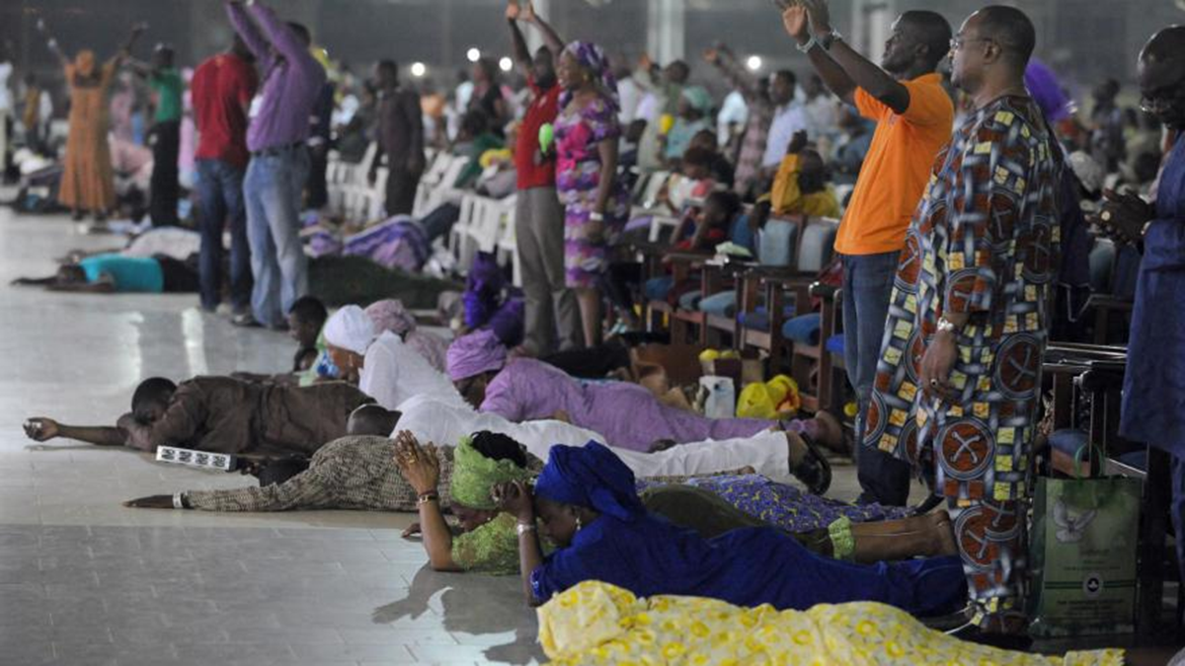
Our present prayer (23-26)
²³ Rouse yourself! Why do you sleep, O Lord?
Awake, do not cast us off forever!
²⁴ Why do you hide your face?
Why do you forget our affliction and oppression?
²⁵ For we sink down to the dust;
our bodies cling to the ground.
²⁶ Rise up, come to our help.
Redeem us for the sake of your steadfast love.

Slide 17
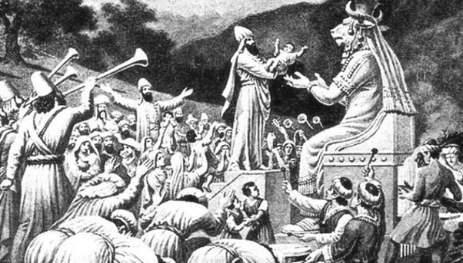
Causes of ‘lost salvation’
Psalm 44
● To forget Yahweh (17)
● To be false to his covenant (17)
● To turn back (18)
● To depart from his ways (18)
● To forget the name of our God (20)
● To spread our hands to a foreign god (20)

Slide 18
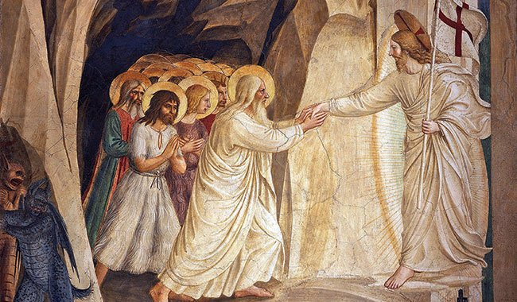
³⁵ Who shall separate us from the love of Christ? Shall trouble or hardship or persecution…?
³⁷ No, in all these things we are more than victorious through him who loved us.
● More than:
● Victorious:
● Loved:
Acquitted + glorified.
No guilt, fear, shame, hell.
Aorist tense = ‘loves us’!

Slide 19
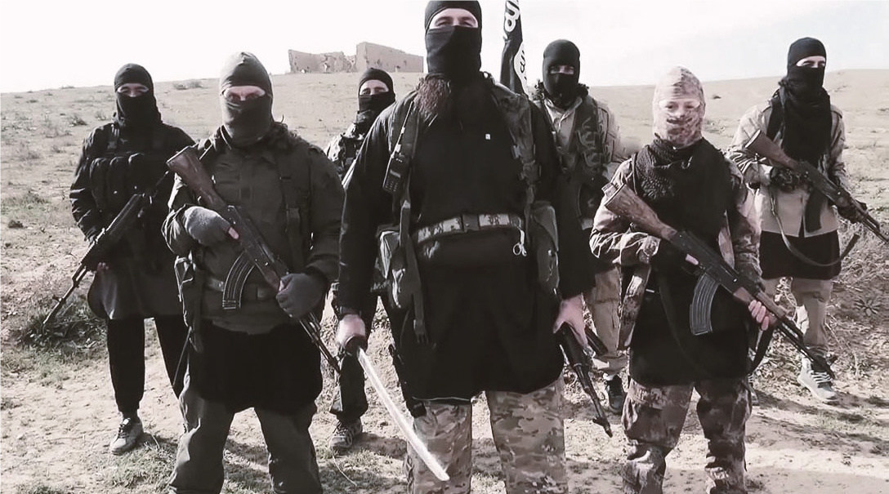
³⁸ For I am convinced that neither death, nor life, nor angels, nor rulers,
nor things present, nor things to come, nor powers,
³⁹ nor height, nor depth,
nor anything else in all creation will be able to separate us from the love of God in Christ Jesus our Lord.
● Anything:
● Separate:
Ktisis = created thing.
The only love that counts!

Slide 20
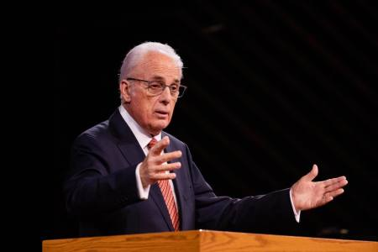
Views on ‘eternal security’
● Calvinism: ‘Perseverance of the saints’.
● Catholicism: May be excommunicated.
● Arminianism: Deny Christ and be lost.
● Religions: Earn your way to Heaven.
● Atheism: No one is saved or lost.
● Psychology: Rational, emotional.
● Scripture: Remain faithful to Jesus
to the end ➔ eternal salvation.

Slide 21
The only requirement
to obtain salvation
is the only requirement
to retain salvation.
“Be faithful unto death, and I will give you the crown of life.”—Jesus

Slide 22
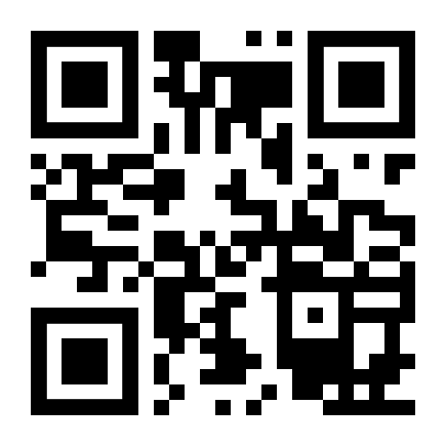
http://romans.forum

