Slide 1
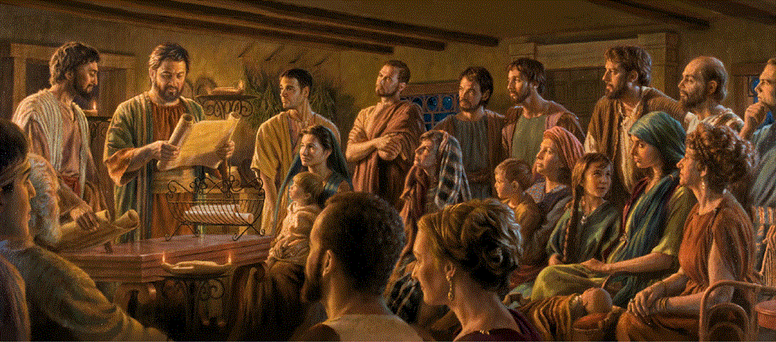
Epistle to the Romans, 9:1-18
A Short Course for Men

Slide 2
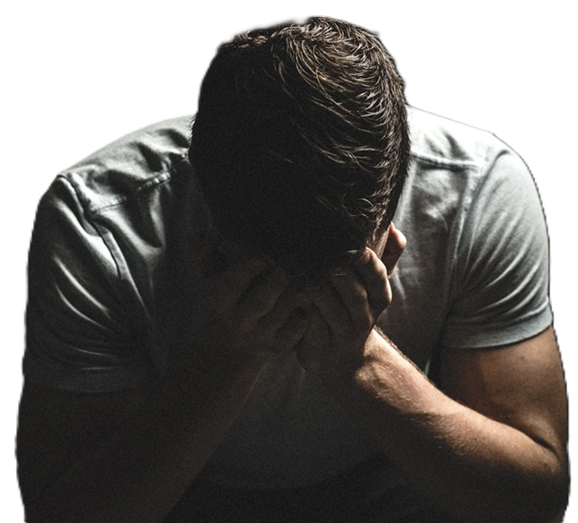
Romans 9:1-18 (NRSVue, 2021)
¹ I am speaking the truth in Christ — I am not lying; my conscience confirms it by the Holy Spirit—
² I have great sorrow and unceasing anguish in my heart.
● In Christ:
● Conscience:
● Confirms:
● In Holy Spirit:
As a Christian.
Personal integrity.
‘Co-witnessing’.
Apostolic insight.

Slide 3
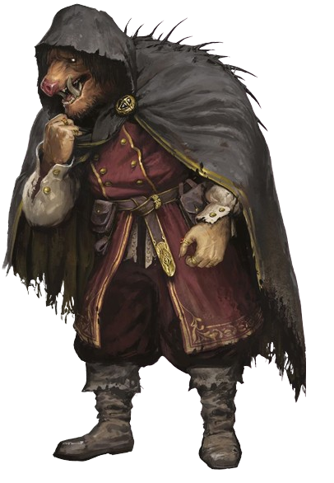
³ For I could wish that I myself were accursed and cut off from Christ for the sake of my own brothers and sisters, my own flesh and blood.
⁴ They are Israelites
● Wish:
● Accursed:
● For:
● Israelites:
Imperfect middle. Unreal.
Anathema.
Would do them no good.
People, not the nation.

Slide 4
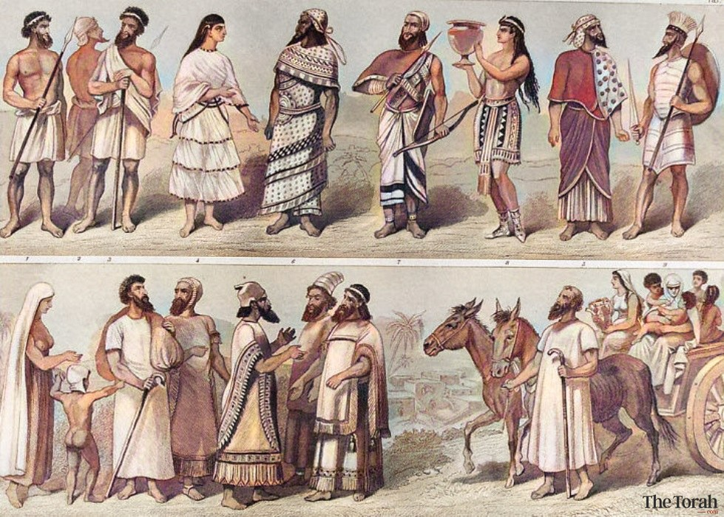
⁴ They are Israelites, and to them belong the adoption, the glory, the covenants, the giving of the law, the worship, and the promises;
⁵ to them belong the patriarchs, and from them, according to the flesh, comes the Christ, who is over all, God blessed forever. Amen.
● Belong:
● God:
Lit., ‘of them (are) …’
Alt., ‘… all. God be blessed…!’

Slide 5
⁵ “… the Christ, who is over all, God blessed forever.”
⁵ ὁ Χριστὸς … ὁ ὢν ἐπὶ πάντων θεὸς εὐλογητὸς εἰς τοὺς αἰῶνας.
the Christ … the being over all God blessed unto the ages.
The Christ (subject) … being … [no article] God (predicate nominative).

Slide 6
Jesus Christ = God?
Rom. 9:5. “the Christ, who is over all, God blessed forever.”
Titus 2:13. “the manifestation of the glory of our great God and Savior, Jesus Christ.
2 Pet. 1:1. “the righteousness of our God and Savior Jesus Christ.”

Slide 7
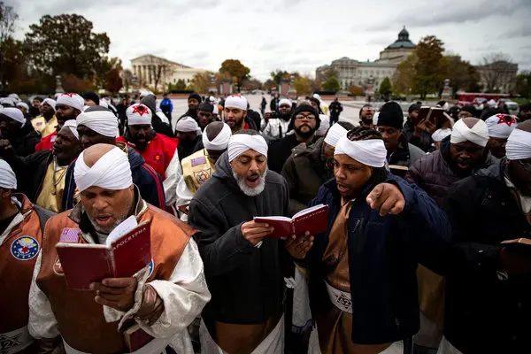
‘Israel’ gave to the world…
1 Adoption (including ‘all nations’)
2 God’s glory (past and coming).
3 Covenants (→ times and epochs).
4 Law (=commands, Torah, Tanakh).
5 Worship (via atoning sacrifices).
6 Promises (material, spiritual, everlasting).
7 Patriarchs (ethnic continuity).
8 The Messiah (atonement & kingdom).

Slide 8
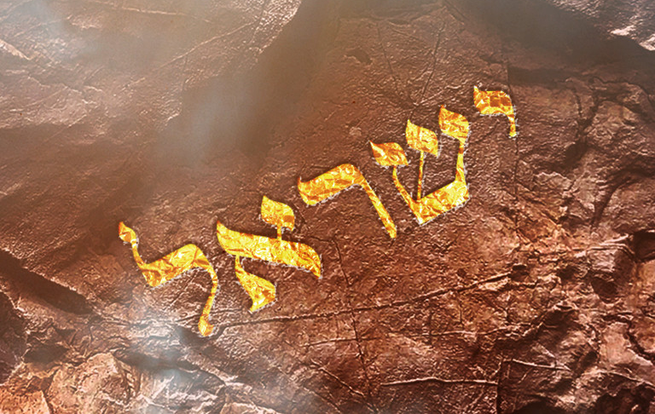
Meaning of ‘Israel’
● Nominal: Jacob’s second name.
● Historical: Jacob’s descendants.
● Ethnic: 12 federated tribes.
● National: Land, king and population.
● Religious: God, Law, temple, traditions.
● Spiritual: Jewish & Gentile Christians.
● Zionist: Political-military state.

Slide 9
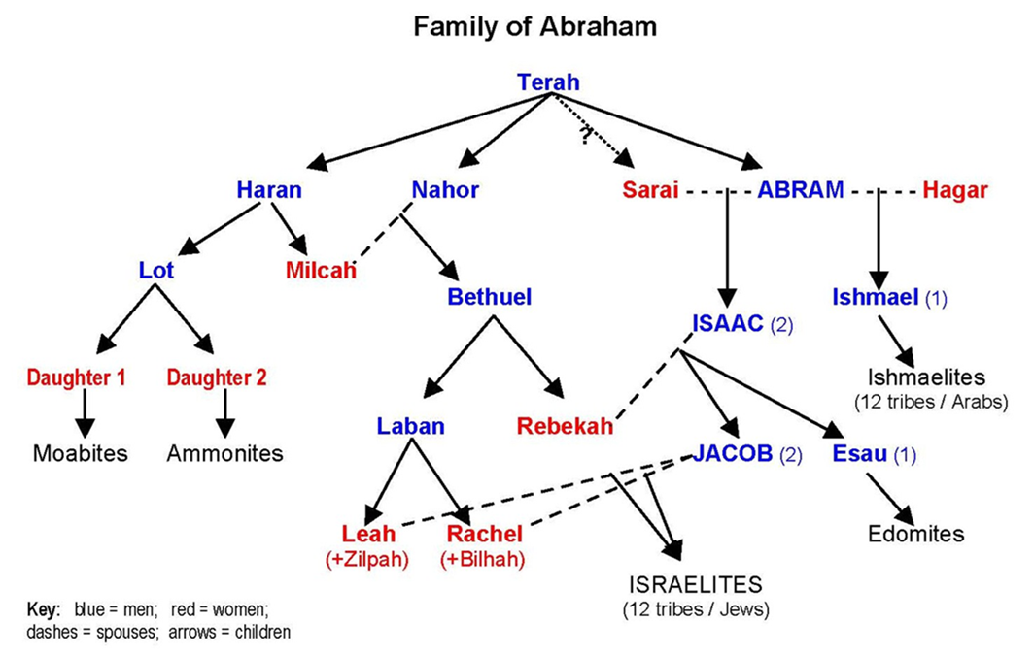
⁶ It is not as though the word of God has failed. For not all those descended from Israel are Israelites,
⁷ and not all of Abraham’s children are his descendants, but “it is through Isaac that descendants shall be named for you.” [Gen. 21:12]
● Israel:
● Not all:
● Named:
Jacob’s second name.
Ishmael and Esau disinherited.
Lit., ‘called’.

Slide 10
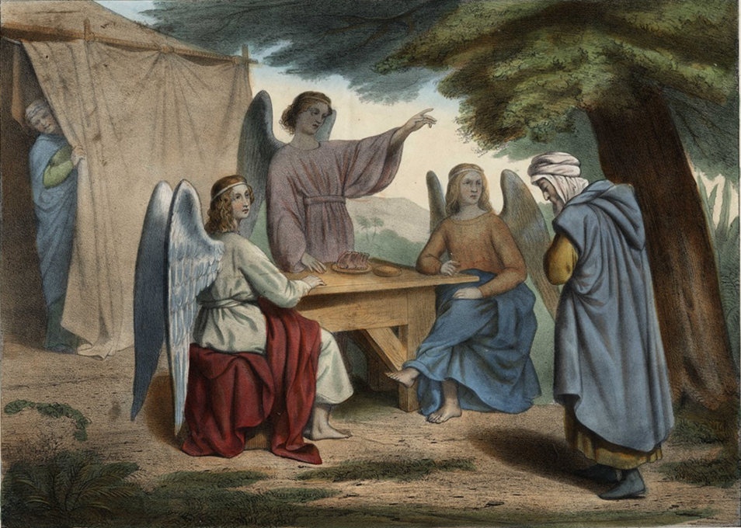
⁸ This means that it is not the children of the flesh who are the children of God, but the children of the promise are counted as descendants.
⁹ For the word of the promise is this: “About this time I will return, and Sarah shall have a son.”
● Flesh:
● Promise:
● Sarah:
Natural birth.
Designated by God!
Genesis 18:14.

Slide 11
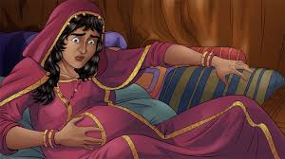
¹⁰ Nor is that all; something similar happened to Rebecca when she had conceived children by one husband, our ancestor Isaac:
¹¹ even before they had been born or had done anything good or bad (so that God’s purpose of election might continue,
¹² not by works but by his call) she was told, “The elder shall serve the younger.”

Slide 12
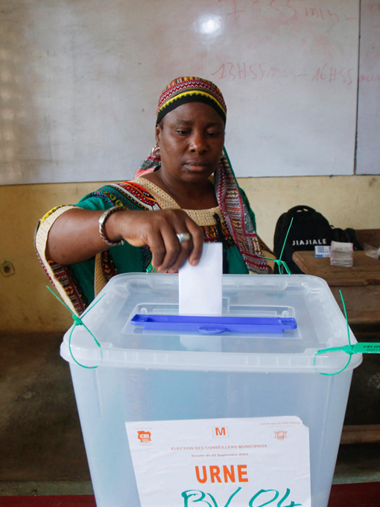
Election
● This was not for personal salvation.
● This was God choosing a descendant.
● God elected Jacob as Isaac’s heir.
● Election is not based on performance.
● God ‘elected’ Israel, yet many Israelites disbelieved, disobeyed and were lost.
● So, election does not ensure personal salvation.

Slide 13
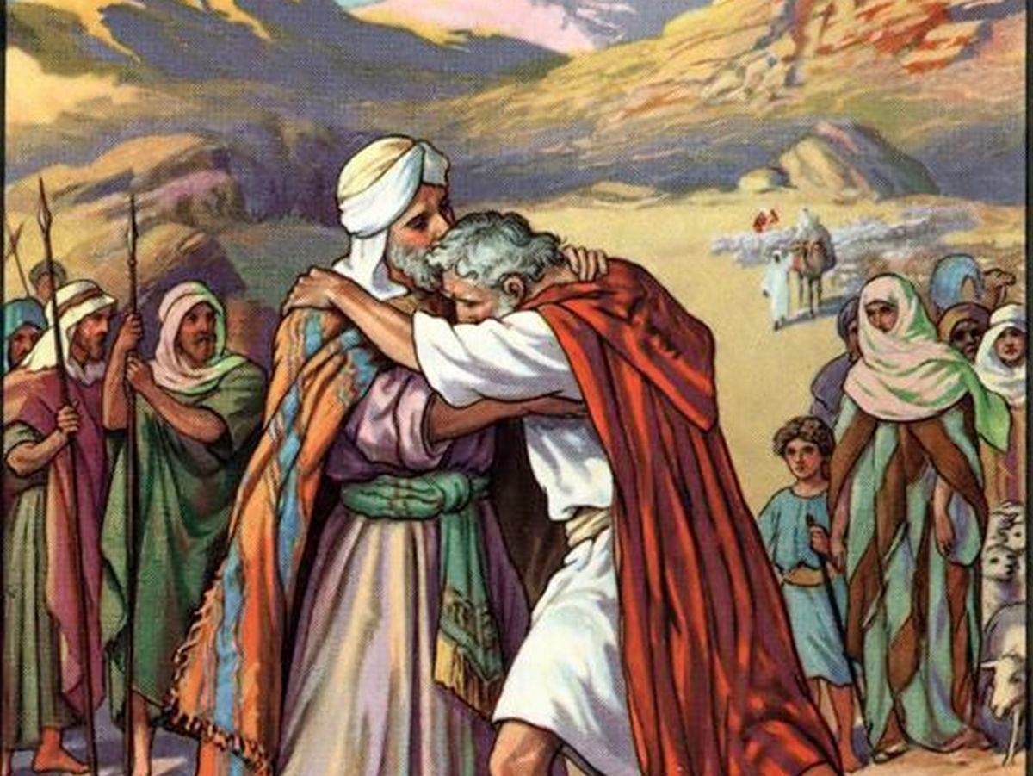
¹³ As it is written, “I have loved Jacob, but I have hated Esau.”
¹⁴ What then are we to say? Is there injustice on God’s part?
● Loved:
● Hated:
● Injustice:
Sovereign choice.
Sovereign rejection.
Was Jacob better than Esau?

Slide 14
By no means! ¹⁵ For he says to Moses, “I will have mercy on whom I have mercy,
and I will have compassion on whom I have compassion.”
¹⁶ So it depends not on human will or exertion but on God who shows mercy.
● I will:
● Mercy:
Sovereign choice.
Not a reward. Exodus 33:19b.

Slide 15
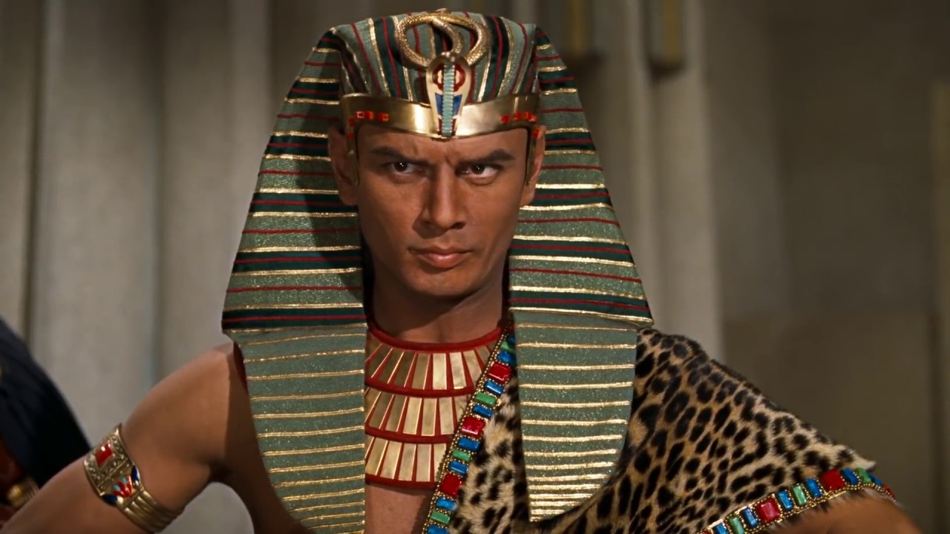
¹⁷ For the scripture says to Pharaoh, “I have raised you up for this very purpose, that I may show my power in you and that my name may be proclaimed in all the earth.”
¹⁸ So then he has mercy on whomever he chooses, and he hardens the heart of whomever he chooses.
● Chooses:
Not human effort or legalism.

Slide 16
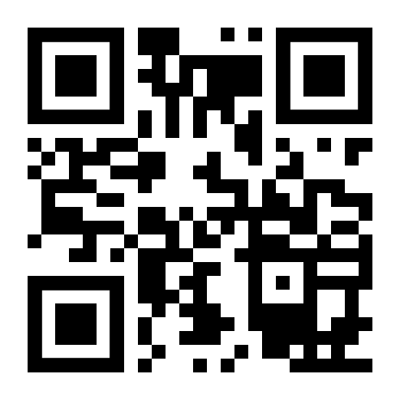
http://romans.forum

