Slide 1
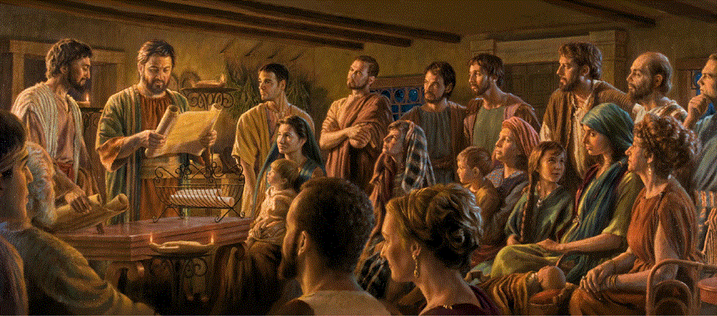
Romans 9:19-33
A Short Course for Men

Slide 2
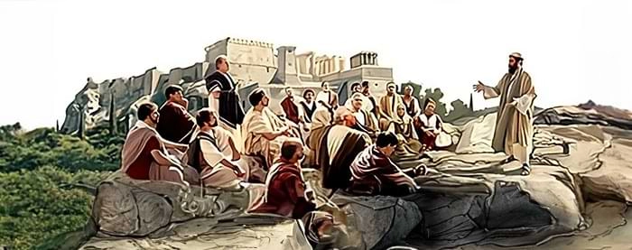
God’s sovereign purpose (9:19-33)
A. Recompense (19-23)
Wrath & Mercy
Patience & preparation
B. Reversal (24-29)
Israel & Gentiles
Israel & remnant
C. Righteousness (30-33)
By faith or by works

Slide 3
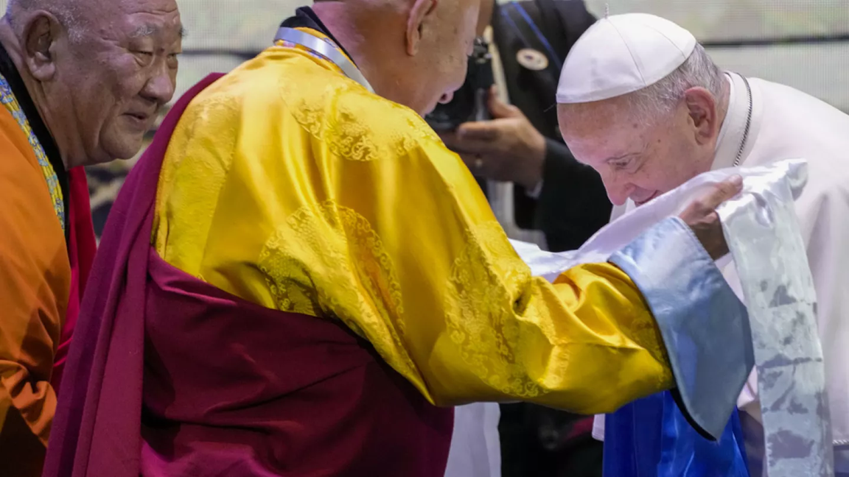
Components of human religions
● Cosmology: origins and history which explain visible reality.
● Beliefs: supernatural entities & forces which control or disrupt daily life.
● Behavior: social & personal rules which maintain social harmony.
● Rituals: supervised by effective shamans or by qualified clerics.

Slide 4
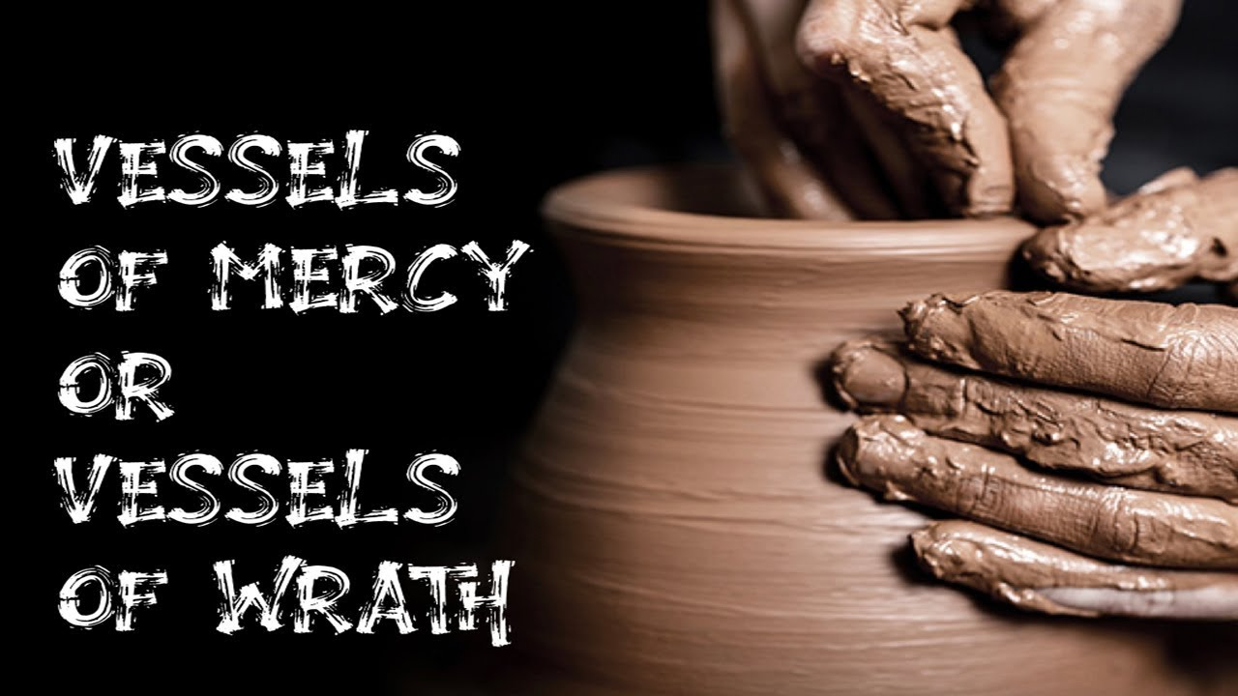
God’s sovereign purpose (9:19-33)
A. Recompense (19-23)
Wrath & Mercy
Patience & preparation
B. Reversal (24-29)
Israel & Gentiles
Israel & remnant
C. Righteousness (30-33)
By faith or by works

Slide 5

Romans 9 (NRSVue, 2021)
¹⁸ So then he has mercy on whomever he chooses, and he hardens the heart of whomever he chooses.
¹⁹ You will say to me then, “Why then does he still find fault? For who can resist his will?”
● Resist:
● Will:
To oppose power || Eph. 6:13.
bouléma, intention, purpose.

Slide 6
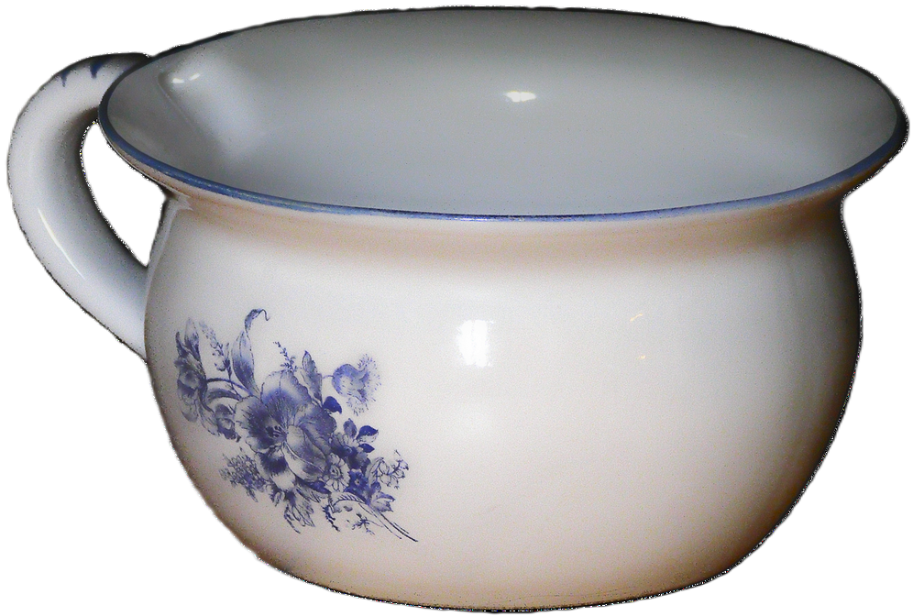
²⁰ But who indeed are you, a human, to argue with God? Will what is molded say to the one who molds it, “Why have you made me like this?”
²¹ Has the potter no right over the clay, to make out of the same lump one object for special use and another for ordinary use?
● Argue:
● Potter:
‘against-from-judge’
Yahweh, Isa. 29:16; 64:8

Slide 7
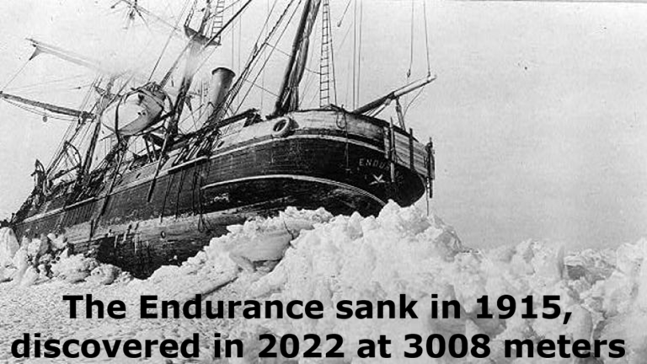
²² What if God, desiring to show his wrath and to make known his power, has endured with much patience the objects of wrath that are made for destruction, …
● Desire:
● Wrath:
● Power:
● Endure:
● Destruction:
Sovereign will
Moral judgement
Able to inflict justice
Long-term plan
Creative purpose

Slide 8
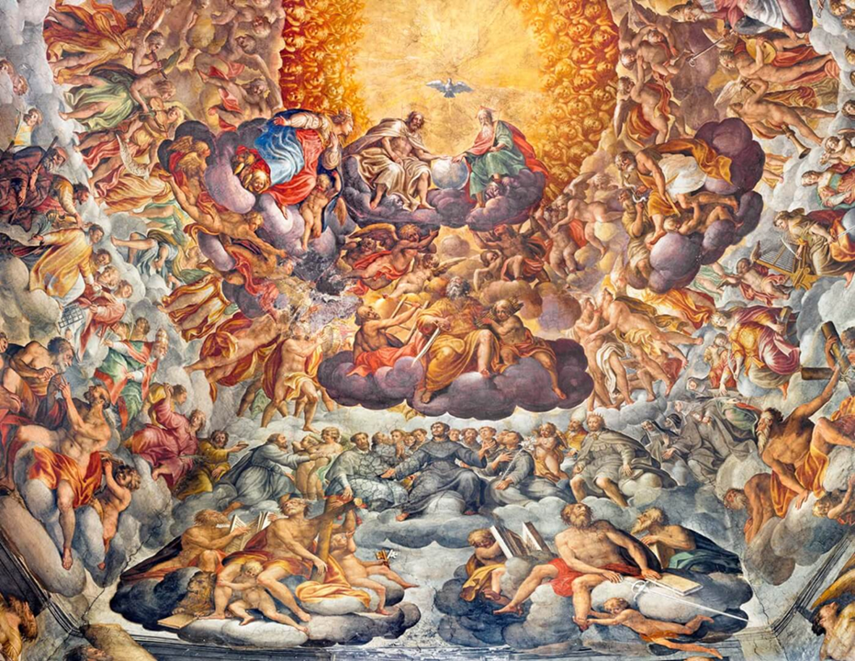
²³ and what if he has done so in order to make known the riches of his glory for the objects of mercy, which he has prepared beforehand for glory.
● Known:
● Riches:
● Mercy:
● Prepared:
● Glory:
God is self-revealing
Amazing abundance
Fulfills needs and purpose
‘Pre-’, before when?
Everlasting life, as co-rulers.

Slide 9
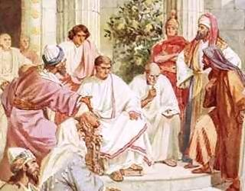
God’s sovereign purpose (9:19-33)
A. Recompense (19-23)
Wrath & Mercy
Patience & preparation
B. Reversal (24-29)
Israel & Gentiles
Israel & remnant
C. Righteousness (30-33)
By faith or by works

Slide 10
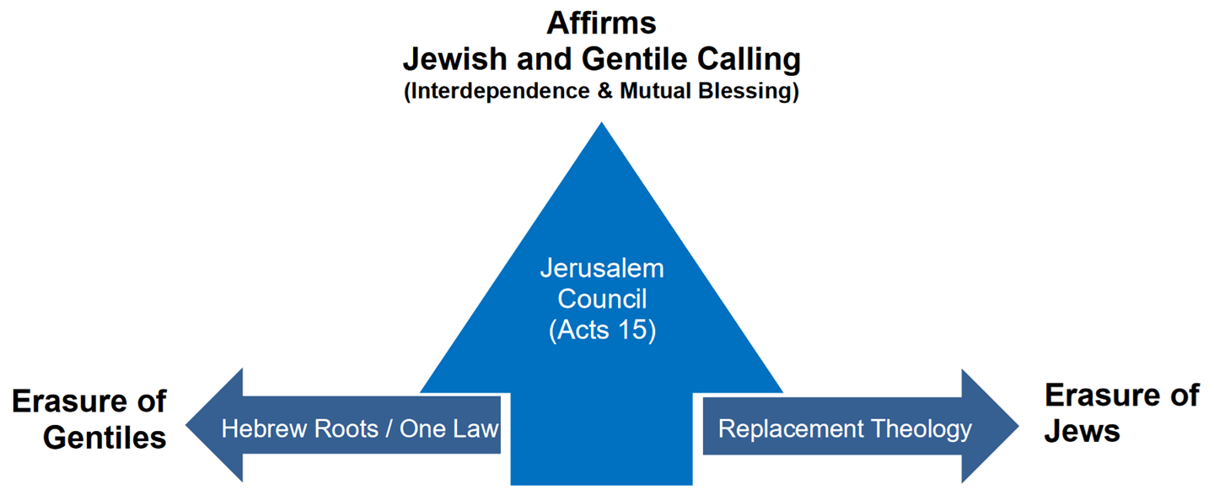
²⁴ including us whom he has called,
not from the Jews only but also from the gentiles?
● Called:
● Jews:
● Gentiles:
To believe and to obey Jesus.
See next slide.
From all geographic, racial, political, ethnic, language and religious backgrounds.

Slide 11
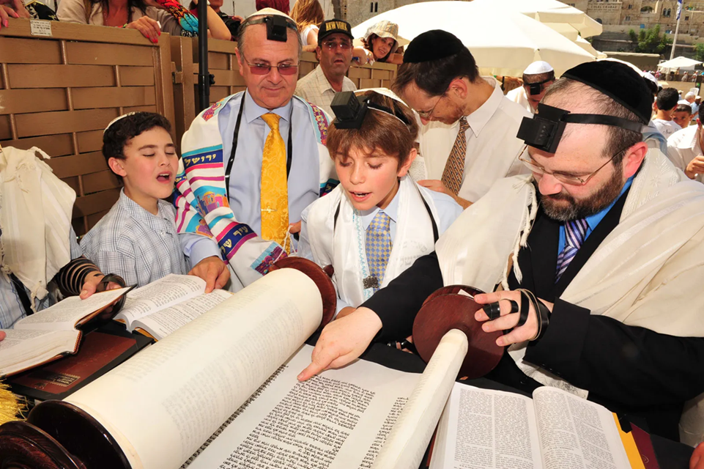
Who/What is a Jew?
● Racial:
● Historic:
● Ethnic:
● Religious:
● Legal:
● Cultural:
● Spiritual:
● Zionist:
Descended from Jacob.
Exiles from Judea province.
Culturally Hebrew, Israelite.
Practice Judaism.
Adherent to a ‘licit’ religion.
Self-identifying as Jewish.
Israelite & Gentile believers.
Privileged Israeli citizens.

Slide 12
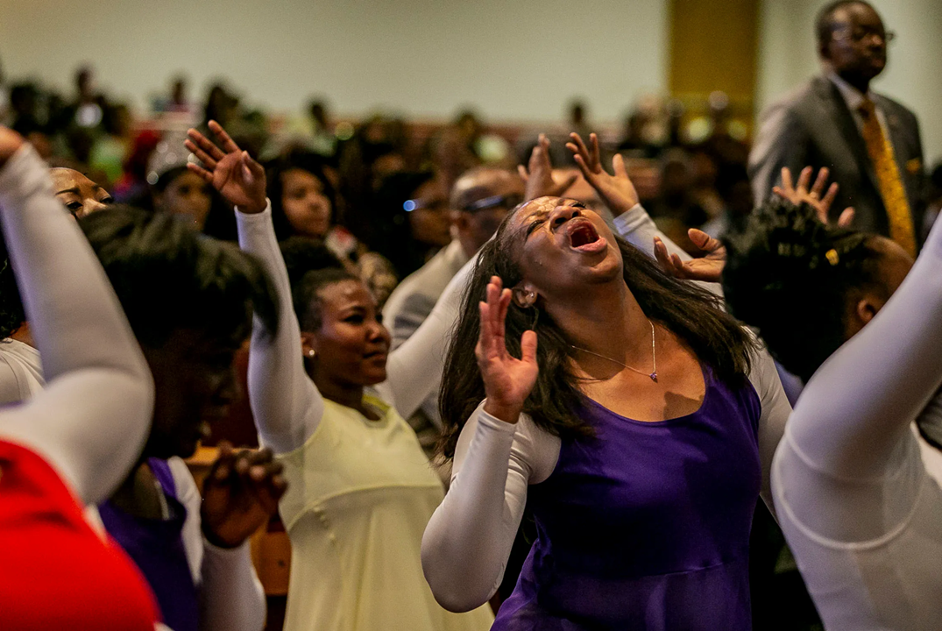
²⁵ As he also says in Hosea, [Hos. 2:23]
“Those who were not my people I will call ‘my people,’ and her who was not beloved I will call ‘beloved.’ ”
²⁶ “And in the place where it was said to them,
‘You are not my people,’ there they shall be called children of the living God.”
● People:
● Children:
‘The great reversal!’
Adopted into God’s family.

Slide 13

²⁷ And Isaiah cries out concerning Israel, “Though the number of the children of Israel were like the sand of the sea, only a remnant of them will be saved,
²⁸ for the Lord will execute his sentence on the earth quickly and decisively.”
● Remnant:
● Earth:
Faithful, believing minority.
‘Land’. See Gen. 12:7

Slide 14
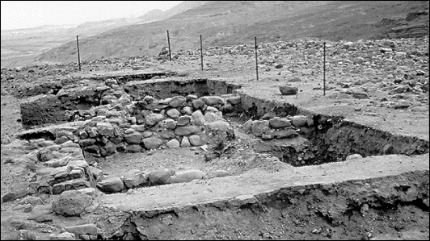
²⁹ And as Isaiah predicted,
“If the Lord of hosts had not left descendants to us,
[then] we would have fared like Sodom and been made like Gomorrah.”
● Isaiah:
● Hosts:
● Descendants:
● Sodom:
1.9; 13.19.
Angel armies.
‘Seed’ Gen. 12:7; 17:4-5.
Lot & daughters spared.

Slide 15
God’s sovereign purpose (9:19-33)
A. Recompense (19-23)
Wrath & Mercy
Patience & preparation
B. Reversal (24-29)
Israel & Gentiles
Israel & remnant
C. Righteousness (30-33)
By faith or by works

Slide 16
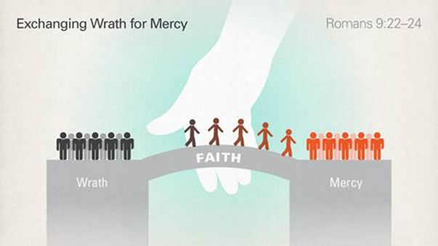
³⁰ What then are we to say? Gentiles, who did not strive for righteousness, have attained it, that is, righteousness through faith,
³¹ but Israel, who did strive for the law of righteousness, did not attain that law.
● Strive:
● Faith:
● Law:
Lit., ‘pursue’.
Believe ➔ receive.
“[Do this…] ➔ acquitted”.

Slide 17
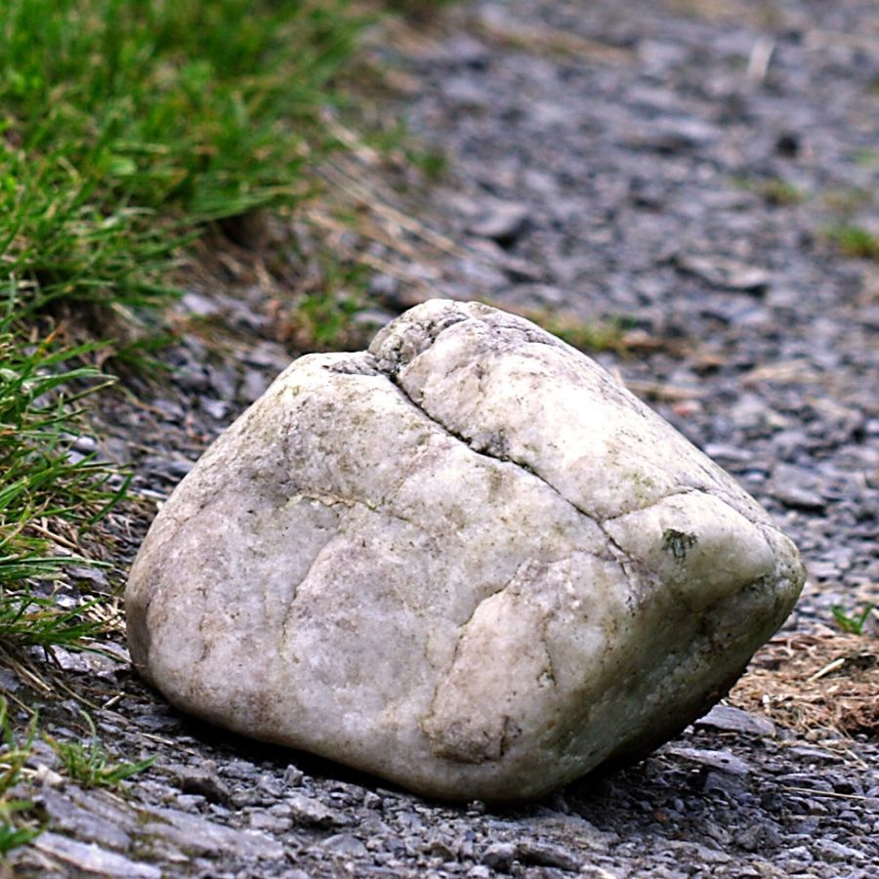
³² Why not? Because they did not strive for it on the basis of faith but as
if it were based on works.
They have stumbled over the stumbling stone, …
● Strive:
● Basis:
● Works:
● Stumble:
‘pursue’
Ek, ‘from’
Human effort and religion.
(See next slide.)
The ‘crux’ of the matter.

Slide 18
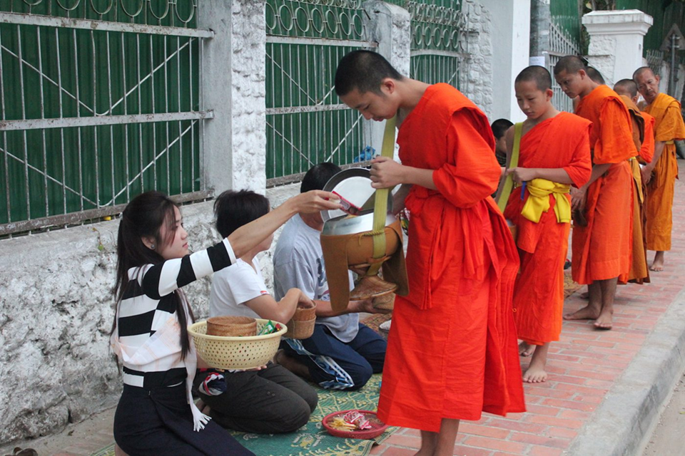
Which are works? Or faith?
1. Alms
2. Believe
3. Charity
4. Faithful
5. Fasting
6. Festivals
7. Forgive
8. Giving
9. Hope
10. Jihad
11. Mission
12. Pray
13. Preach
14. Repent
15. Sabbath
16. Services
17. Study
18. Trust

Slide 19
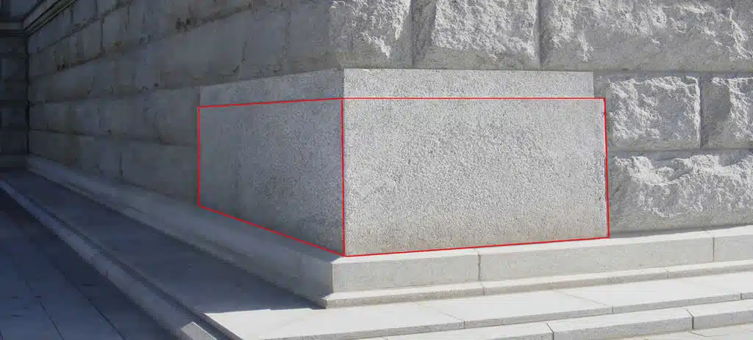
³³ as it is written,
“See, I am laying in Zion a stone
that will make people stumble,
a rock that will make them fall,
and whoever trusts in him
will not be put to shame.” [Isa. 28:16 LXX]
● Stone:
● Trusts:
● Him:
Heb. ‘eben, fem. noun.
Heb. & Gk., believes, faithful.
Heb. masc. pron. = LORD God?

Slide 20

Conclusion
● This is not pre-determined salvation!
● This is God determining how people obtain salvation.
● People must obtain salvation by remaining faithful to Messiah Jesus.
● People do not earn salvation by their hard work or religious identity.

Slide 21
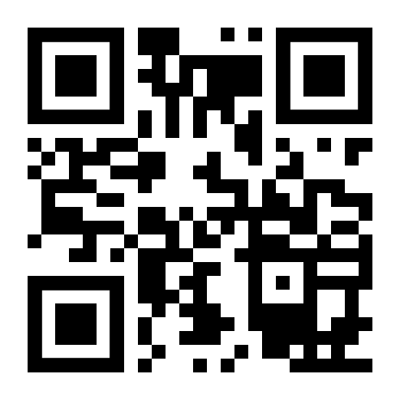
http://romans.forum

Slide 22
…
¹ Verse
¹ Verse
● …:
● …:
● …:
…
…
…

Slide 23
…
¹ Verse
¹ Verse
● …:
● …:
● …:
…
…
…

Slide 24
¹ Verse
¹ Verse
● …:
● …:
● …:
…
…
…

Slide 25
Titre
● …: …
● …: …
● …: …
● …: …
● …: …
● …: …
● …: …
● …: …

Slide 26
…

