Slide 1

Text, references
Lesson 10
How Shall They Hear?
Vancouver, May 29, 2026
With Galen J. Currah, Dmiss.
currah.download/pages/perspectives/lesson10

Slide 2
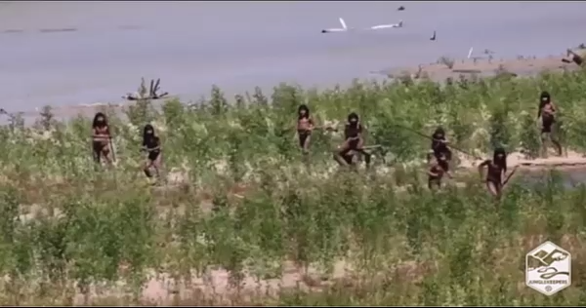
First contact with an Amazon people 2025

Slide 3


9 Key Concepts
Culture (and cultural difference)
Worldview
Cross-cultural communication
Ethnocentrism
Contextualization
Redemptive Analogy
Deep-level conversion
Power Encounter
Excluded middle.

Slide 4


5 Presuppositions
● Humans do not discover the Good News about Jesus; it must be disclosed to them.
● That Good News is more than information; it includes an invitation to know God.
● The Good News can flow easily within a culture, but it does not easily leap between cultures.
● God converts folk within their culture, and Jesus’ disciples can learn to obey Him in ways that ‘redeem’ their culture.
● Our task entails helping others hear God’s call.

Slide 5
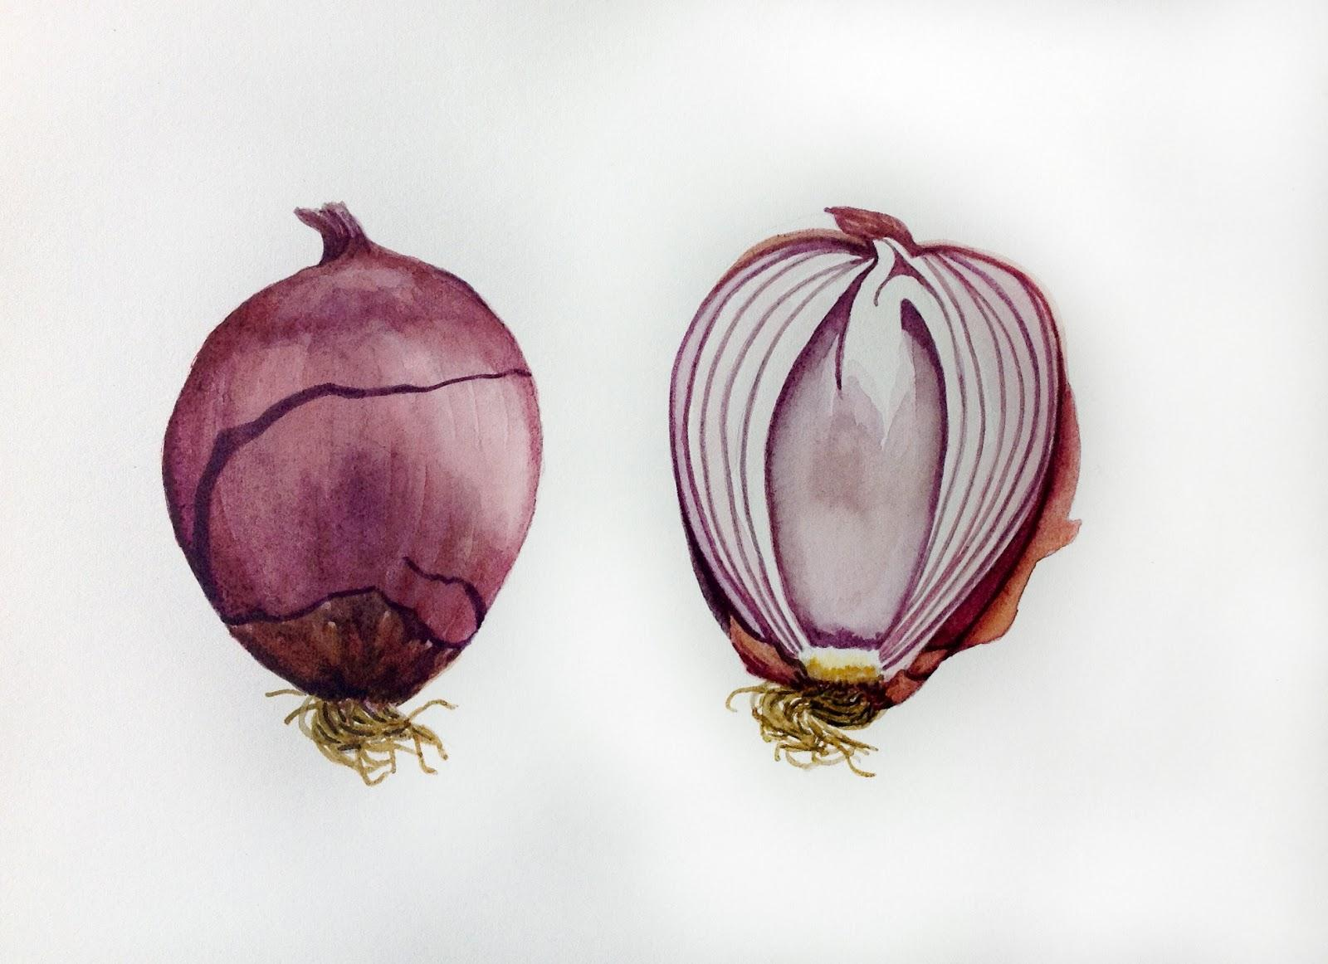
The Cultural Onion
Social authority
Cultural beliefs
External behavior
Personal experience
Adapted from Donals K. Smith, Creating Understanding, 1992, pp 253-5

Slide 6
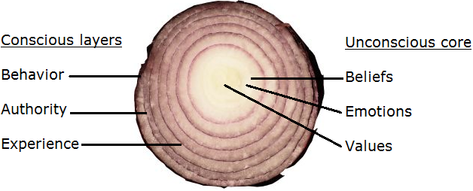
The Cultural Onion
● Behavior: What I do.
● Authority: Who tells me to do so.
● Experience: What happens to me.
● Beliefs: What I know to be true and real.
● Values: What I know to be bad, good, and best.
● Emotions: How I feel about it.

Slide 7

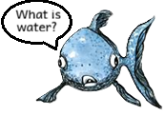

Worldview = Beliefs about …
● What is real.
● Who are we.
● Whence we came.
● What causes things to happen.
● Who or what is alive, present, powerful.
● Who are the invisible and what they do.
● Who or what bring good, evil, joy, sorrow.
These unexamined beliefs determine values and behavior of those who share a common culture.

Slide 8
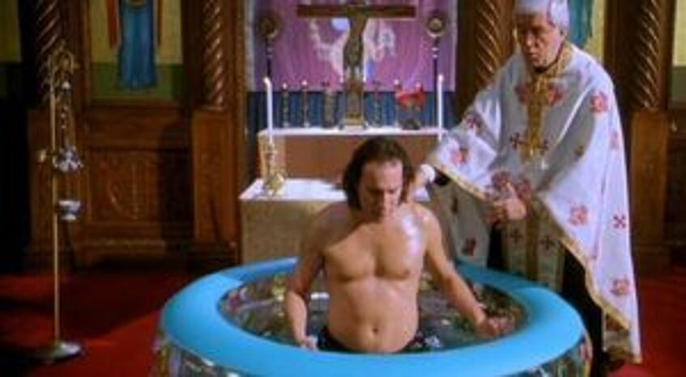
Worldview Change & Conversion
● Seek not behavioral changes first, but seek change at a deep, worldview level.
● Make conversion a change of allegiance to the lordship of Jesus Christ.
● The evidence of new life includes a revolutionary change in worldview, in behavior and in how folk relate one to another.
● Help believers to find ‘dynamic equivalence,’ surface-level expressions of church, rather than to adopt foreign religious forms and practices.

Slide 9
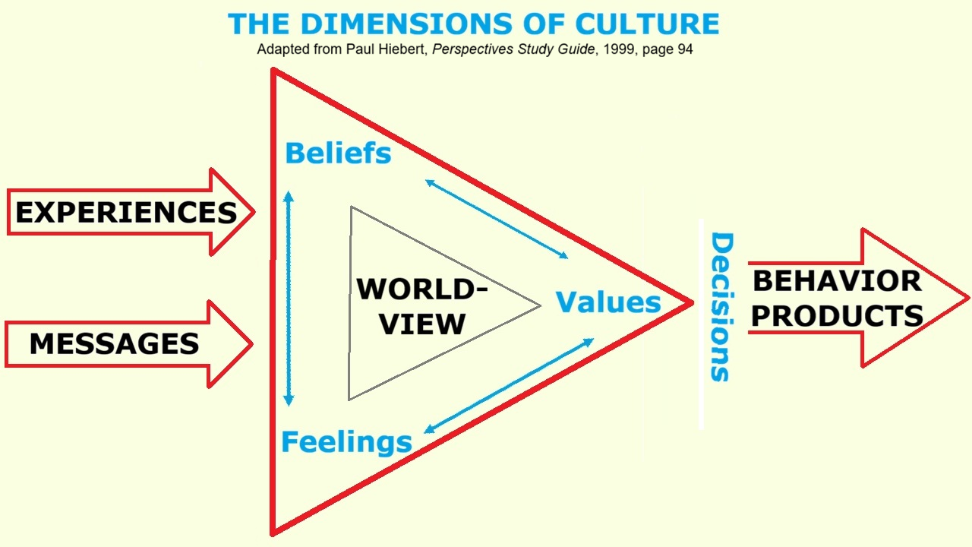

Slide 10
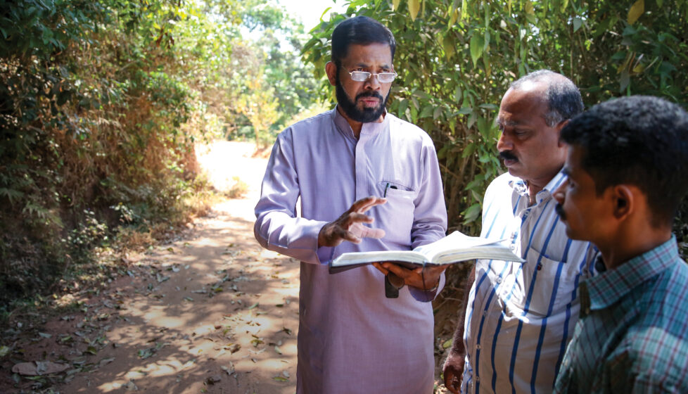
7 Christian-worker competences
● Joyful spiritual life & obedience.
● Bible knowledge & backgrounds.
● Cultural awareness & appreciation.
● Worldview discovery & analysis.
● Communication messages & tactics.
● Church-planting & disciple-making.
● Social change ideals & strategy.

Slide 11

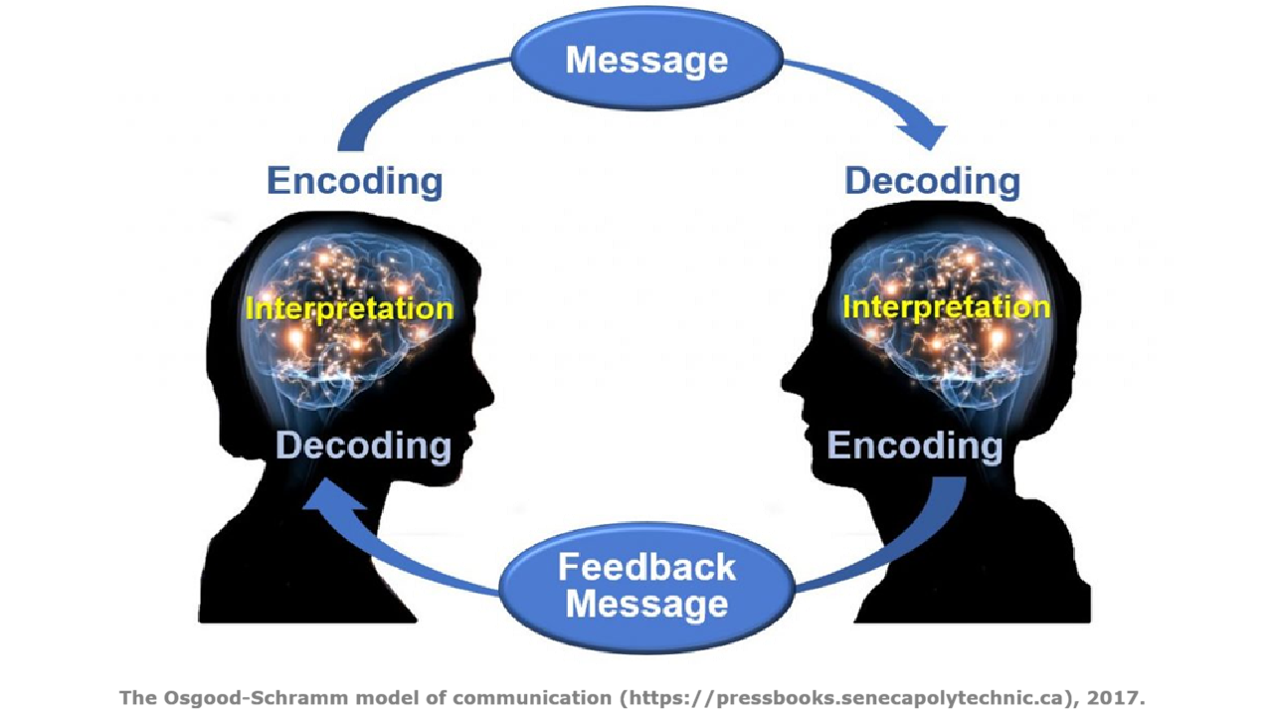

Slide 12
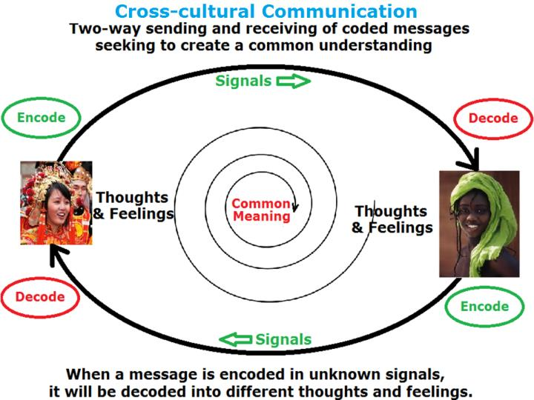

Slide 13
The 12 “love languages” of culture
● All human communication occurs through the use of these 12 languages.
● Mission requires that we learn and communicate using these languages.
● These help us to understand those with whom we are trying to communicate.
● These helps us more effectively to create common understanding.

Slide 14
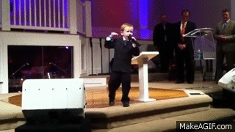
1. Verbal
● ‘Let there be light’ — Gen 1:3
● ‘I am with you,’ declares the Lord — Hag 1:13
● ‘Take courage, it is I; do not be afraid’ — Mt 14:27
Notes:
USA Example… What do we rely on?

Slide 15
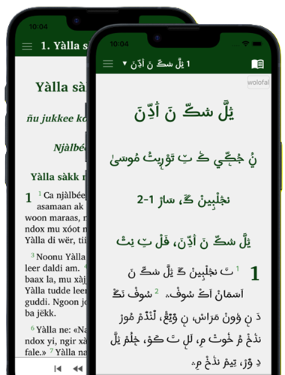
2. Written
● The LORD gave me the two tablets of stone written by the finger of God — Deut 9:10
● From childhood you have been acquainted with the sacred writings — Pro 7:3
Notes:
USA Example… What do we rely on?

Slide 16
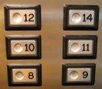
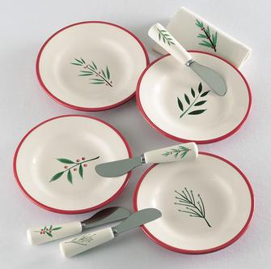
3. Numeric
666
● The number of the beast … six hundred and sixty-six — Rev 13:18
● Seven times a day I praise You — Psa 119:64

Slide 17
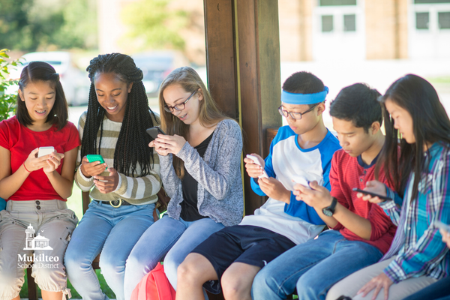

4. Pictorial
● With cherubim skillfully embroidered into the cloth using blue, purple, and scarlet yarn — Exo 26:31

Slide 18
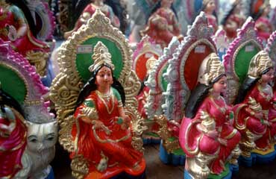
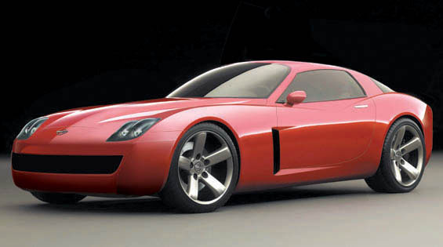
5. Artifactual
● He made a bronze altar, twenty cubits in length and twenty cubits in width and ten cubits in height. — 2 Chr 4:1

Slide 19
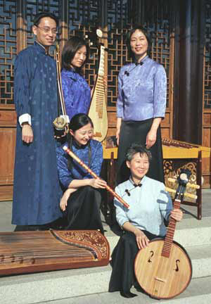

6. Audio
● Praise him with tambourine and dance; praise him with strings and pipe! Praise him with sounding cymbals; praise him with loud clashing cymbals! — Psalm 150:3-4

Slide 20
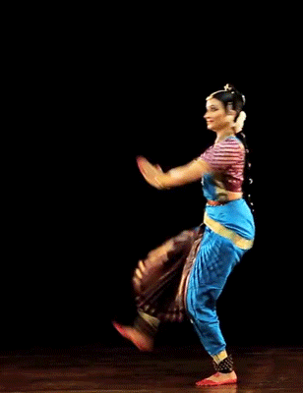
7. Kinesic
● Lie down on your left side — Ezek 4:4
● Jesus stooped down and with His finger wrote on the ground — John 8:6

Slide 21

8. Optical
● About noon a great light from heaven suddenly shone around me — Acts 22:6
● When you see these things taking place — Luke 21:31

Slide 22
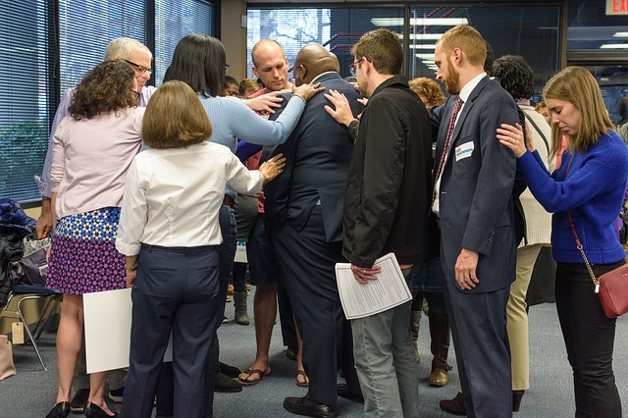
9. Tactile
● Greet one another with a holy kiss — Rom 16:16
● He gave her his hand and raised her up — Acts 9:38-41

Slide 23

10. Spatial
● Make it 450 feet long, 75 feet wide, and 45 feet high — Gen 6:15

Slide 24

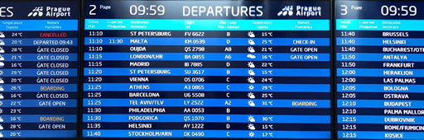
11. Temporal
● Each day continuously — Exo 29:38-39
● Immediately the rooster crowed a second time — Luke 22:60

Slide 25
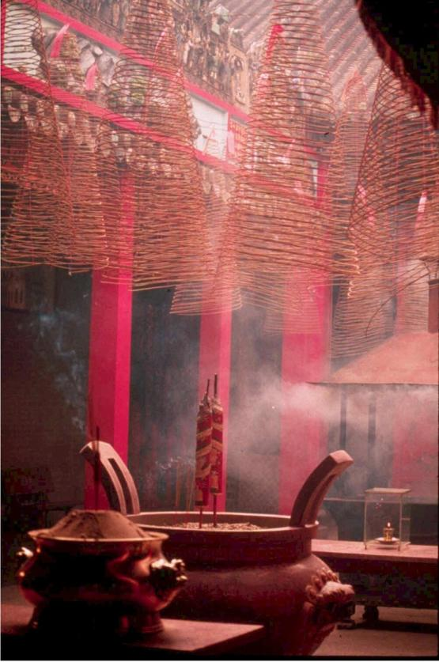

12. Olfactory
● Spices for the anointing oil and for the fragrant incense — Exo 25:6
● The master of the feast tasted the water now become wine — John 2:9

Slide 26
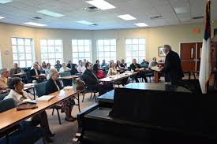
Exercise
Identify any of the 12 signal systems in this room, right now. (2 minutes)
● What is the signal?
● What does it mean to you?
● How do you feel about it?

Slide 27
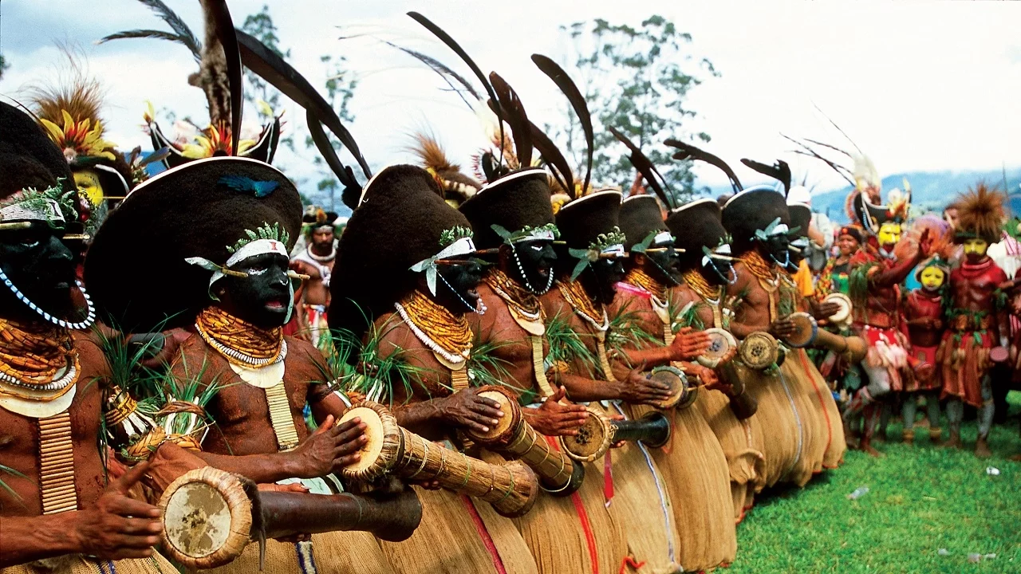
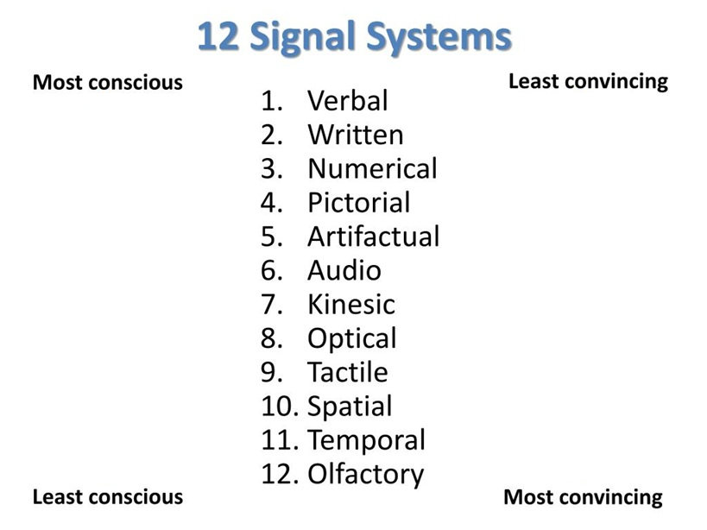

Slide 28
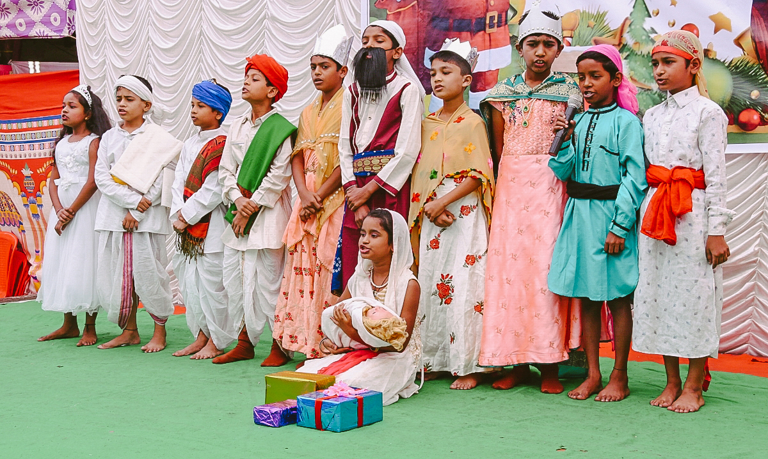
Make Use of Signal Systems
● Several or all occur simultaneously.
● Local folk employ these more correctly.
● Employ several whenever possible.
● Observe these in local settings.
● Discuss possible meanings & usage.
● Verify hypotheses with local folk.
● Choose a mix of new and local media.
● Local folk to do most communicating.

Slide 29
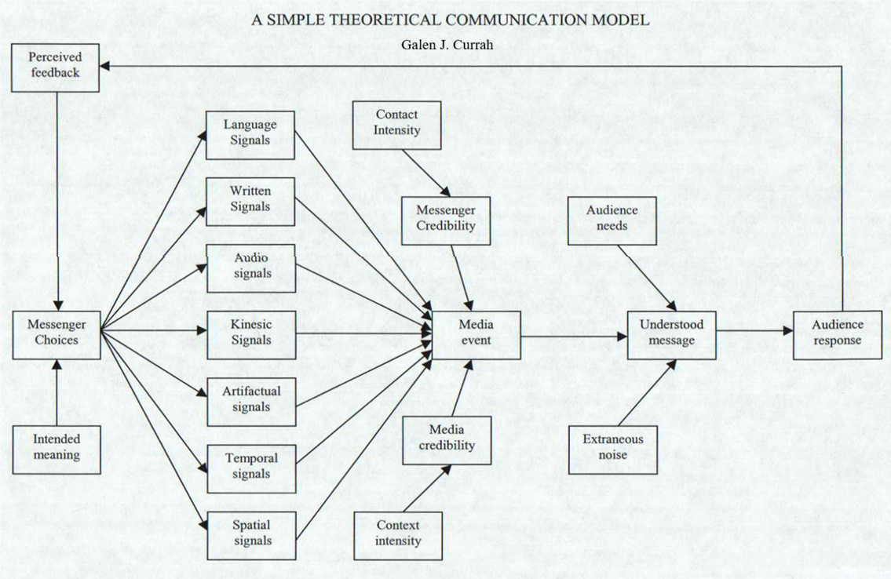

Slide 30
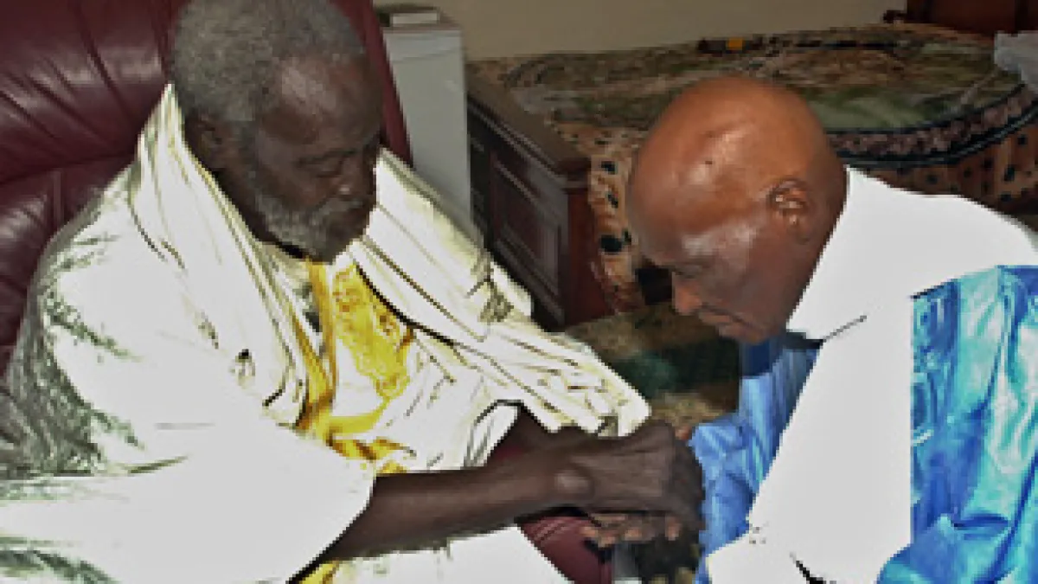

Find ‘Redemptive Analogies’
● “Gëm te jébbalu” = “Believe and give yourself.”
● Believe (in Islam) and give yourself (and your wealth) to someone (who will intercede for you on earth and at the final judgment.)
● An act of obeisance and sacrifice to a religious cleric who has baraka (power) to save you.
● An analogy to faith in Jesus as believers’ only Mediator and Intercessor (1 Tim. 2:5; Heb. 7:25).

Slide 31
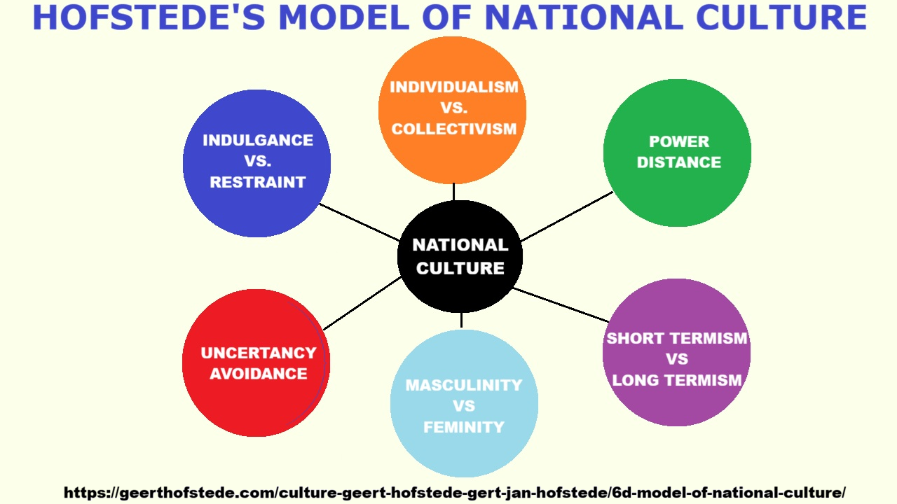

Slide 32
The 6-D model of national culture
● Geert Hofstede, assisted by others, came up with six basic issues that society needs to come to term with in order to organize itself.
● These are called dimensions of culture. Each of them has been expressed on a scale that runs roughly from 0 to 100.
https://geerthofstede.com/culture-geert-hofstede-gert-jan-hofstede/6d-model-of-national-culture/

Slide 33
Collectivism – Individualism
● Individualism is the extent to which people feel independent.
● As opposed collectivism which is being interdependent as members of larger wholes.
? With whom will you share about Jesus? Individuals? Or groups?
https://geerthofstede.com/culture-geert-hofstede-gert-jan-hofstede/6d-model-of-national-culture/

Slide 34
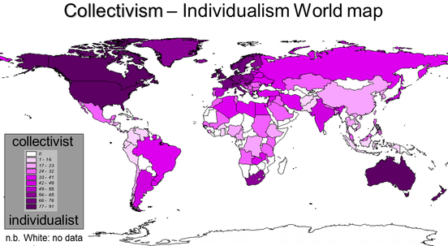
https://geerthofstede.com/culture-geert-hofstede-gert-jan-hofstede/6d-model-of-national-culture/

Slide 35
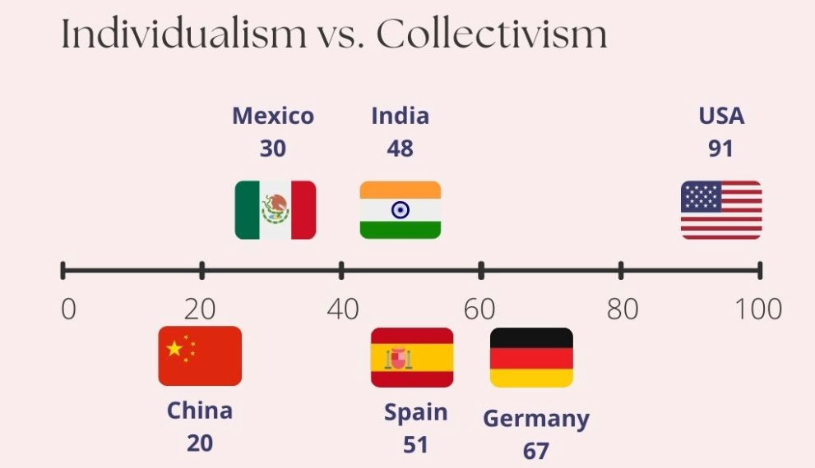
Collective
Individual
https://geerthofstede.com/culture-geert-hofstede-gert-jan-hofstede/6d-model-of-national-culture/

Slide 36
Power Distance
● The extent to which the less powerful members of organizations and institutions …
● Accept and expect that power is distributed unequally.
? What traits do you seek in those whom you empower as leaders?
https://geerthofstede.com/culture-geert-hofstede-gert-jan-hofstede/6d-model-of-national-culture/

Slide 37
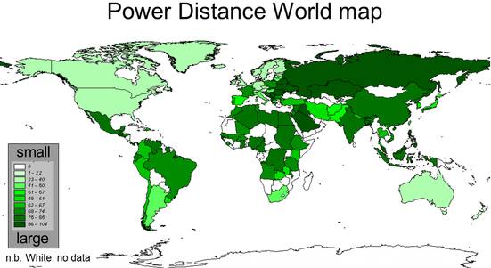
https://geerthofstede.com/culture-geert-hofstede-gert-jan-hofstede/6d-model-of-national-culture/

Slide 38
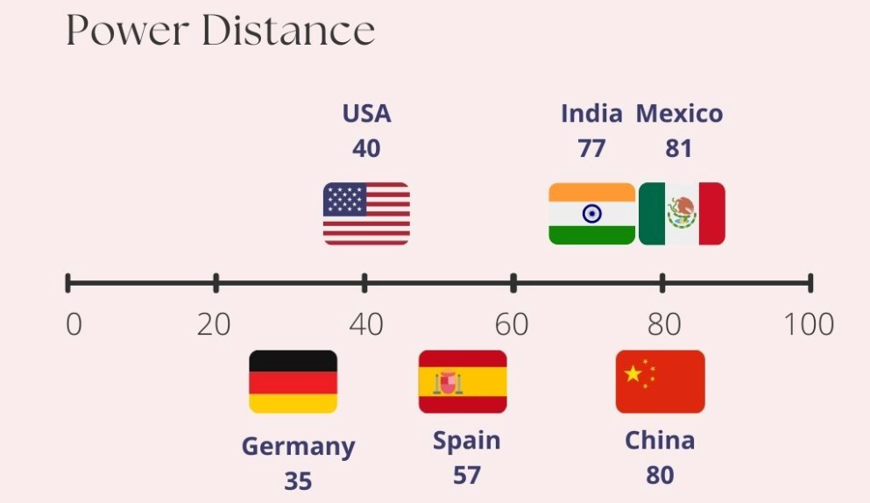
https://geerthofstede.com/culture-geert-hofstede-gert-jan-hofstede/6d-model-of-national-culture/

Slide 39
Femineity – Masculinity
● In a feminine society, the genders are emotionally closer. Competing is not so openly endorsed.
● Masculinity is the extent to which the use of force in endorsed socially.
? Which biblical characters will you present as ideals to follow?
https://geerthofstede.com/culture-geert-hofstede-gert-jan-hofstede/6d-model-of-national-culture/

Slide 40
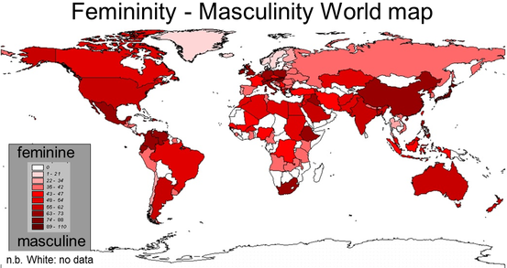
https://geerthofstede.com/culture-geert-hofstede-gert-jan-hofstede/6d-model-of-national-culture/

Slide 41
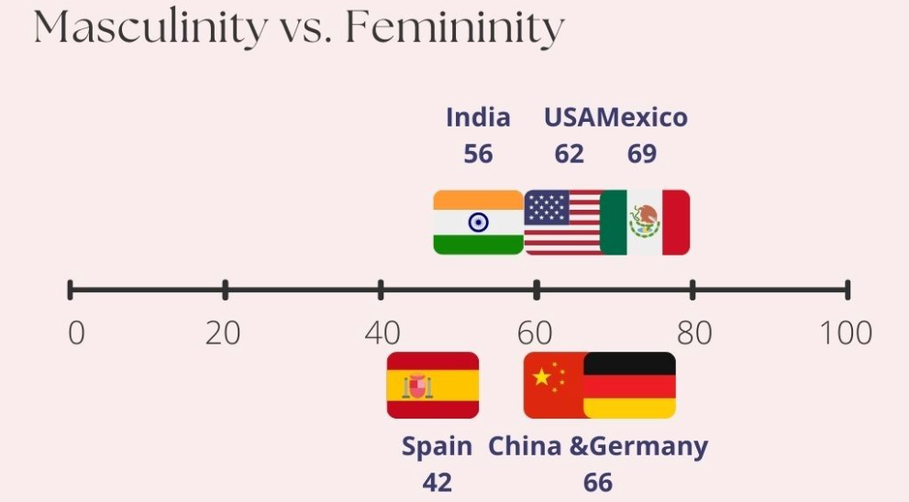
Feminine
Masculine
https://geerthofstede.com/culture-geert-hofstede-gert-jan-hofstede/6d-model-of-national-culture/

Slide 42
Uncertainty Avoidance
● Uncertainty avoidance deals with a society’s tolerance for ambiguity.
● Avoidance results from anxiety and distrust in the face of the unknown, and conversely, with a wish to have fixed habits and rituals, and to know the truth.
? How much liturgy will in introduce?

Slide 43
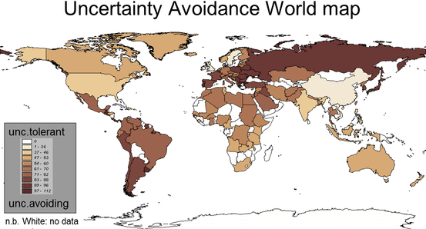
https://geerthofstede.com/culture-geert-hofstede-gert-jan-hofstede/6d-model-of-national-culture/

Slide 44
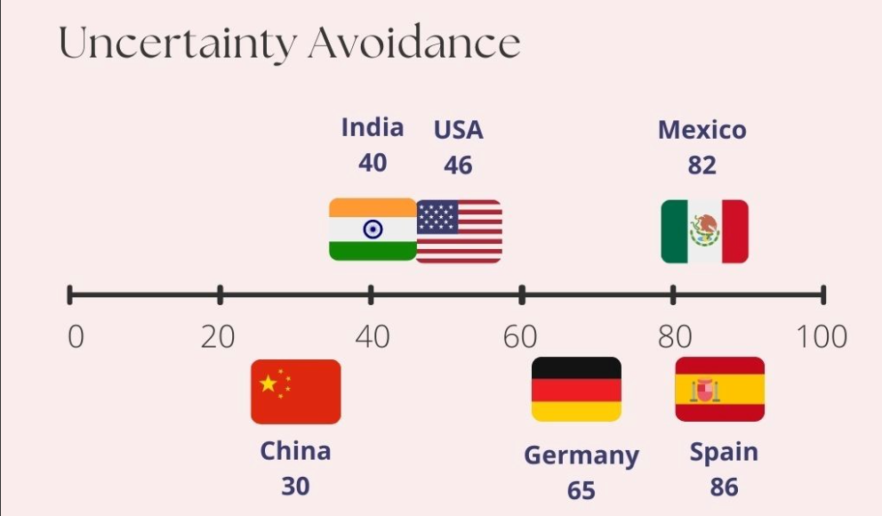
https://geerthofstede.com/culture-geert-hofstede-gert-jan-hofstede/6d-model-of-national-culture/

Slide 45
Short vs. Long-term Orientation
● In a short-time-oriented culture, the world is essentially as it was created, so that the past provides a moral compass. [➔ Less preparation.]
● In a long-time-oriented culture, a basic notion about the world is that it is in flux, and preparing for the future is always needed. [➔ More preparation.]

Slide 46
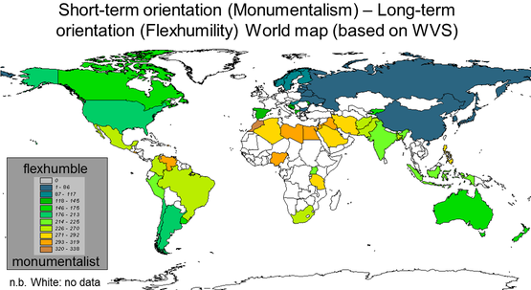
https://geerthofstede.com/culture-geert-hofstede-gert-jan-hofstede/6d-model-of-national-culture/

Slide 47
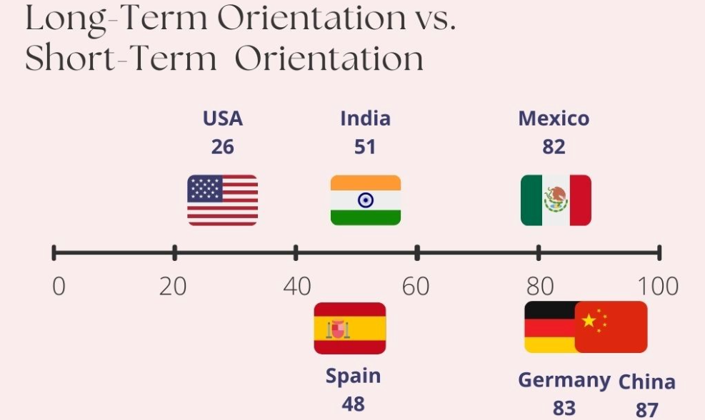
Short term
https://geerthofstede.com/culture-geert-hofstede-gert-jan-hofstede/6d-model-of-national-culture/

Slide 48
Indulgence – Restraint
● In an indulgent culture it is good to be free. Doing what your impulses want you to do, is good. Friends are important and life makes sense.
● In a restrained culture, the feeling is that life is hard, and duty, not freedom, is the normal state of being.
? What to teach about church attendance
https://geerthofstede.com/culture-geert-hofstede-gert-jan-hofstede/6d-model-of-national-culture/

Slide 49
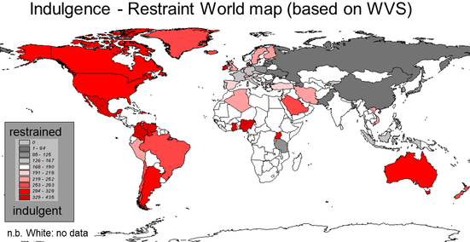
https://geerthofstede.com/culture-geert-hofstede-gert-jan-hofstede/6d-model-of-national-culture/

Slide 50
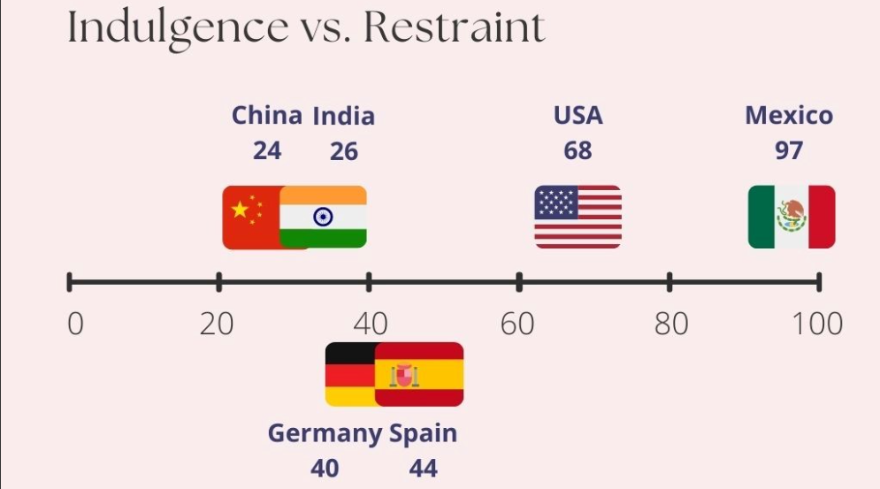
Restrained
Indulgent
https://geerthofstede.com/culture-geert-hofstede-gert-jan-hofstede/6d-model-of-national-culture/

Slide 51
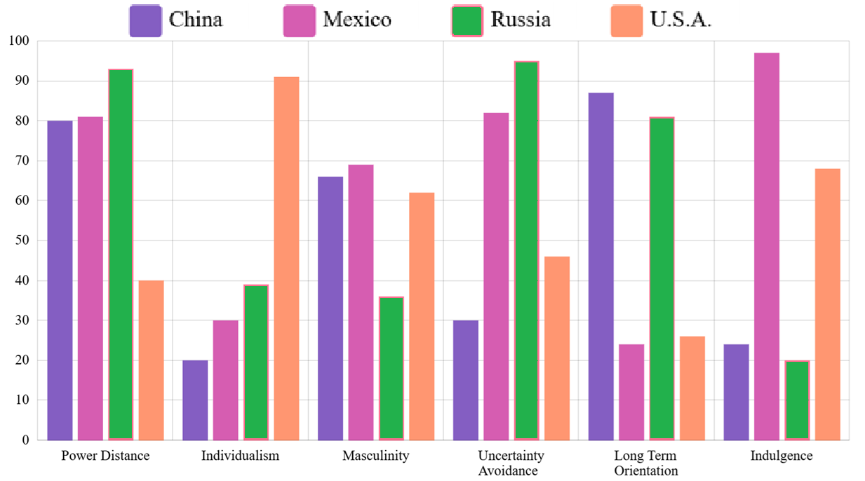
https://geerthofstede.com/country-comparison-bar-charts/

Slide 52
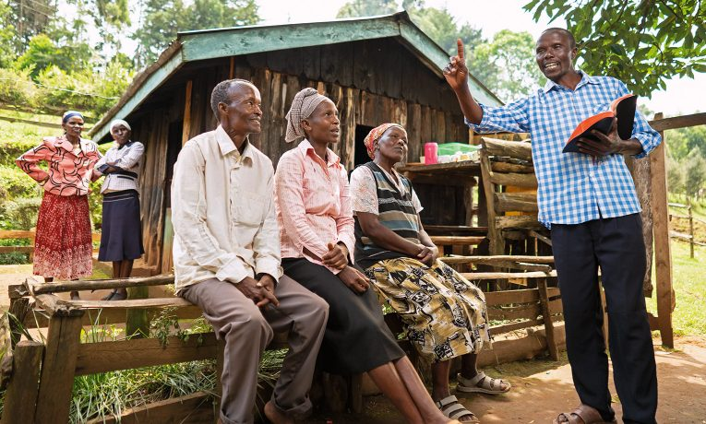
Discuss Implications for Ministry
● With whom will you share about Jesus? (Individuals? Youth? Families? Chiefs?)
● What importance will you give to baptism and to communion?
● Which personality traits will you seek in potential leaders?
● Which economic practices will you promote among believers?

Slide 53
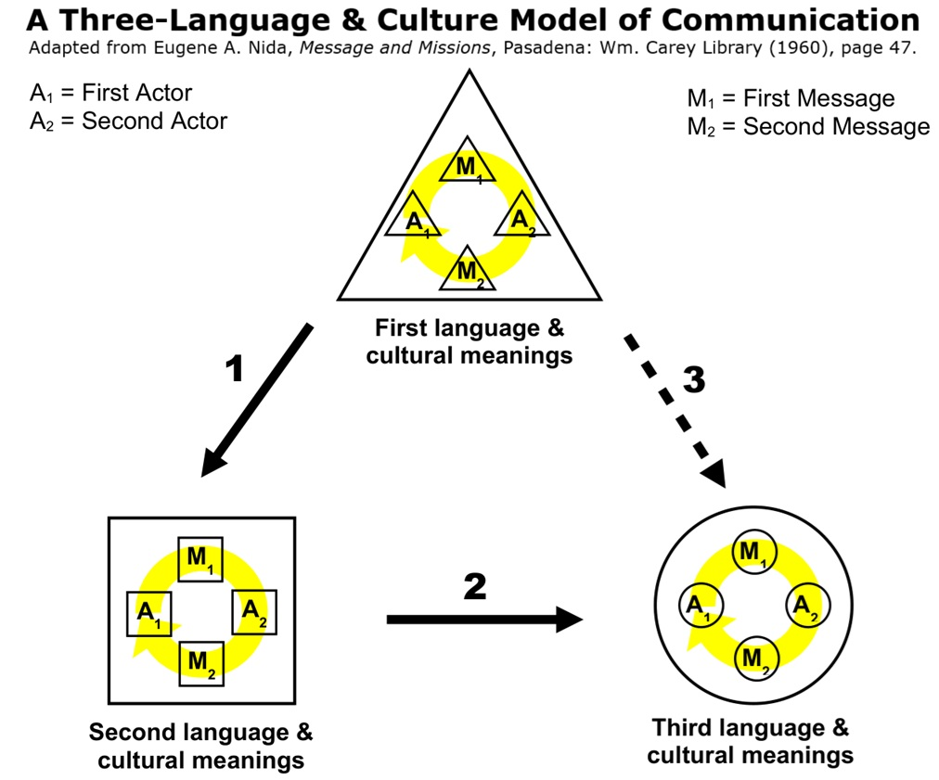

Slide 54
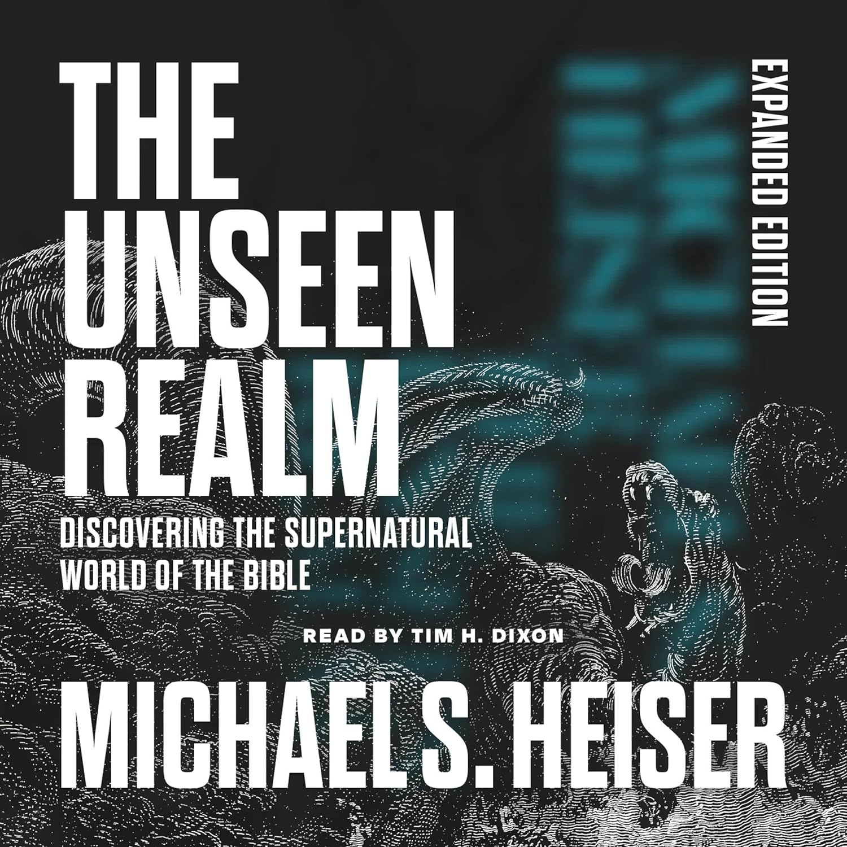

Slide 55
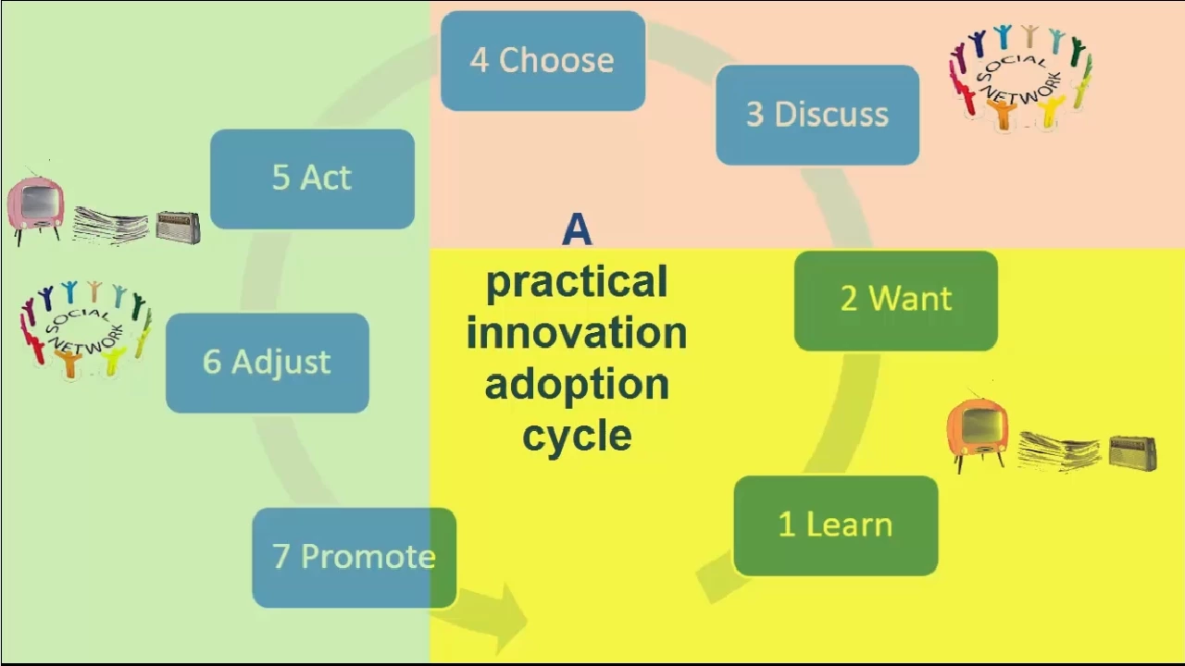

Slide 56
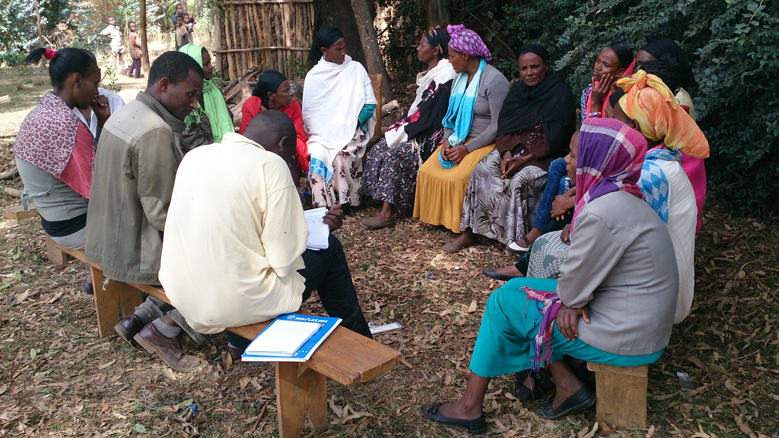
Communicate for Lasting Change
● Lasting change occurs within existing social networks.
● Plan messages and media for each phase of change.
● Be ready with required inputs at the point of decision, lest willing groups conclude, “It does not work!”

Slide 57
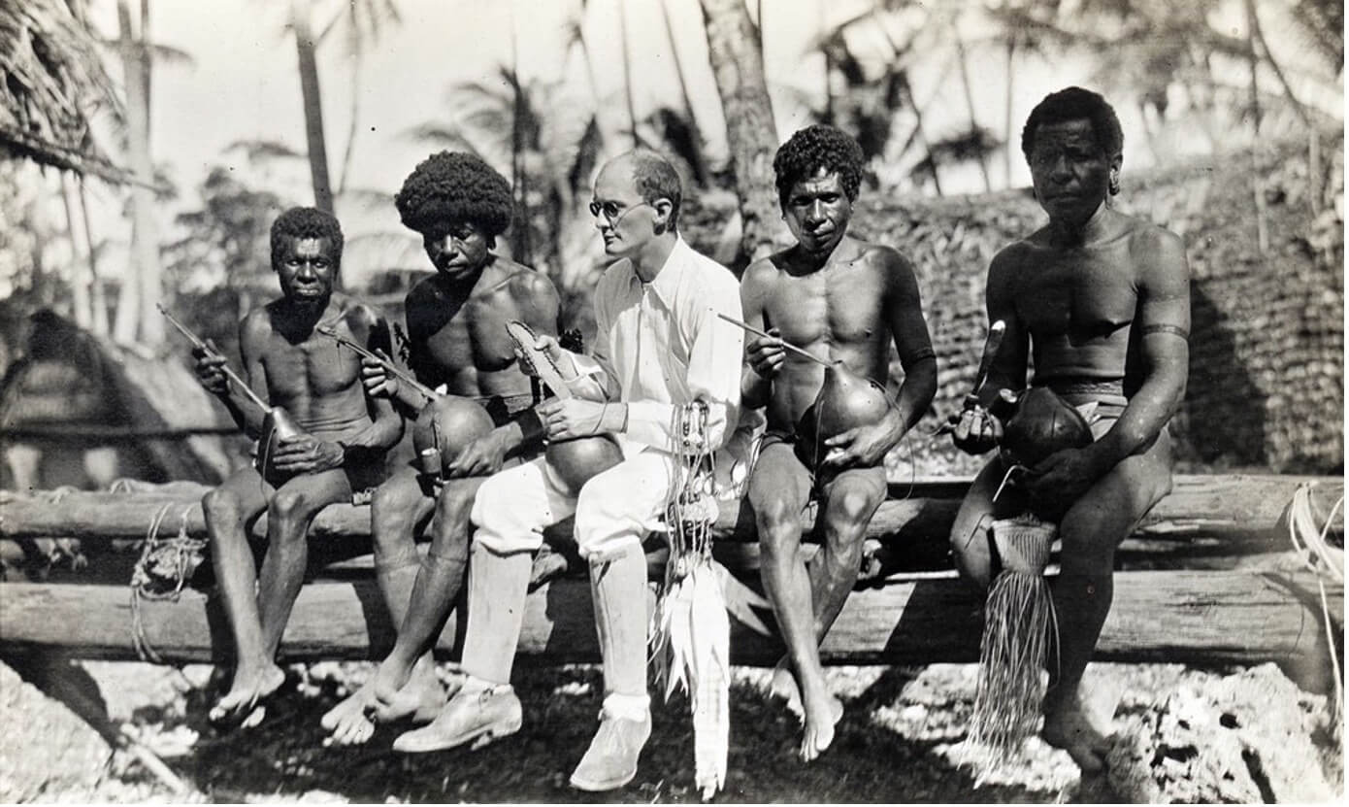
Ethnographic Interviewing
● Discover insiders’ knowledge & skills, and understand their meanings.
● Interview individuals or small groups about their activities & explanations.
● Pose open-ended, “grand tour” queries, listen and take notes.
● Then ask for information about their replies, preferably in their language.

Slide 58
Typical queries
● Can you describe _______ to me?
● What kinds of _______ are there?
● What are the stages of doing _______?
● What are the parts of a _______?
● What are your reasons for _______?
● In what places do you _______?
● Who are the persons in a _______?
● What results from _______?

Slide 59
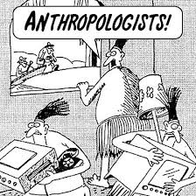
Exercise
Ask someone what is their work, hobby or expertise. Then:
● Pose a “grand tour” question.
● Pose a query about their reply.
● Pose a query about this reply.

Slide 60
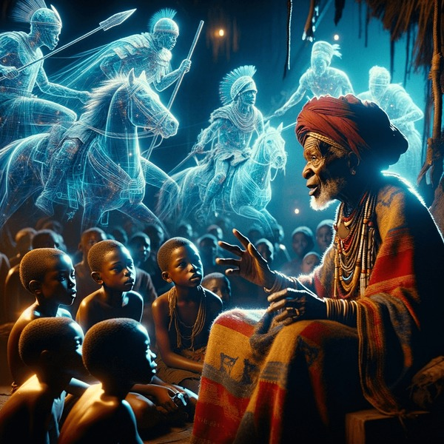
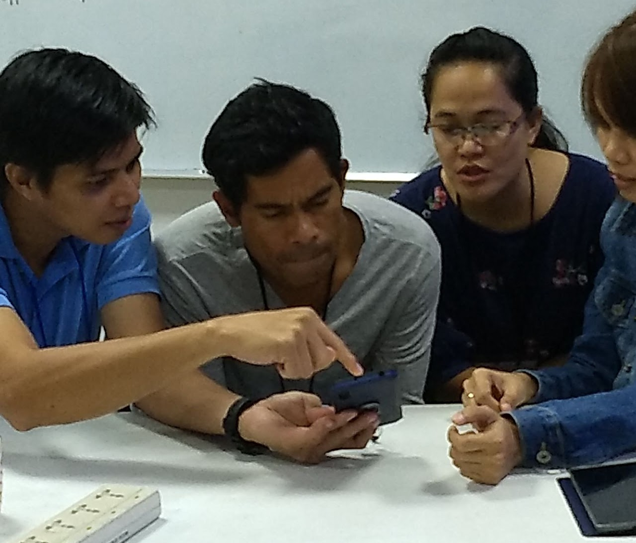
Orality
● Some societies prefer oral over written messages.
● Train or empower skilled story tellers.
● Memorize biblical stories and texts.
● Invest in oral translations and media

Slide 61


Phone apps for oral translation
https://www.honeybeeobt.com/get-the-app
Go to the Android app store

